Slide 1

Technical Continuity Management 1.0

Slide 2
Technical Continuity Management 1.0
Why
A need to formalise and make transparent simple, easy to use polices and playbooks in the event of a major technical outage to ensure remediation is conducted in an agile and communicative way.
How
Why?
Define policy and processes based on best practices that supplement Colart’s business continuity management for the Tech space.
How?
What
What?
Design guiding policies and processes that will be followed by the Tech team and business leaders in order to safeguard systems and valuable company data.
* the golden circle

Slide 3
STRUCTURE
Master Document
IT Risk Management
IT Risk Assessment & Review
What to do and procedures in a event of chaos
Test & Failover
Audit
Outage Playbook
Controlled test and failovers priority components
Evidence documents Data Centre is healthy and strong
Strategic Level, to respond WHY, Gold Team
Tactical Level, to respond WHAT, Silver Team
Operational Level, to respond HOW, Bronze Team
Change Control Squad
Mission Control Squad

Slide 4
Master Document
The master document which contains all information on process and strategy is found here:
Technology Continuity Management Strategy v1.0

Slide 5
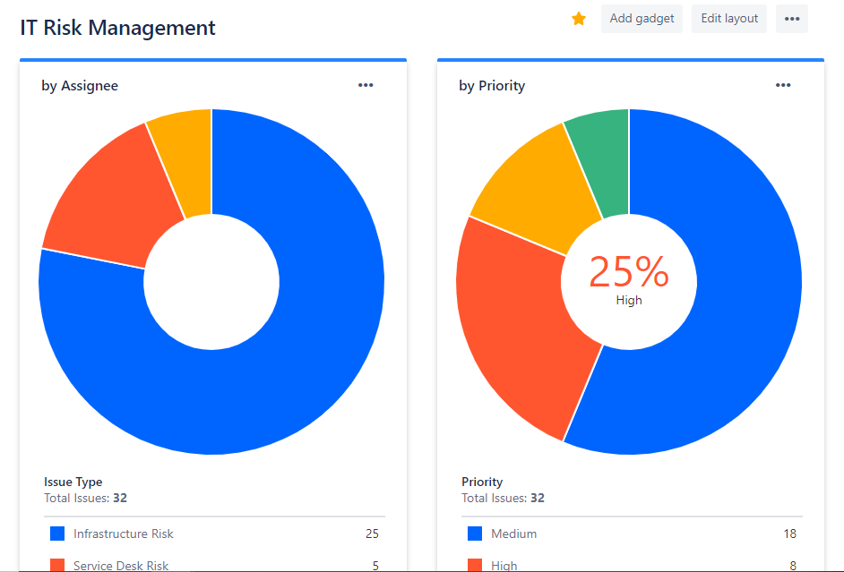
Risk Management
All risks that have been identified by Tech leaders are recorded within the Risk Management online board which is reviewed regularly.

Slide 6
Outage Playbook
The playbook which details how to proceed in the event of a major outrage is found below:
Colart IT Outage Playbook v1.0

Slide 7
Communication - Squads
All comms for planned changes or major events/downtime will be communicated via email through either Change Control or Mission Control accounts and will appear as below:

Slide 8
Thank you

