Slide 1
head OFFICE Covid-19 HANDBOOK
JUNE 2020

Slide 2


Contents
Attendance at Head Office
Moving round the building
Building facilities
Meetings, shared equipment and hot desking
Eating, drinking and food preparation
Visitors and deliveries
Use of personal protective equipment
Emergency evacuation
Suspected COVID?
Mental health and wellbeing
First aid and first aiders
Questions and further information

Slide 3
Attendance at Head Office
Whilst numbers attending Head Office are expected to be low, we ask everybody to observe the following measures to ensure both you and your colleagues' safety. We will continue to monitor the effectiveness of the return to work program to ensure that it remains effective.
Do not attend Head Office if you show symptoms or have come into close contact with someone with the virus; in these circumstances you must self isolate.
Confirm attendance with your line manager prior to attendance at HO.
Use hand sanitiser, then complete a temperature check on arrival. Temperature must be < 38° C for entry to building.
Complete a health declaration and confirm attendance with your line manager. Line managers will be responsible for ensuring social distancing at desks.
Practise social distancing, maintaining a 2 metre distance at all times.
Follow good hygiene practice, signage will be posted around the building.
  Hand washing
  No social contact
  Use hand sanitiser
  Do not touch face
Avoid using public transport to travel to Head Office, wherever possible.
Stagger arrival and departure times.
Social distance whilst off site e.g. lunch times.

Slide 4
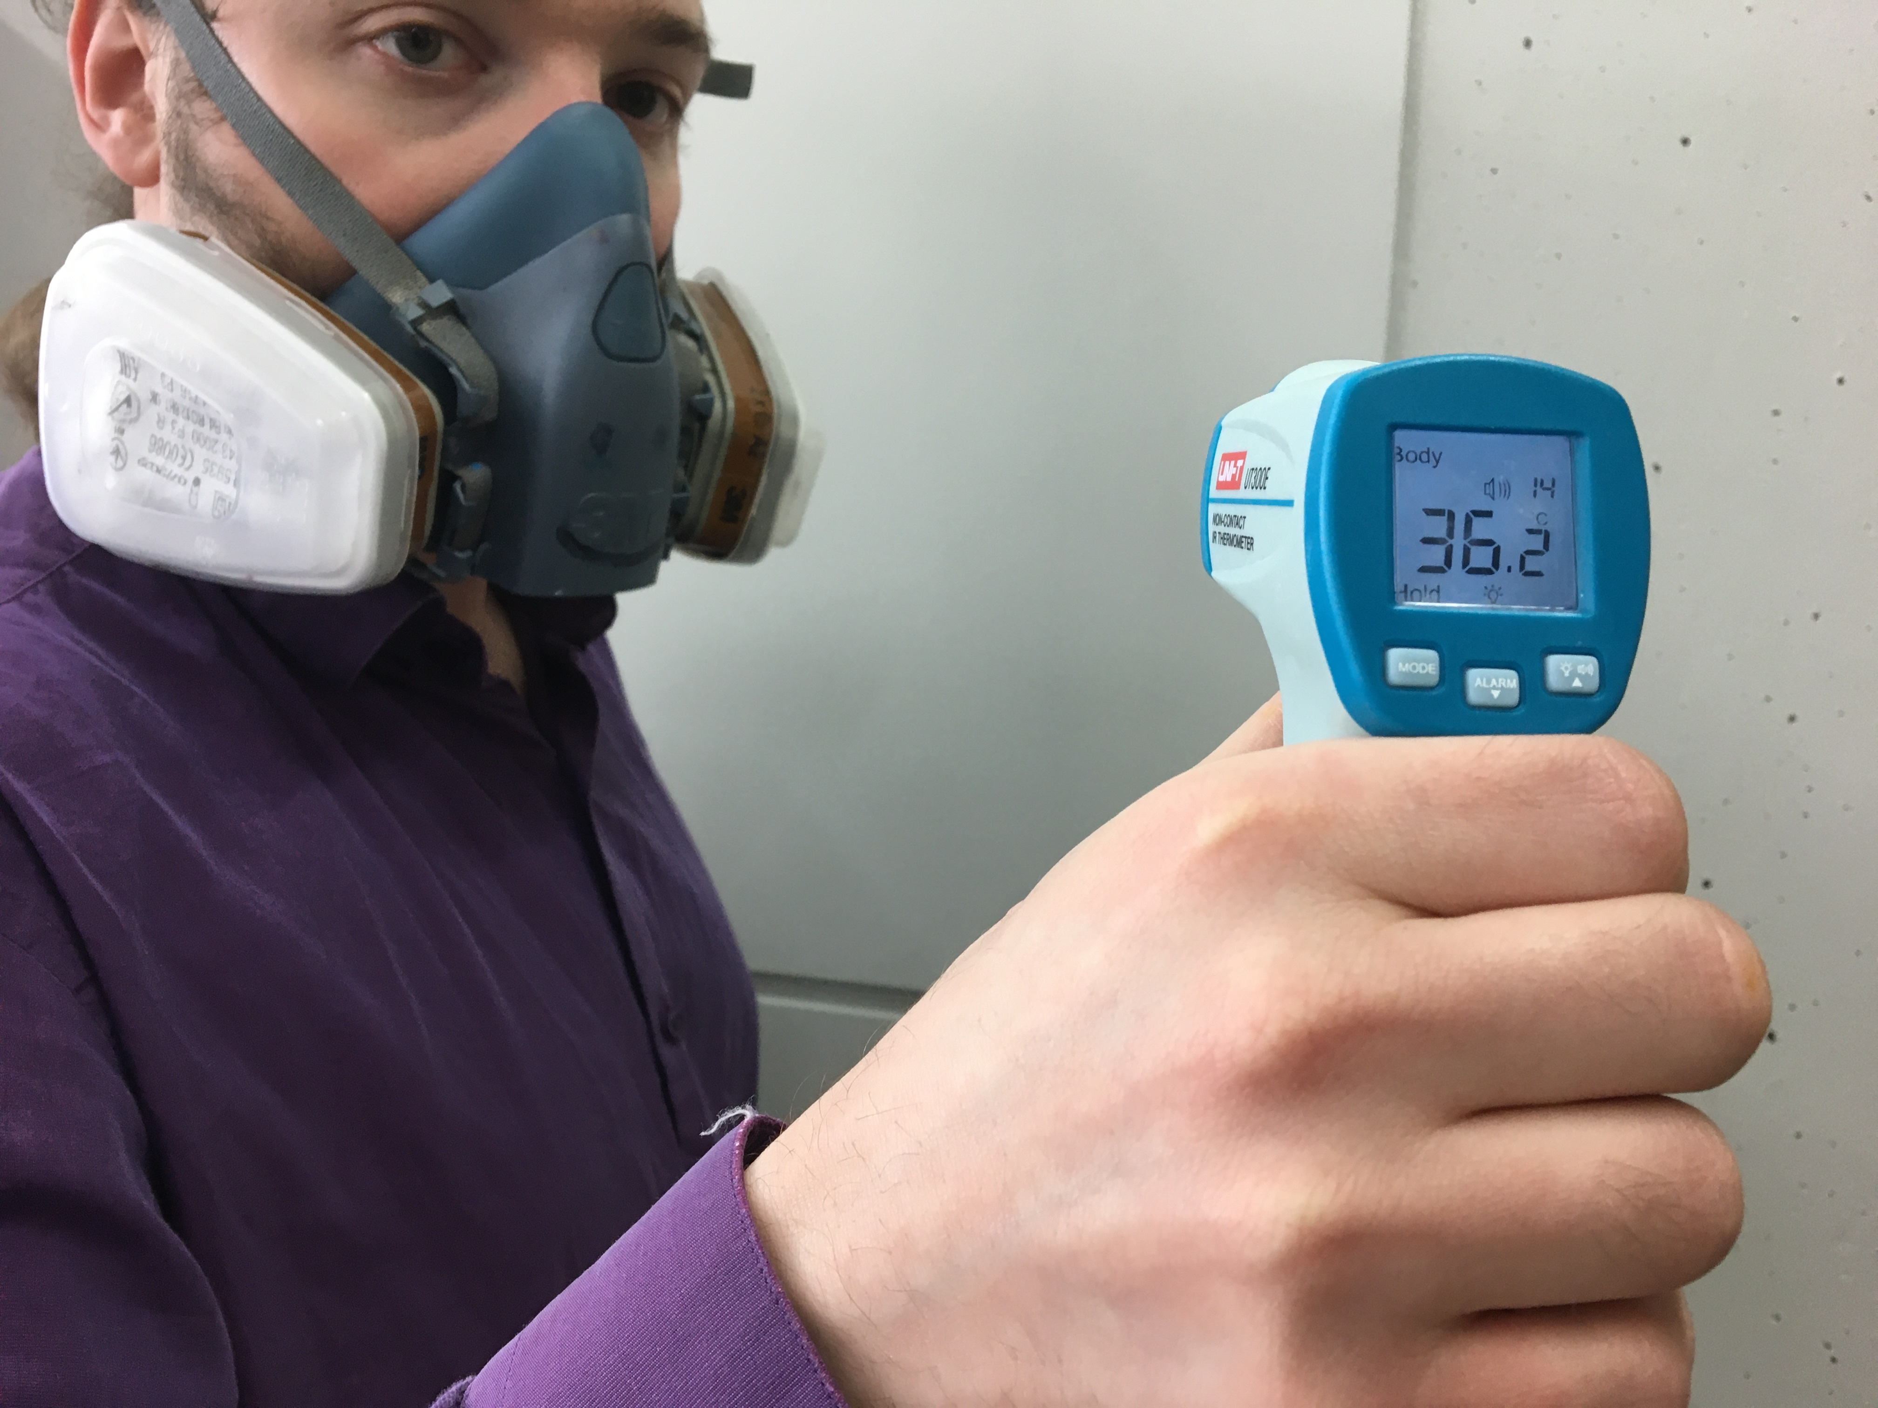
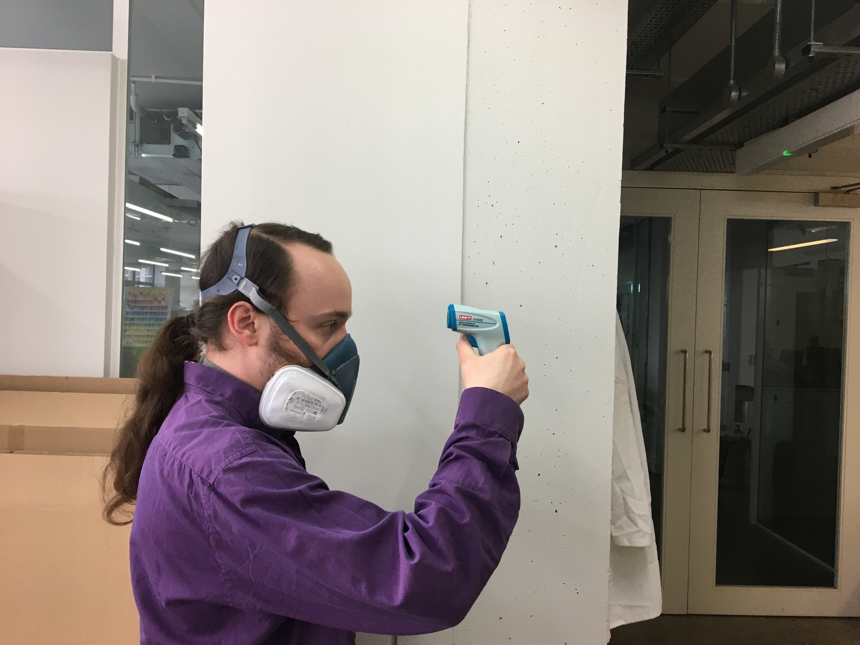
Temperature check on arrival
Use hand sanitiser, then complete a temperature check on arrival. Temperature must be < 38° C for entry to building.
How to use the thermometer? – See the pictures

Slide 5
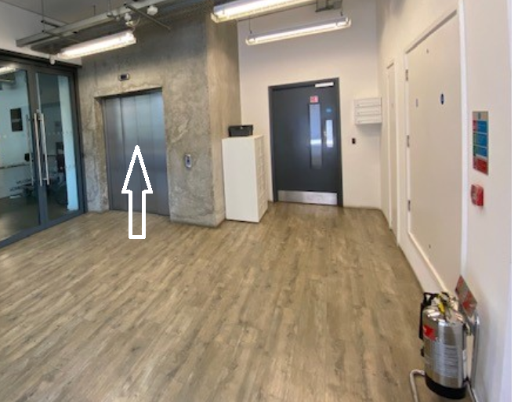
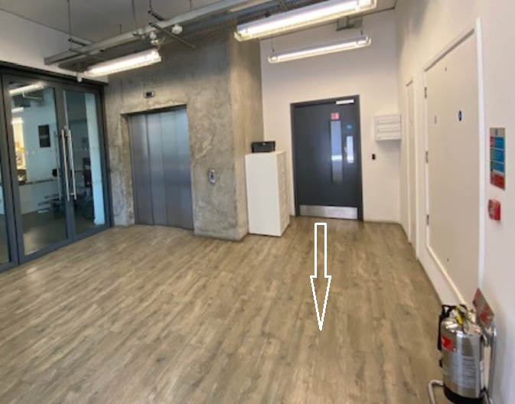
Moving Around the Building
The Stairs – One Way System
The staircase opposite the main entrance and adjacent to the lift will be used for moving down the floors and exiting the building only.
The staircase at the back of the building will be used for moving upwards.
The Main Lift – Upwards Travel Only (unless you have a health condition)
The lift should be used by those entering the building and ascending to their desk.
The maximum capacity of the lift will be 2 passengers at one time. Floor signage will be in place.
Please avoid using the lift to move 1 or 2 floors.
The small lift will remain out of use.

Slide 6
Building Facilities
Reception
There will be no reception cover for the month of June; this will be reviewed each month.
Postage
Postage will not be available from Head Office, whilst there is no reception cover. Please speak to HR about urgent postal service.
Ventilation
Use open windows to ventilate your workspace.
The air-conditioning system will remain in use, and has been serviced in June 2020, replacing all filters.
Toilets
Current toilet procedures remain in place; hand driers will remain off and paper towels and lidded bins provided.
Shower Facilities
The showers will be out of use.
Smoking Area
The smoking area will remain accessible, please socially distance yourself from others.

Slide 7
Meetings, Shared Equipment and Hot Desking
Meetings Rooms
Avoid face to face meetings wherever possible.
If a face to face meeting cannot be avoided practise social distancing and keep meetings as short as possible, ideally < 15 mins, or use a face mask.
Wear a mask in group meetings that cannot be avoided or held virtually.
Pods
One person at time only.
Shared Equipment
Wherever possible avoid using shared equipment.
If you need to use shared equipment e.g. in meeting rooms, the laboratory or passing product samples, practise good hygiene and use the hand sanitiser provided.
Desks
There should be no hot desking. Everyone should only use their own IT equipment.
You must only use your desk if you can maintain a 2 m distance whist sat at your desk, including moving to and from any walkways.
You must get confirmation from your line manager before travelling to Head Office, as they will be responsible for ensuring there is no overcrowding i.e. your neighbouring colleagues are not in on the same day.
Clear Desks
To aid cleaning please ensure your desks are clear from equipment and paperwork.

Slide 8
Eating, Drinking and Food Preparation
Kitchen
The kitchen will remain open with a capacity for two people at one time.
Please keep the kitchen clear of clutter, this will help maintain a clean environment.
The Tea Room
The Tea Room and sitting area will remain open; ensure you socially distance yourself from others using the tea room.
Please wipe down your area after use, including table and chair backs.
The Coffee Machine
The coffee machine will remain off.

Slide 9
Visitors and Deliveries
Visitors
We ask you to not bring business visitors into Head Office for the month of June. This will be reviewed on a monthly basis.
Contractors for essential maintenance will be permitted.
It is the responsibility of the host to:
  Pick up visitor at reception
  Ask them to sign in and complete a health declaration on arrival.
  Ensure all external visitors are aware of our basic H&S principles
    Moving around the building and any one-way systems.
    Emergency evacuation plan.
Deliveries
Head Office deliveries are currently being sent to the White Building. Please contact their reception to arrange collection on parcels; email reception@thewhitebuildingw11.com or call 020 3994 6430
Please do not have personal deliveries sent to Head Office.

Slide 10
Use of Personal Protective Equipment
PPE and Hygiene
Hand washing is key. Wash for 20 seconds with hot water and soap.
Where handwashing is not possible, use hand sanitiser provided.
Face Masks/Face Covering
We ask you to wear a mask or face covering anytime you leave your desk.
The supply of masks will be provided by the Company, please only take what you need. Please also feel free to bring your own mask.
Wherever possible, group and face to face meetings should be avoided, instead conducting virtual meetings via Teams or Skype.
Used masks can be disposed in general waste.
Hand Sanitiser
Hand sanitiser will be provided for your use, when hand washing is not possible.
Desk Screens
At present and due to the limited numbers expected at Head Office, screens will not be necessary. This will be reviewed as more people return to Head Office.
You must only use your desk if you can maintain a 2 m distance whilst sat at your desk, including moving to and from any walkways. Inform your line manager if wish to work at Head Office.

Slide 11
Emergency Evacuations
Fire Drill
Planned fire evacuation drills have been suspended in order to avoid deliberately creating a situation where social distancing would be difficult to maintain.
Evacuation Plan - Modifications
If the fire alarm sounds, you must evacuate the building. In this situation the greatest immediate risk is the fire and you are requested to evacuate as normal. Once clear of the building you should observe the following changes;
Once clear of the building employees should disperse in the direct of the assembly point (Hunt Close) and should congregate in the vicinity of the assembly point.
Fire wardens will congregate at the actual assembly point under social distancing, where they will wait to be informed of next steps.
The fire wardens will indicate when it is safe to return to the building, which should be done under social distancing.

Slide 12
Suspected COVID?
What to do if you become unwell following contact with someone who may have COVID-19
If you have already been given specific advice from your employer or Public Health England (PHE) about who to call if you become unwell, follow that advice.
Otherwise, if you develop symptoms of coronavirus infection (COVID-19), however mild, you will need to stay at home for 7 days - refer to the advice on the NHS website and the Stay at Home guidance.
What to do if someone at work and shows symptoms of COVID-19
ISOLATE: Remove the person from others. Ensure the person is wearing a surgical mask, if possible.
INFORM: Inform their line manager and HR. Tell health authorities by calling 111. Follow the advice of health officials. Depending on your situation, authorities could give you specific advice.
TRANSPORT: Ensure the person has transport, either to their home or to a medical facility.
CLEAN: A deep clean will be arranged.
IDENTIFY: Investigate who they had close contact with in the work place up to 24 hours before they first started experiencing symptoms. Close contact means anyone who has been face-to-face for at least 15 minutes with the infected person or has been in the same space as them for two hours. Those employees must work from home for 14 days. Colart will comply with the government advice on “Test and Trace”.
REVIEW: The workplace should review the way it controls the risks of COVID-19 and decide whether work may need to change, with employees kept up to date on what is happening and on the appropriate safety procedures.

Slide 13

Mental Health and Wellbeing
“We aren’t all in this together. We’re in the same rough seas, but we’re in very different boats. Some of those boats are very leaky. Some of those boats were never given oars. Some of those boats have high-powered motors on them. We are not all in the same boat.” Cynthia Enloe – Feminist writer, theorist, and professor.
Please be mindful that viewpoints will differ. Now more than ever it's important to be respectful and support each other.
For those of you in the Colart Pension Scheme, our employee assistance scheme UNUM can be reached here. The service is here to help you and your family and offers advice on a range of topics concerning health, family, money matters and work. For a range of tools and guidance to help maintain good mental health, please visit the mental health hub.

Slide 14
First Aid
During our phased return to work, there will not be a first aider on each floor.
If first aid is required,
Contact Pierre Sanchez 4th Floor most days
    T +44208 424 3246
    M +44 7 907 355 024
In Pierre’s absence, ring 999 for life threatening situations, otherwise ring 111. Afterwards you must notify HR and/or the Health & Safety Team: Jennifer O’Brien, Alison Wabe and Pierre Sanchez.
First aid boxes are available on each floor and in reception.

Slide 15
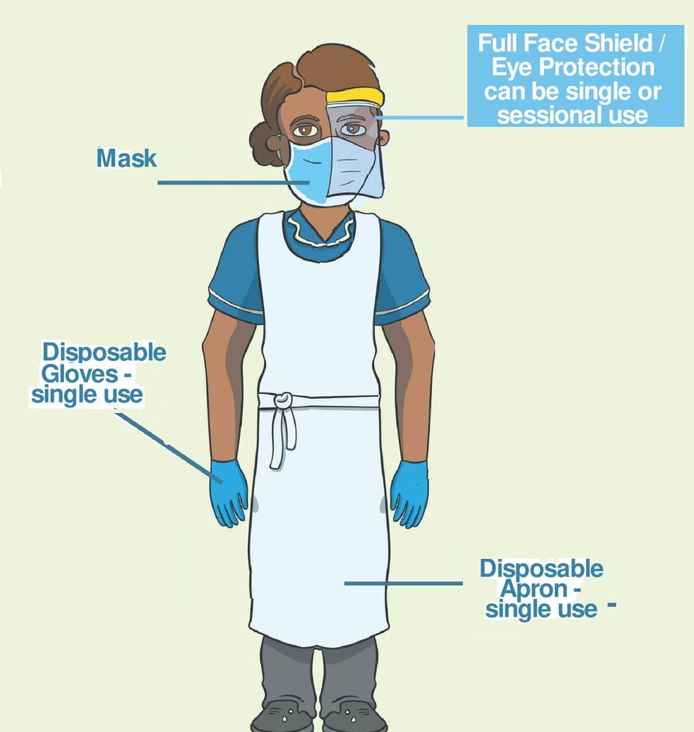
First Aiders
Be aware of the risks to yourself and others. When approaching a casualty there is always a risk of cross contamination – especially when you may have to get close to the casualty to assess what is wrong or to check their breathing. It is always important to be aware of the risks of how this cross contamination has occurred. According to NHS 111 we do not know exactly how coronavirus spreads from person to person but similar viruses are spread in cough droplets.
Keep yourself updated and informed. As this is a new disease this is an ever-changing situation and the government and NHS are continually updating their advice. Make sure that you regularly review the NHS 111 or Gov.uk website which has a specific section on Coronavirus.
Remember your own needs. These are challenging and uncertain times for all. The COVID-19 outbreak has meant a lot of upheaval and worry for people. In order to help others you will also need to look after your own needs. Make sure you take time to talk about your fears and concerns with someone you trust and to take out time to look after yourself.

Slide 16
What to do.. (Additional PPE is mandatory)
Providing Assistance
If you need to provide assistance to an individual, place the person in a place away from others. If there is no physically separate room, ask others who are not involved in providing assistance to stay at least 2 metres away from the individual.
PPE
Wash your hands thoroughly with soap and water before putting on and after taking off PPE.
You should use the PPE provided. Disposable face mask, disposable gloves, eye protection (such as face visor or goggles) and disposable apron. Use and dispose of all PPE according to the instructions and training previously provided.
Keep Yourself Safe
Don’t lose sight of other cross contamination that could occur that isn’t related to COVID-19.
Wear gloves when dealing with open wounds.
Cover cuts and grazes on your hands with waterproof dressing.
Dispose of all waste safely.
Do not touch a wound with your bare hand.
Do not touch any part of a dressing that will come in contact with a wound.

Slide 17
First Aider Hygiene
Dispose of your PPE in a safe and controlled manner.
After contact with the individual, wash your hands thoroughly with soap and water or alcohol hand rub.
Avoid touching your mouth, eyes and/or nose, unless you have recently cleaned your hands after having contact with the individual.
There are no additional precautions to be taken in relation to cleaning your clothing/uniform other than what is usual practice.
Cleaning Area
Cleaning will depend on where assistance was provided. Public areas where a symptomatic individual has passed through and spent minimal time in (such as corridors) but which are not visibly contaminated with body fluids can be cleaned in the usual way. However, all surfaces that the symptomatic individual has come into contact with must be cleaned and disinfected.
Blood or Body Fluid Spill
Keep people away from the area. Clean the area using a spill-kit, the PPE provided and following the instructions provided with the spill-kit. Seek further advice from emergency services when they arrive. It is important to avoid all contact with body fluids until cleaning can take place.

Slide 18
Questions
If you feel that you are unable to comply to the rules for any reasons or are in a high risk group for COVID19, please contact your Line Manager ASAP.
For further information the COVID risk assessment will be available in the H&S Tool Kit on the intranet.
If you have further questions or concerns, you can contact HR or your Head Office H&S Team:
Harsa Beagley, HR
Stavroula Tzoumi, HR
Jennifer O’Brien, H&S
Alison Wabe, H&S
Pierre Sanchez, H&S

