Slide 1

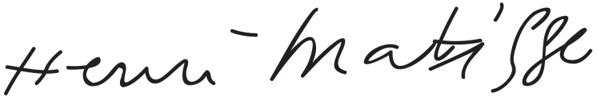
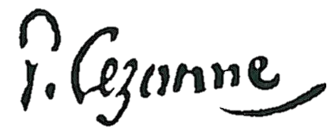

Founder of the fine arts industry in 1720…

Slide 2

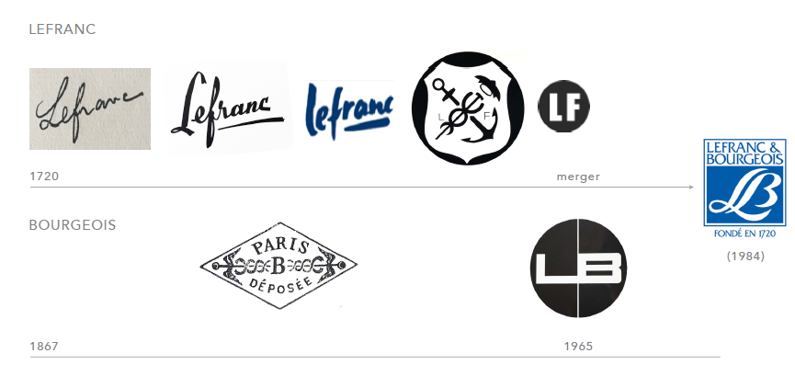
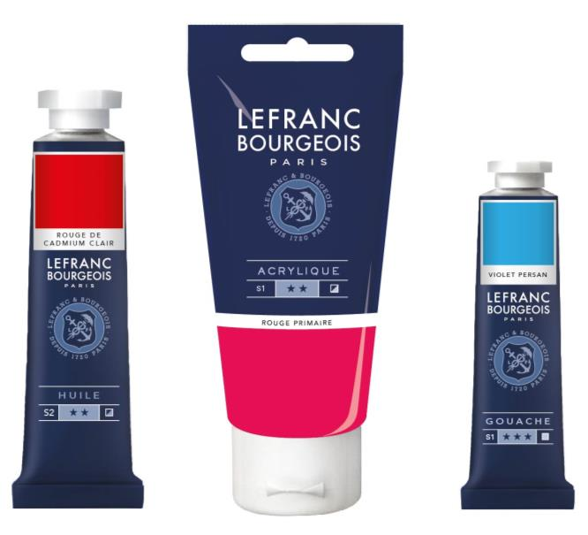
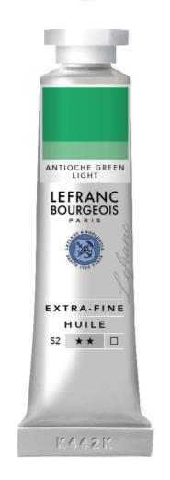
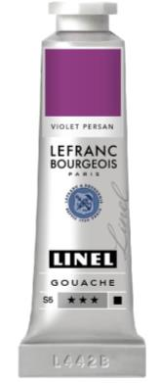
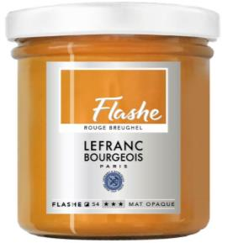
LEFRANC BOURGEOIS – A New Brand Identity in 2017

Slide 3
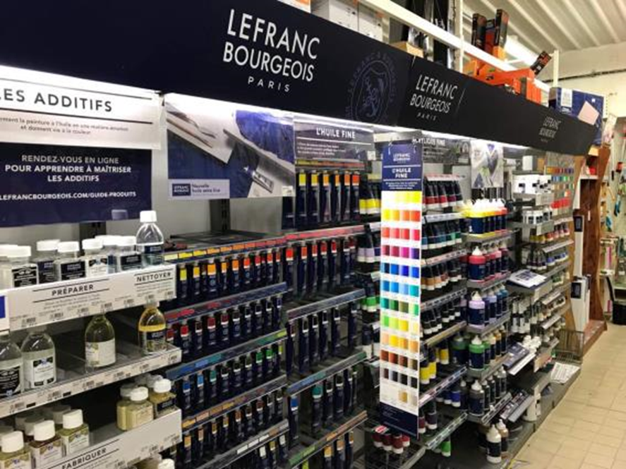
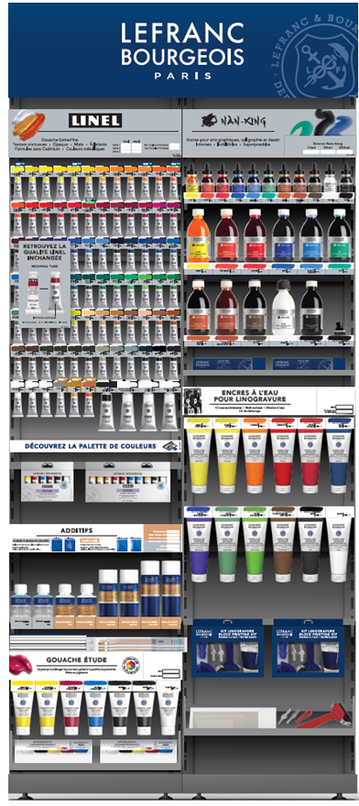
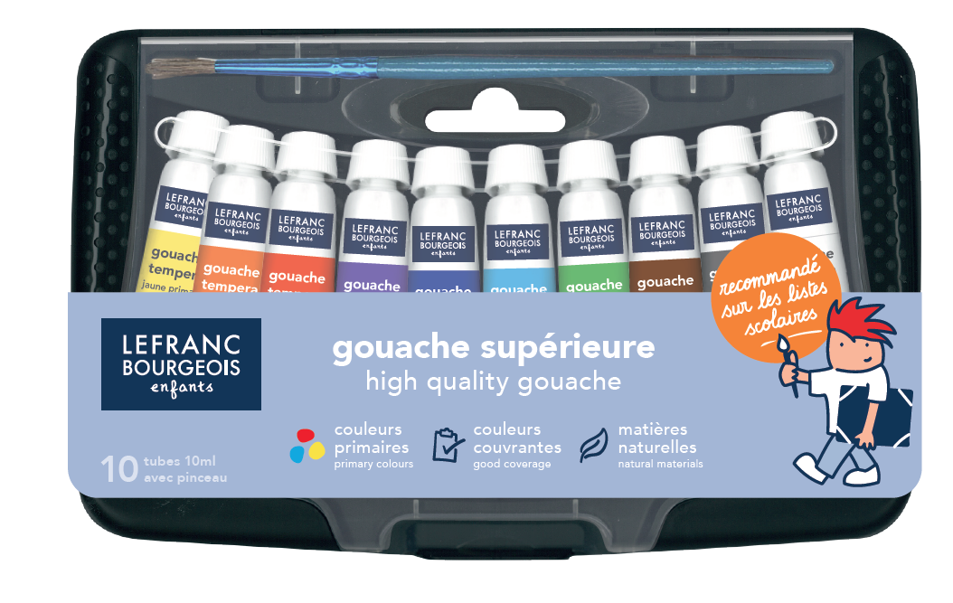
LEFRANC BOURGEOIS – A journey to revamp offer & image
2017 Oils
2018 Acrylics
2019 Enfants
2020 Gouache Inks

Slide 4
LEFRANC BOURGEOIS – First encouraging results in 2020
7,2M£
France
12M£
Global
Lefranc Bourgeois YTD sales are on budget, globally and locally…
Margin has been improved in the last 3 years but needs to be strengthened
Lefranc Bourgeois is the preferred brand in France in most fine arts categories

Slide 5
LEFRANC BOURGEOIS – France shows real brand rebound
Fine Arts activity show sales increase and margin consolidation
Enfants (Kids) activity show significant margin improvement while keeping market position

Slide 6
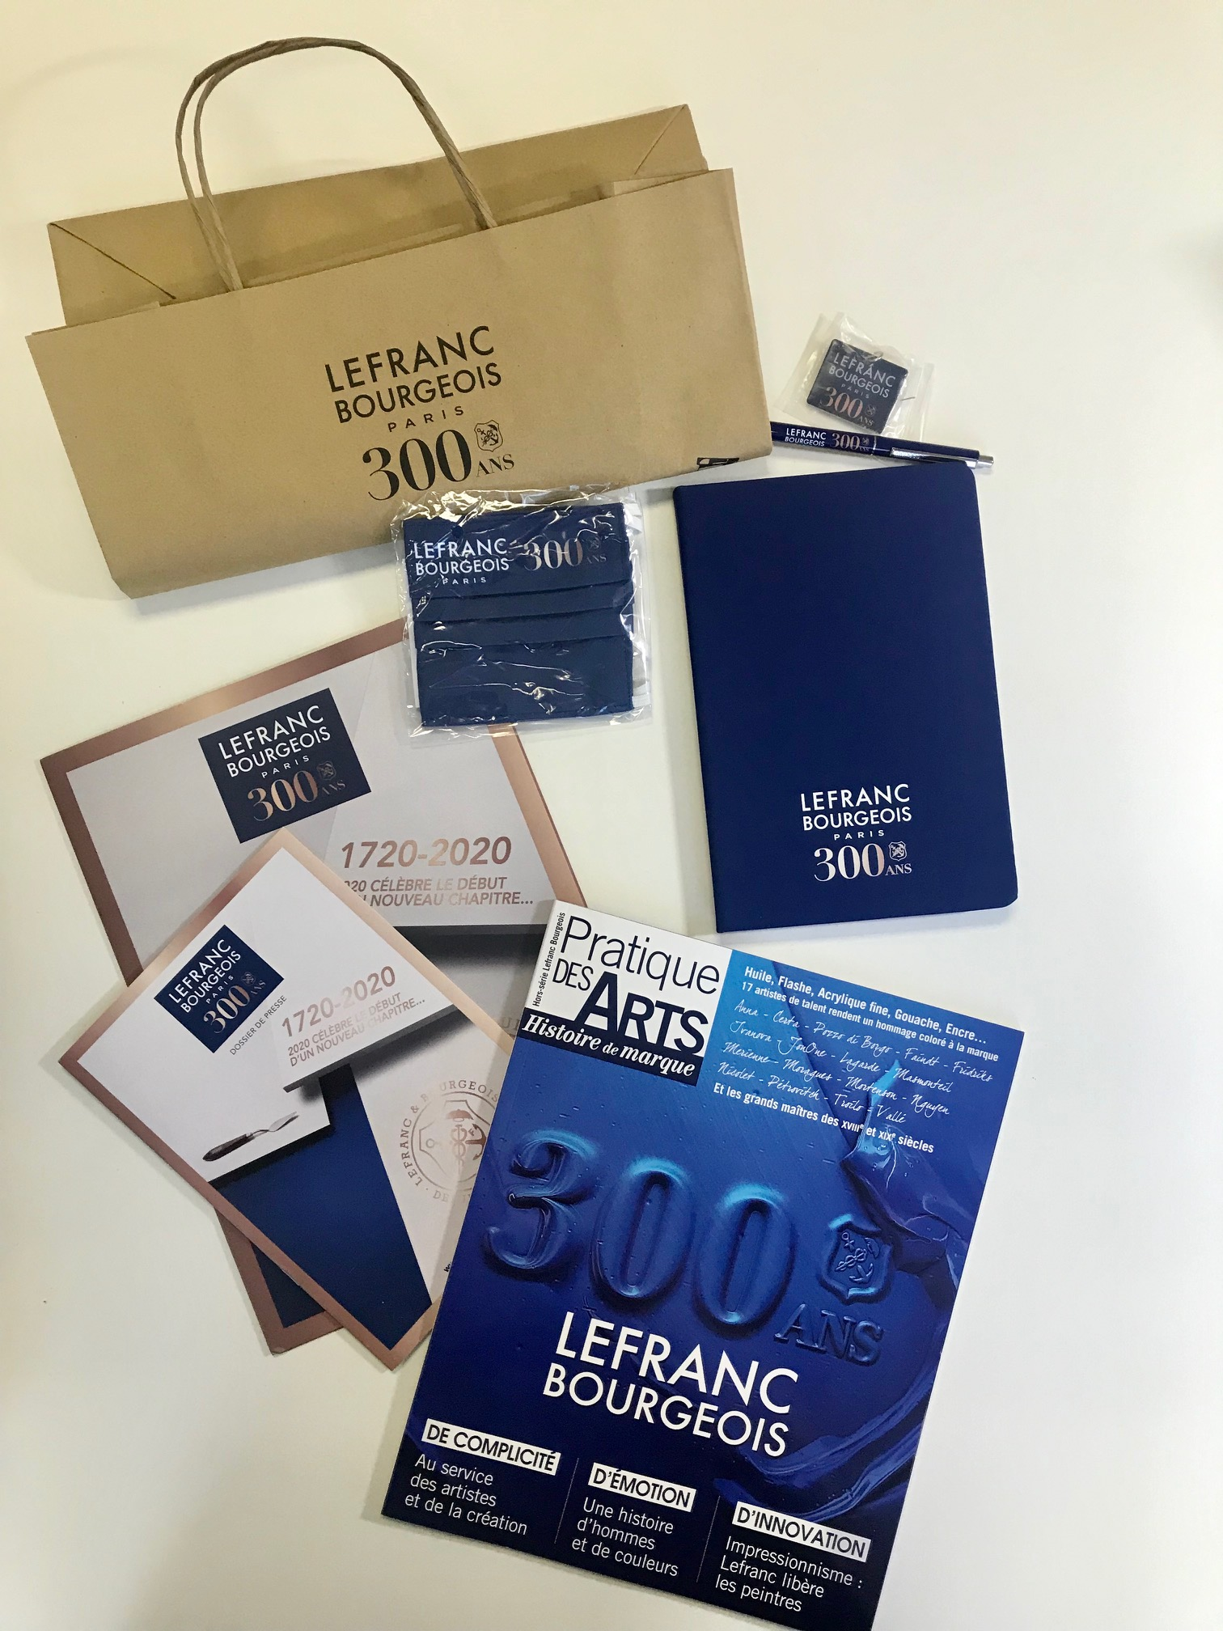
A unique celebration…300 years!!!!!

Slide 7
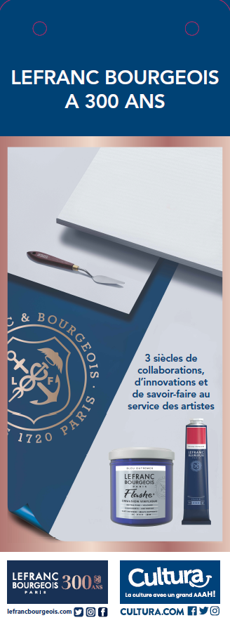
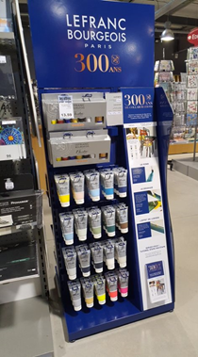
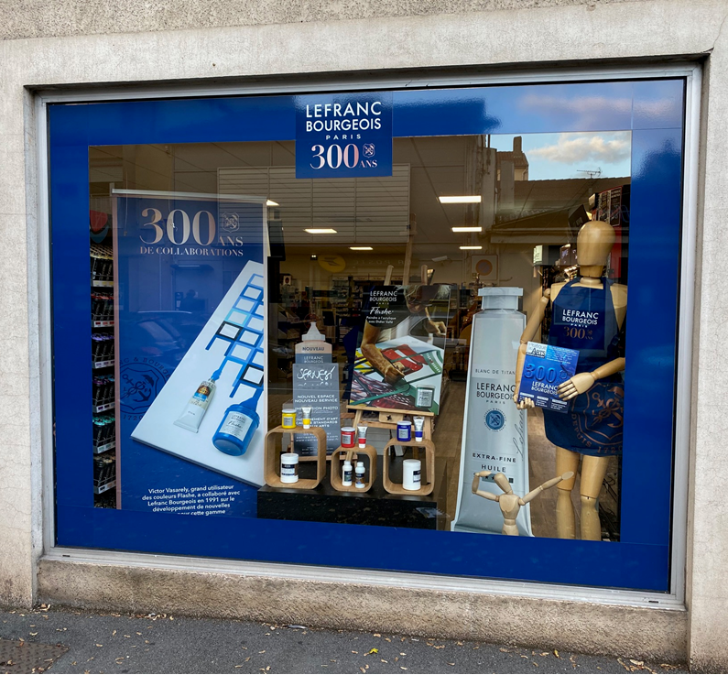
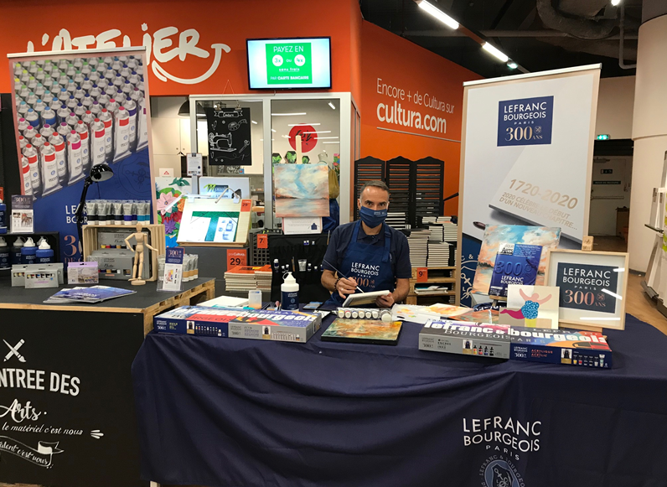
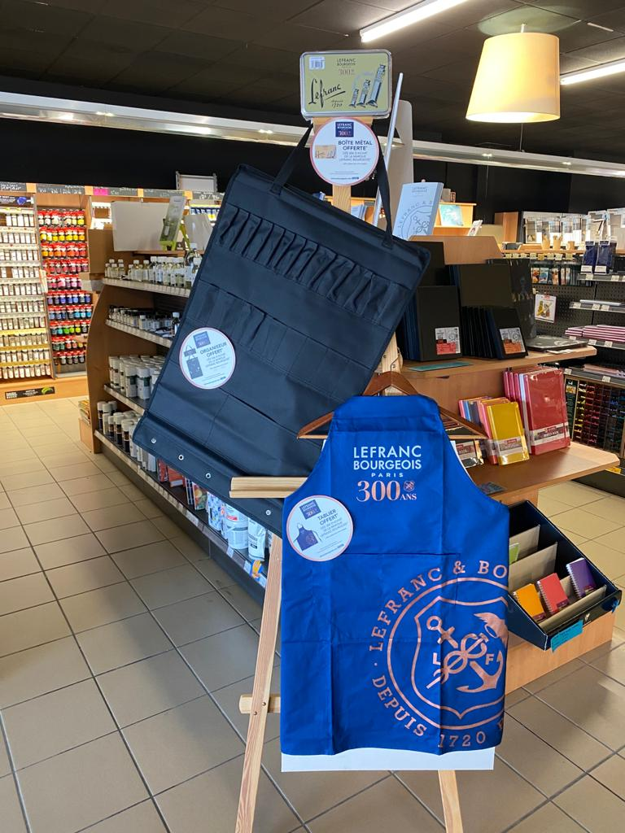
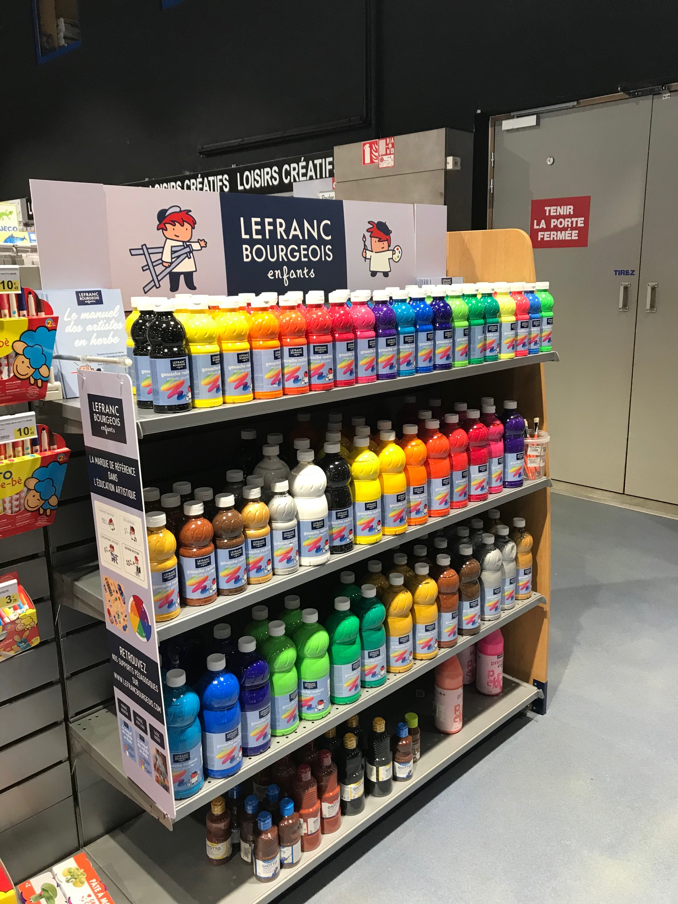
IN STORE ACTIVATION

Slide 8
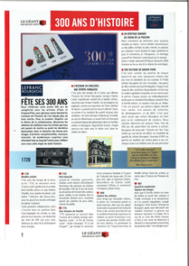
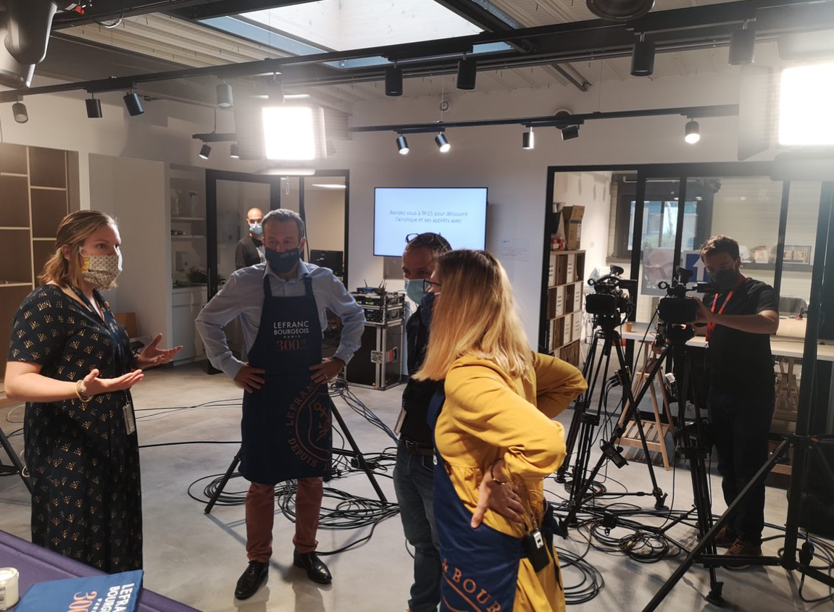
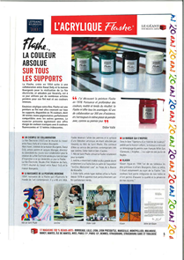
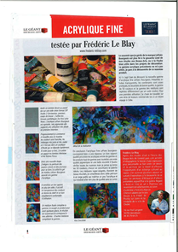
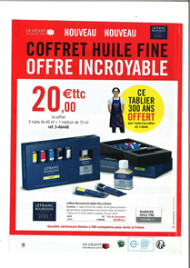
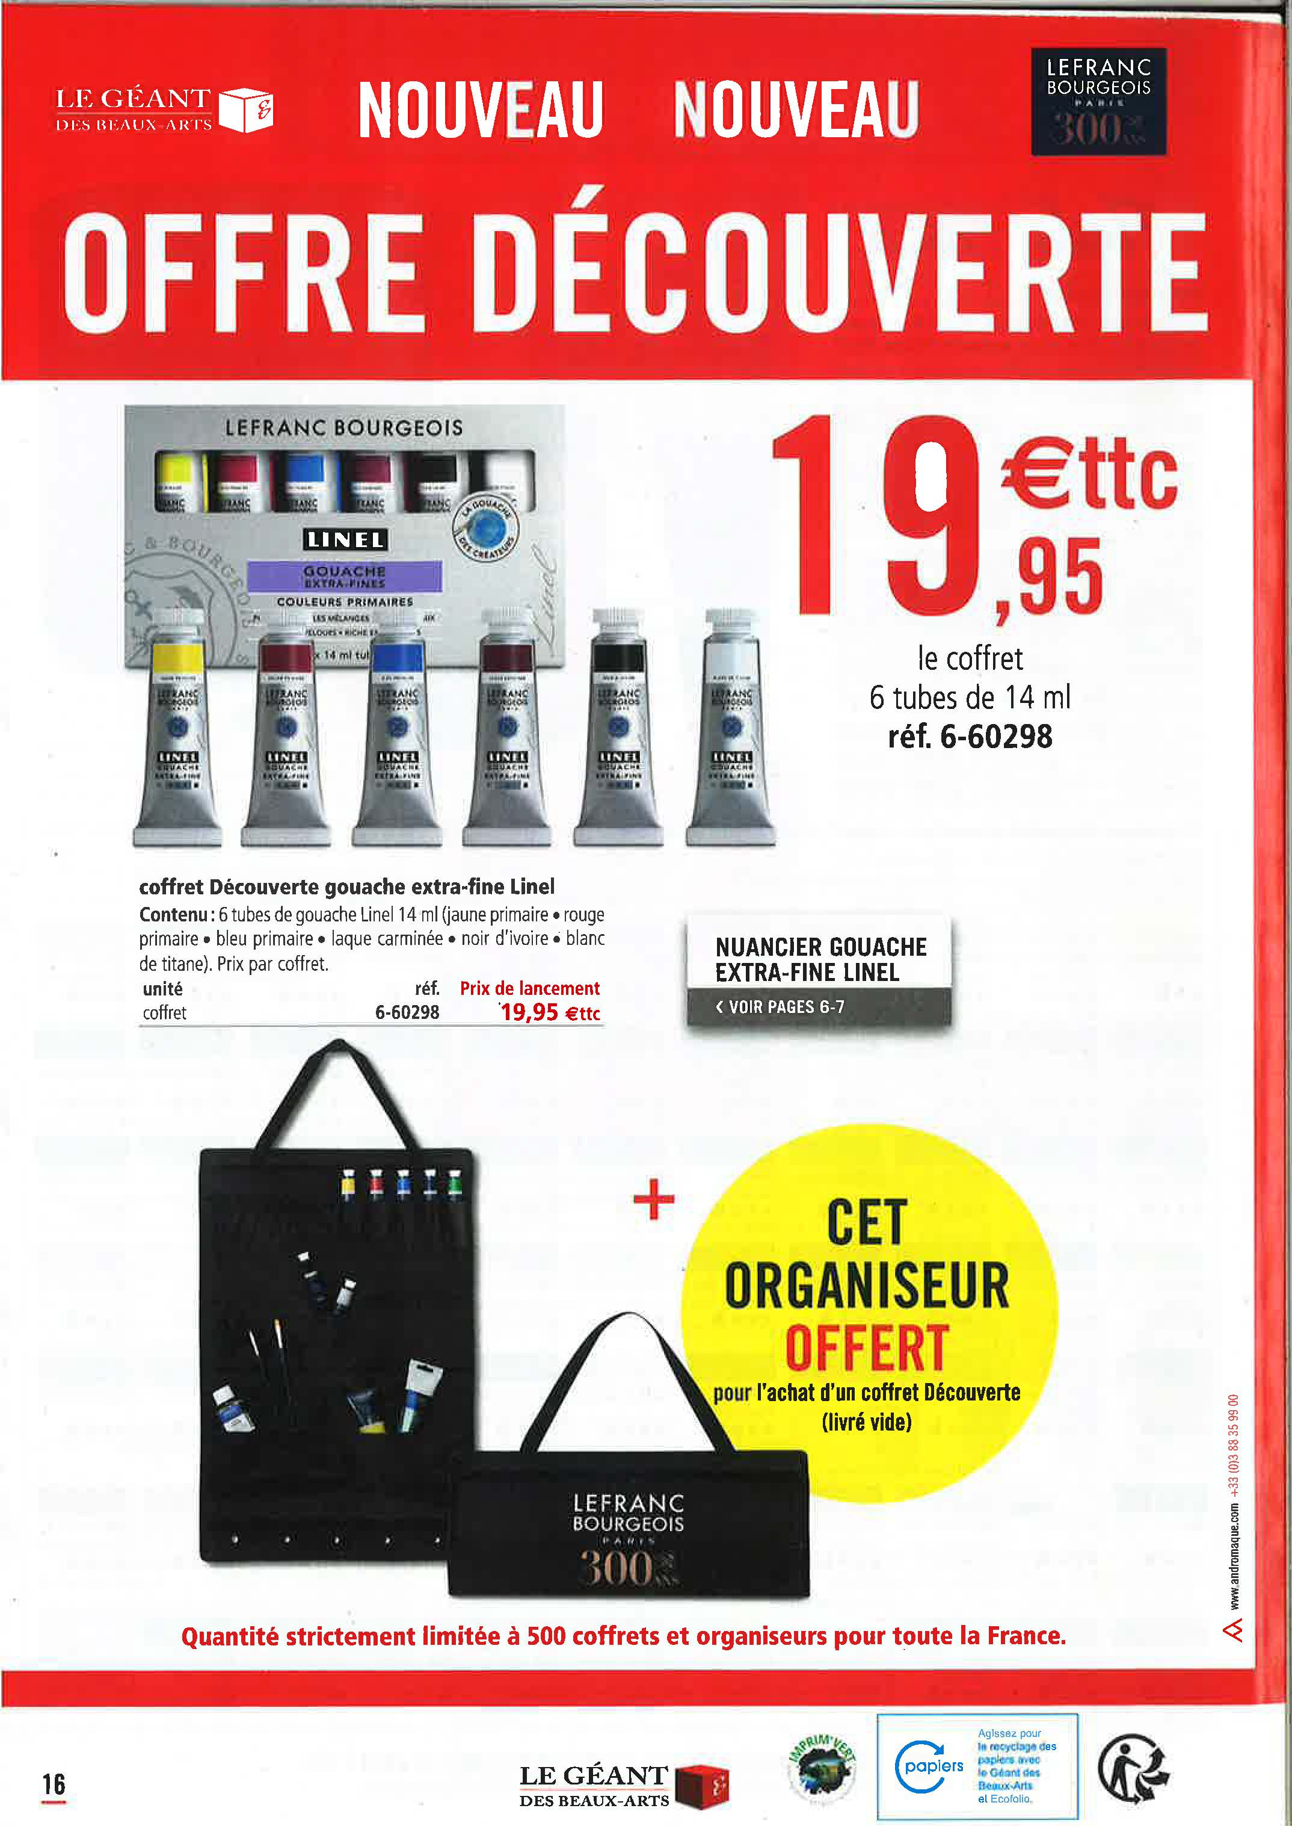
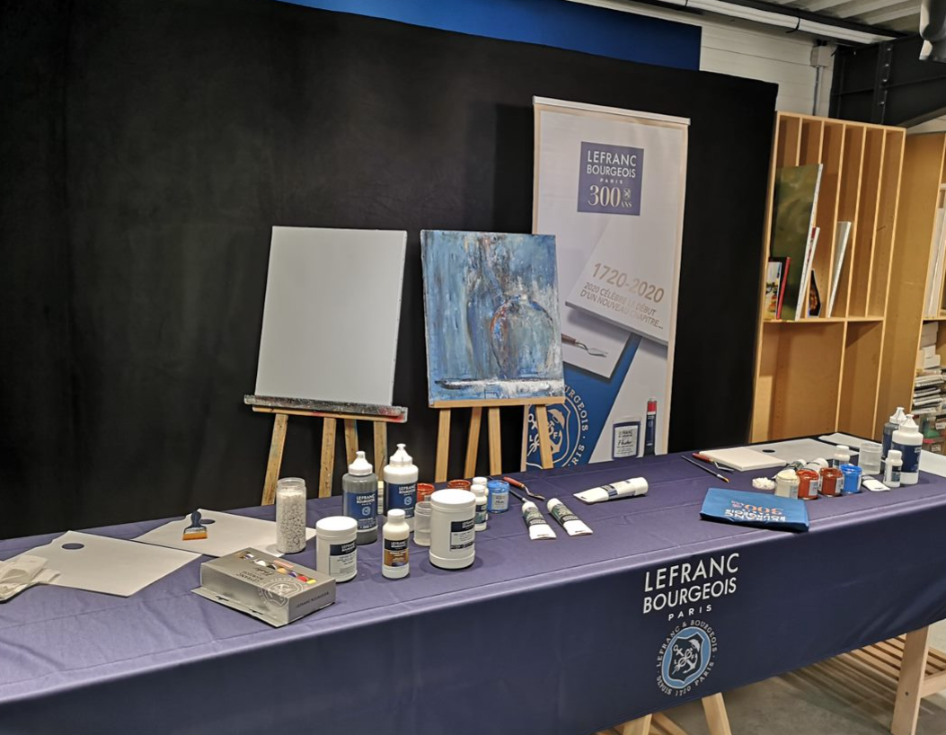
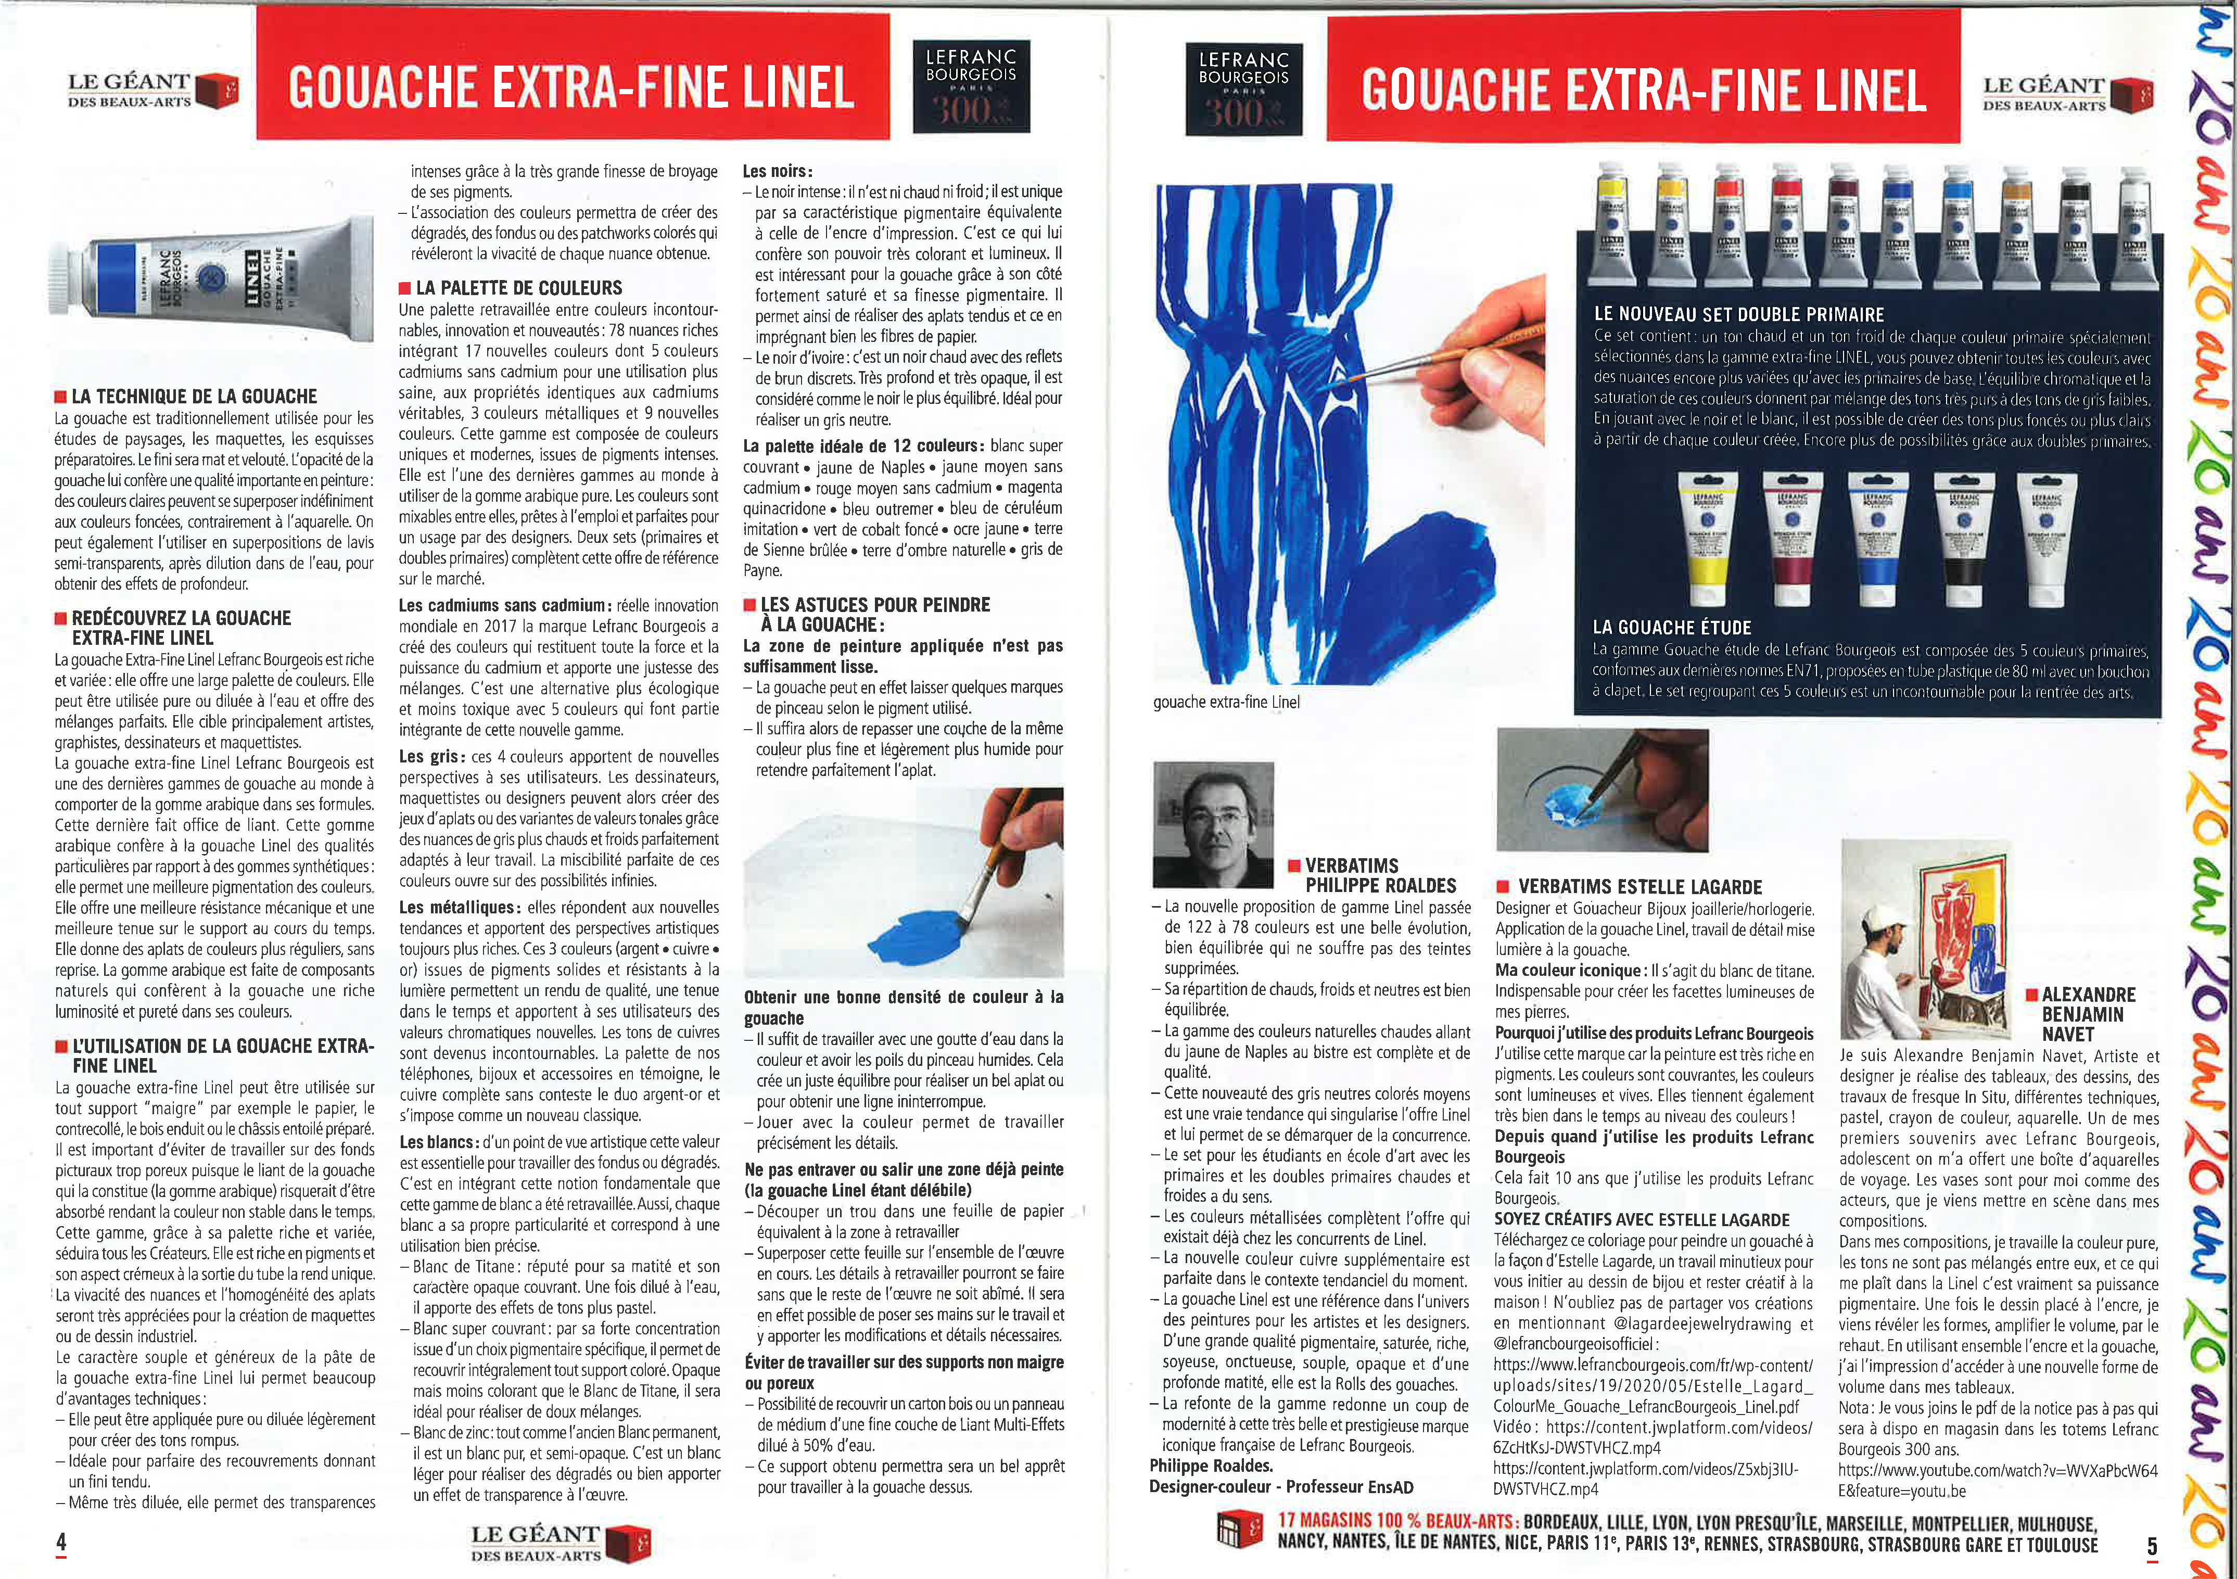
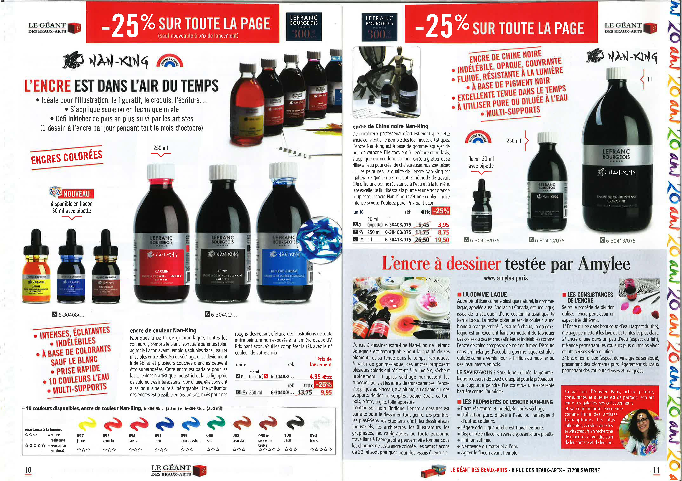

TRADE ACTIVATION
Gerstaecker
100 000 ex.
Staff training live event
Cultura
90 stores

Slide 9
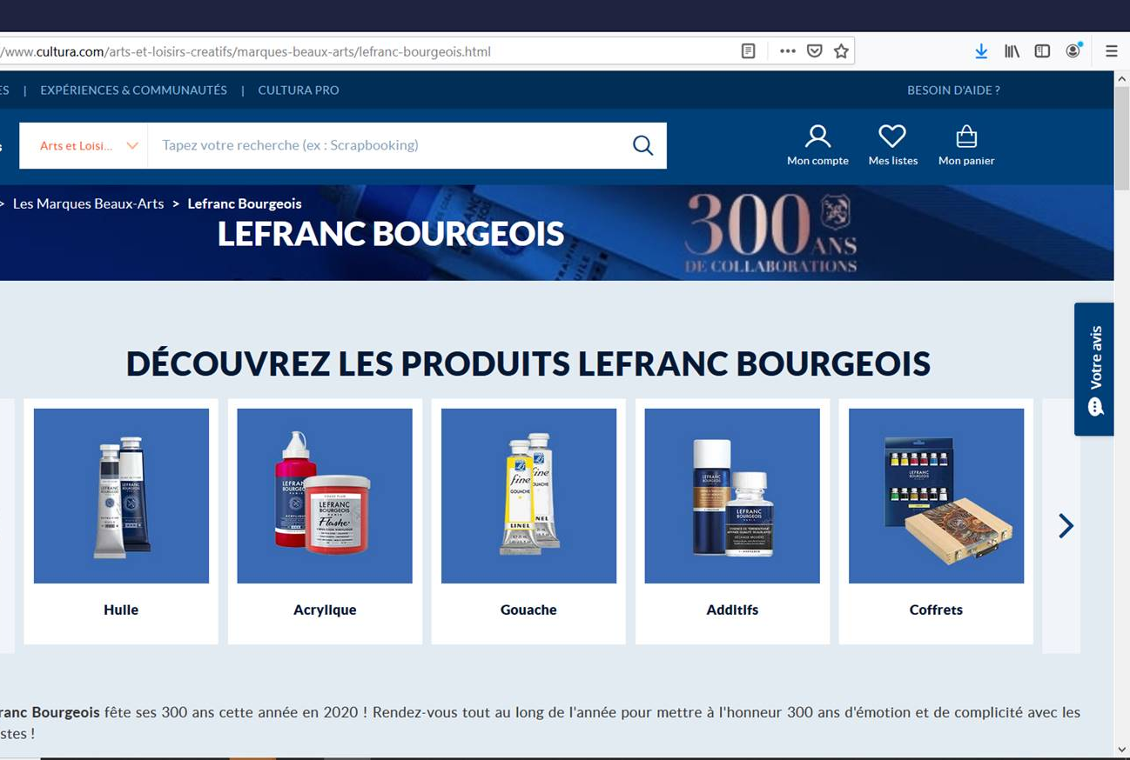
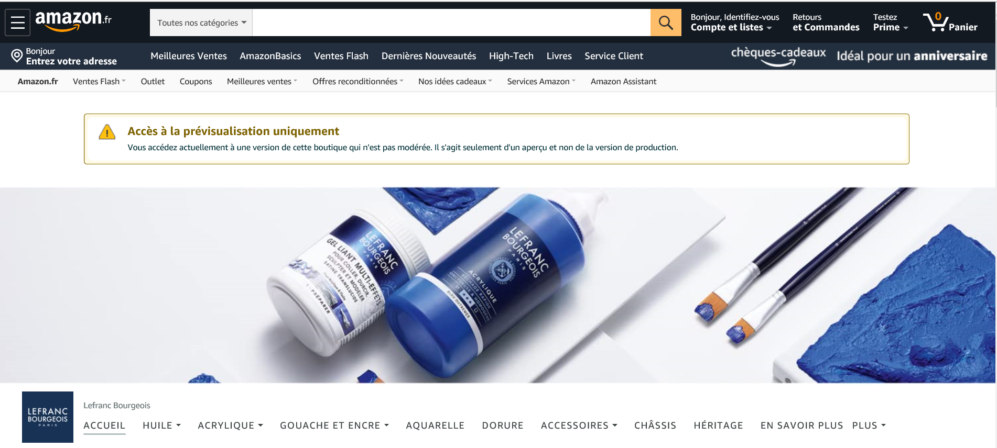
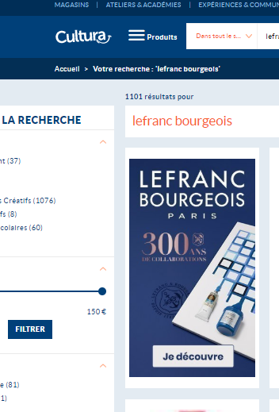
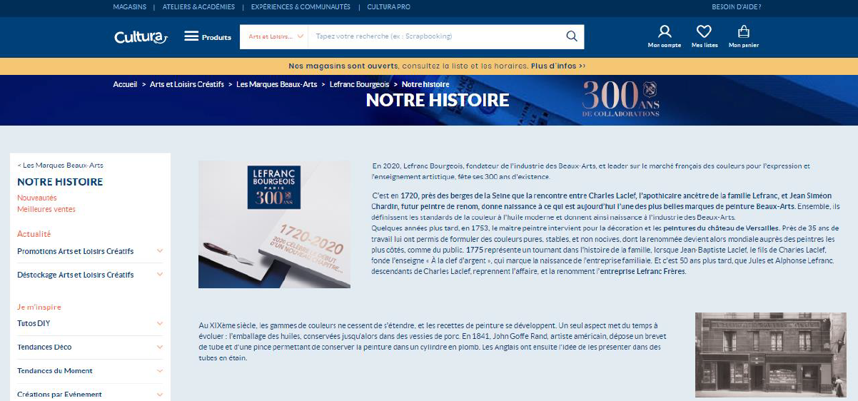
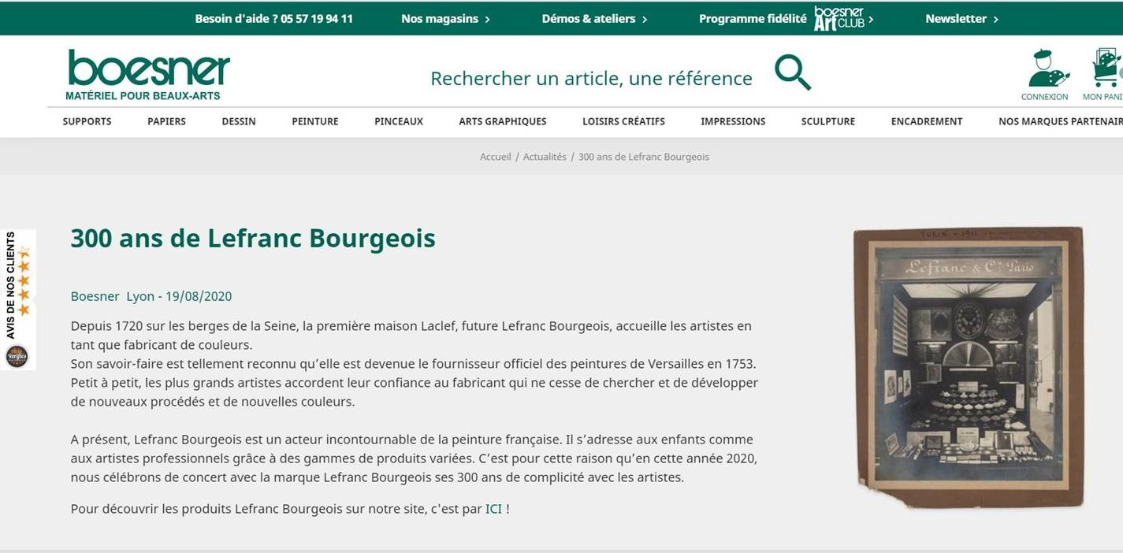
E-TAILERS ACTIVATION
Brand store Amazon
Boutique Cultura

Slide 10
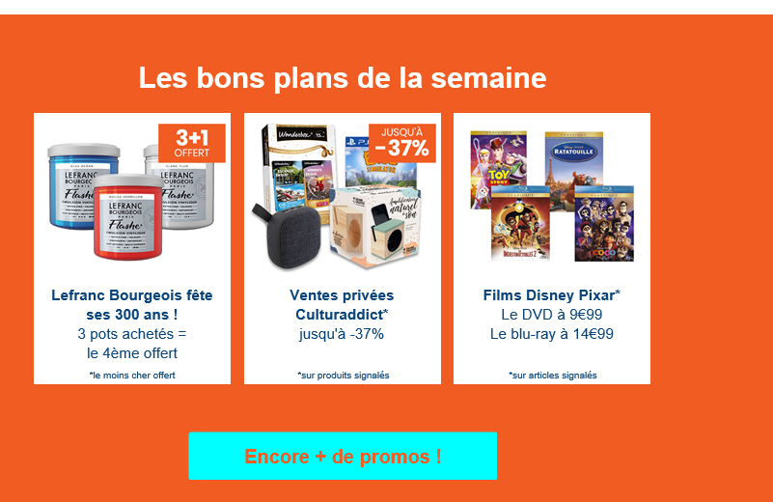
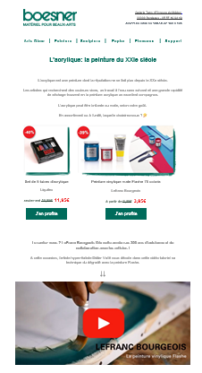
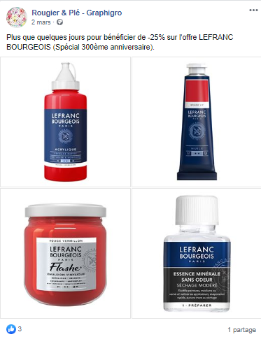
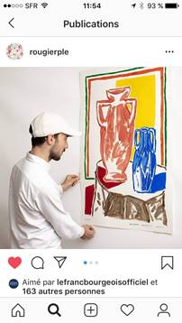
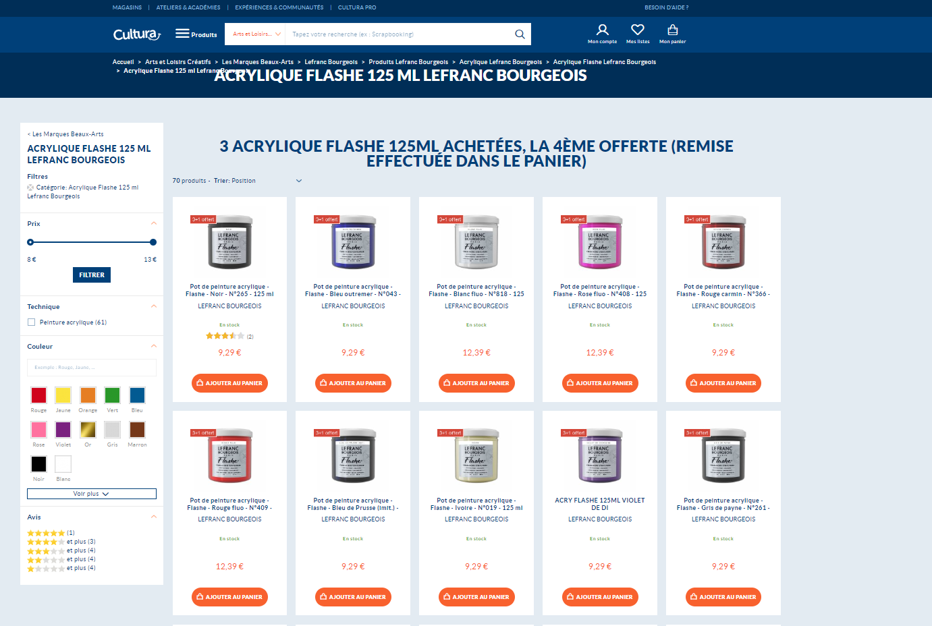
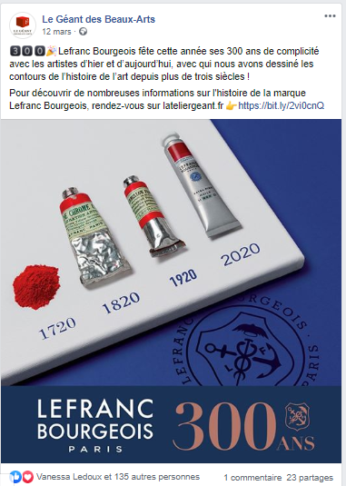
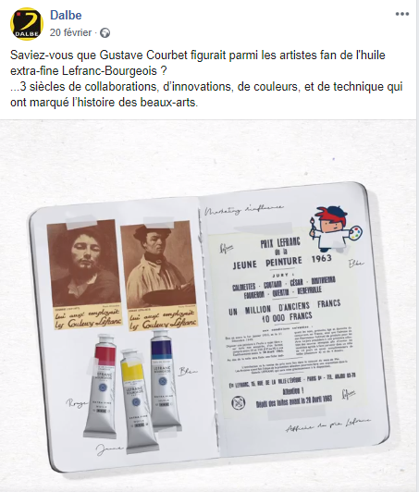
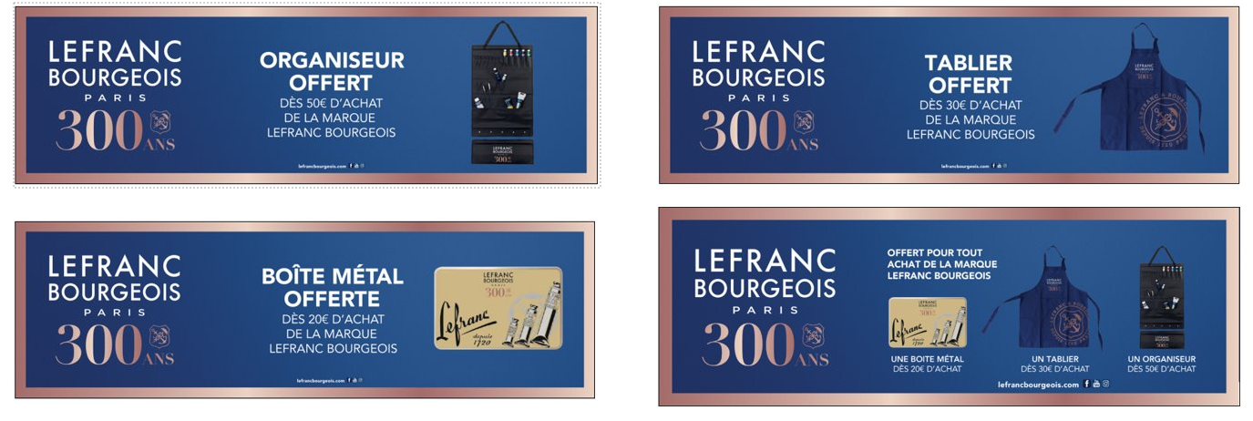





E-TAILERS ACTIVATION

Slide 11
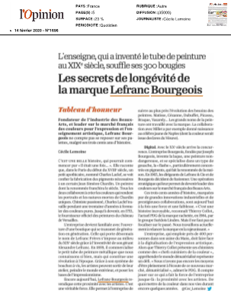
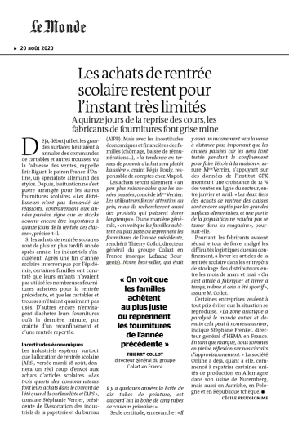
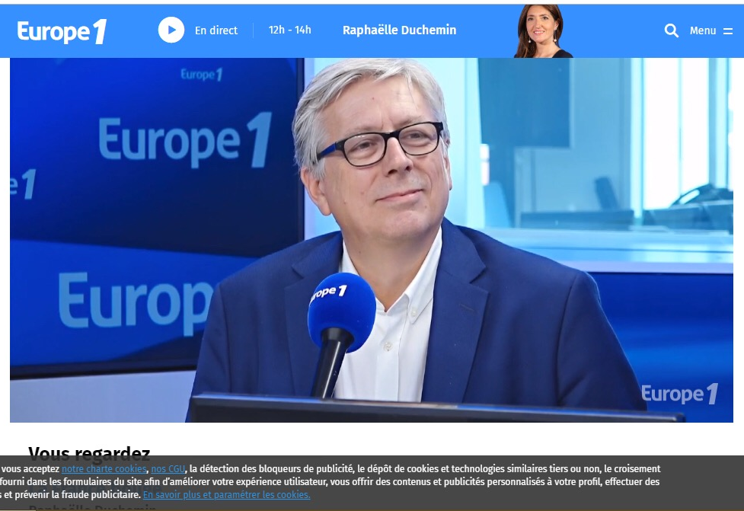
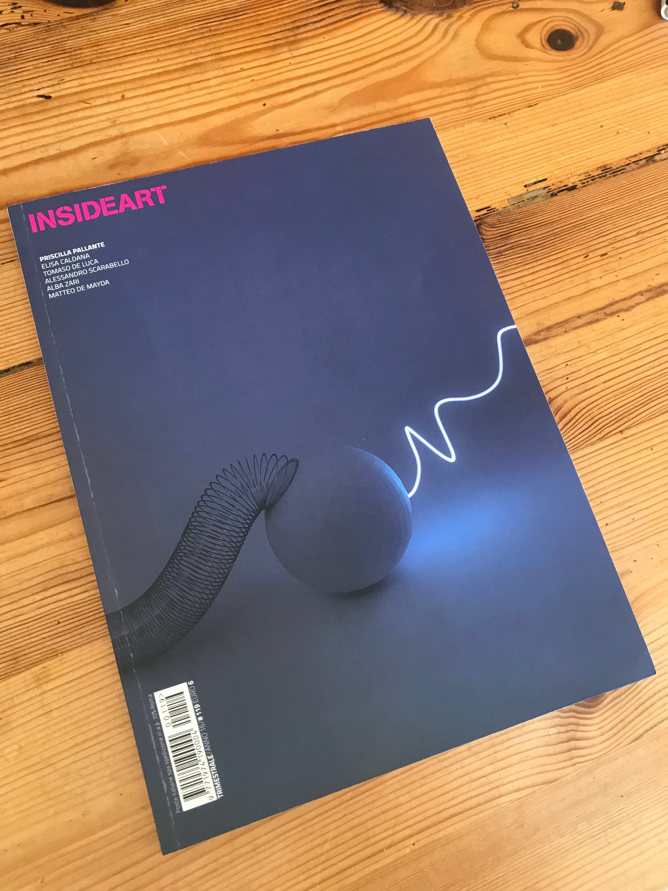

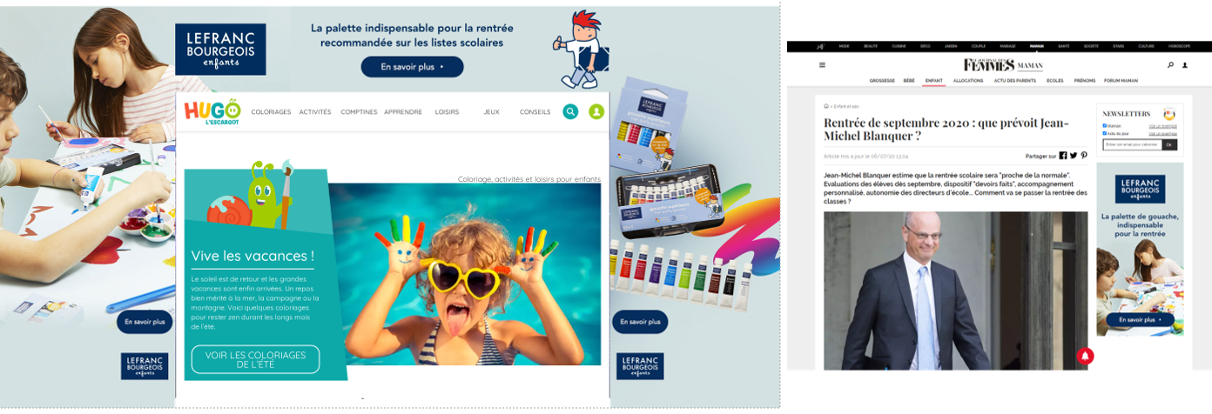
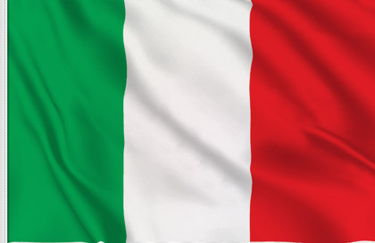
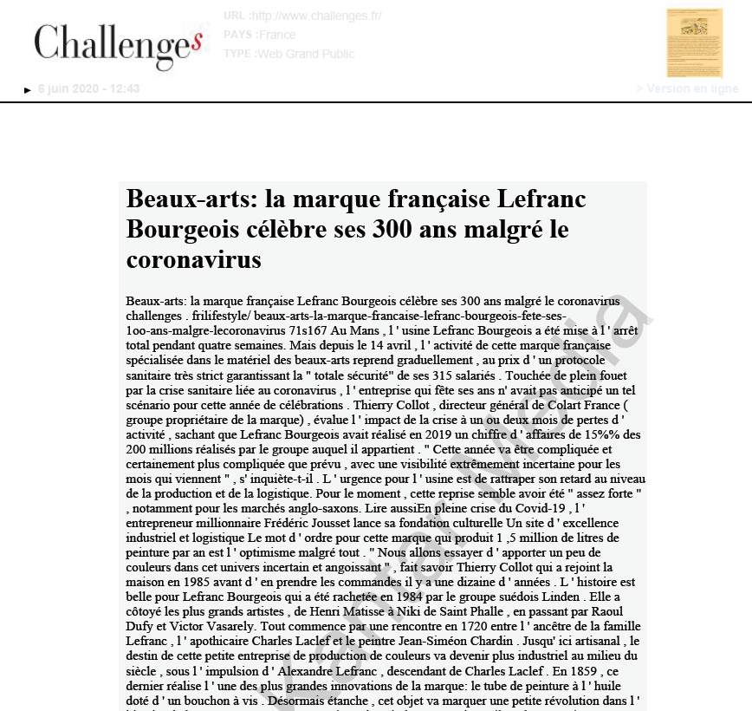
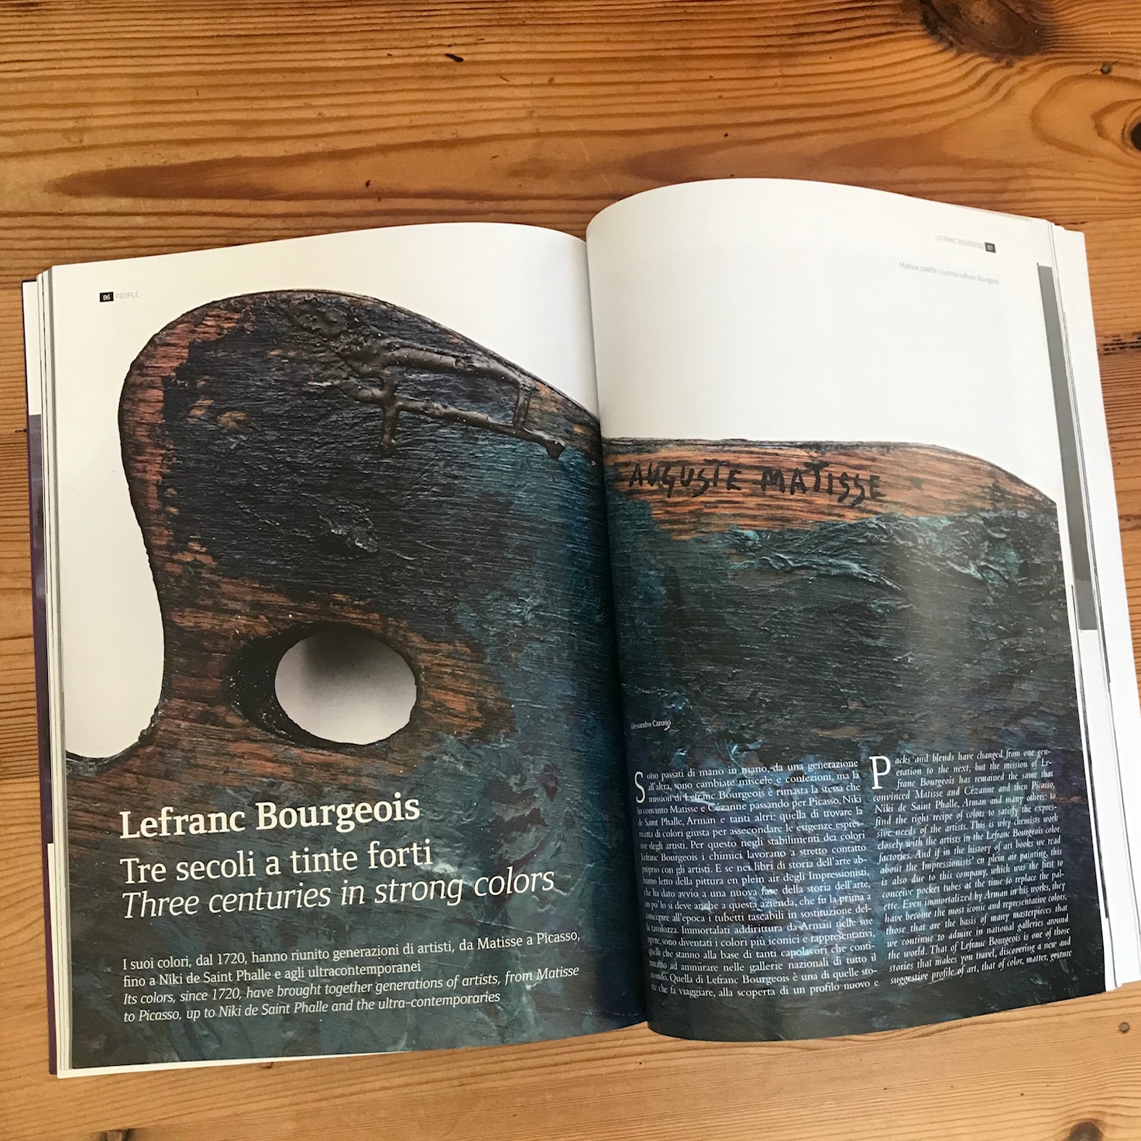
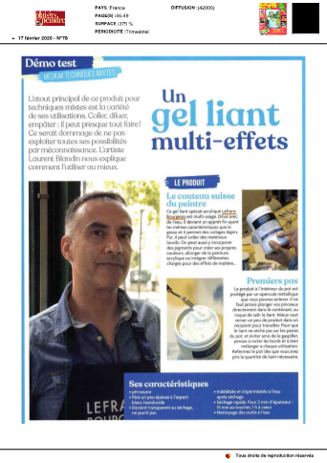
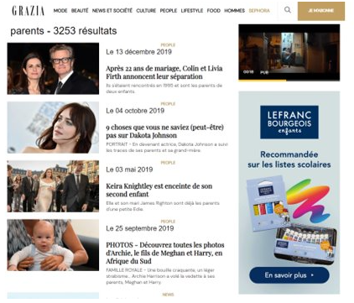
PR AND MEDIA ACTIVATION
100 publications press/radio/web, 25 M Reach

Slide 12
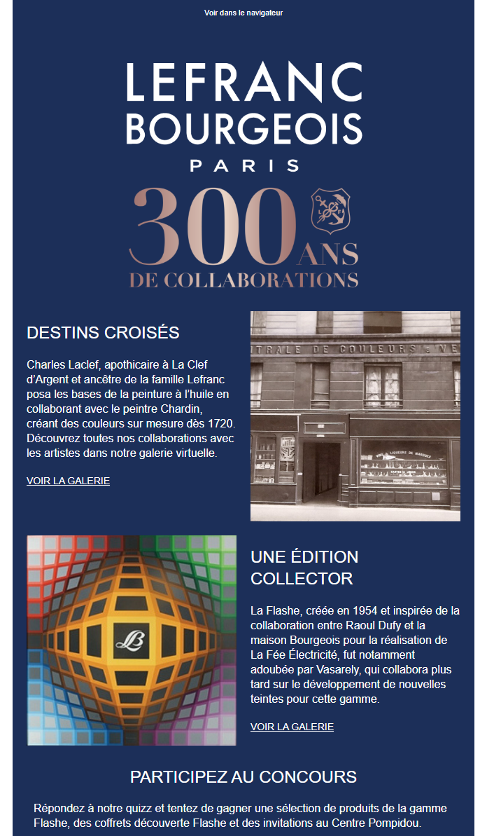







SOCIAL ACTIVATION
Posts 2,6 M Reach
Newsletters 10K Reach

Slide 13



300th ANNIVERSARY SETS COLLECTION
4 sets
Vintage packaging
Oil/Acrylic/Gouache/Ink
Golden Ticket

Slide 14
We will continue to celebrate in 2021….

Slide 15





2020 and beyond….
Vasarely exhibition in Le Mans
Relaunch Charbonnel
300th celebration in Q1 2021

Slide 16
Special Edition Lefranc Bourgeois “Pratiques des Arts” magazine

