Slide 1
Welcome to your new PowerPoint template!
Internal + External: Suitable for both, if you’re sharing externally make sure to save your presentation as a pdf.
Format: We have provided a wide selection of slides to help you in creating your presentations and a library of additional slides will be provided through the intranet..
Images: If you’d like to add new images, please have a look at the Colart brand images on The Bank
Colours: If you look at the ‘Design’ tab, there’s a ‘Colart’ colour theme which you should try to adhere to
Font: You should use the ‘Colart Standard’ family of fonts throughout your presentations.

Slide 2
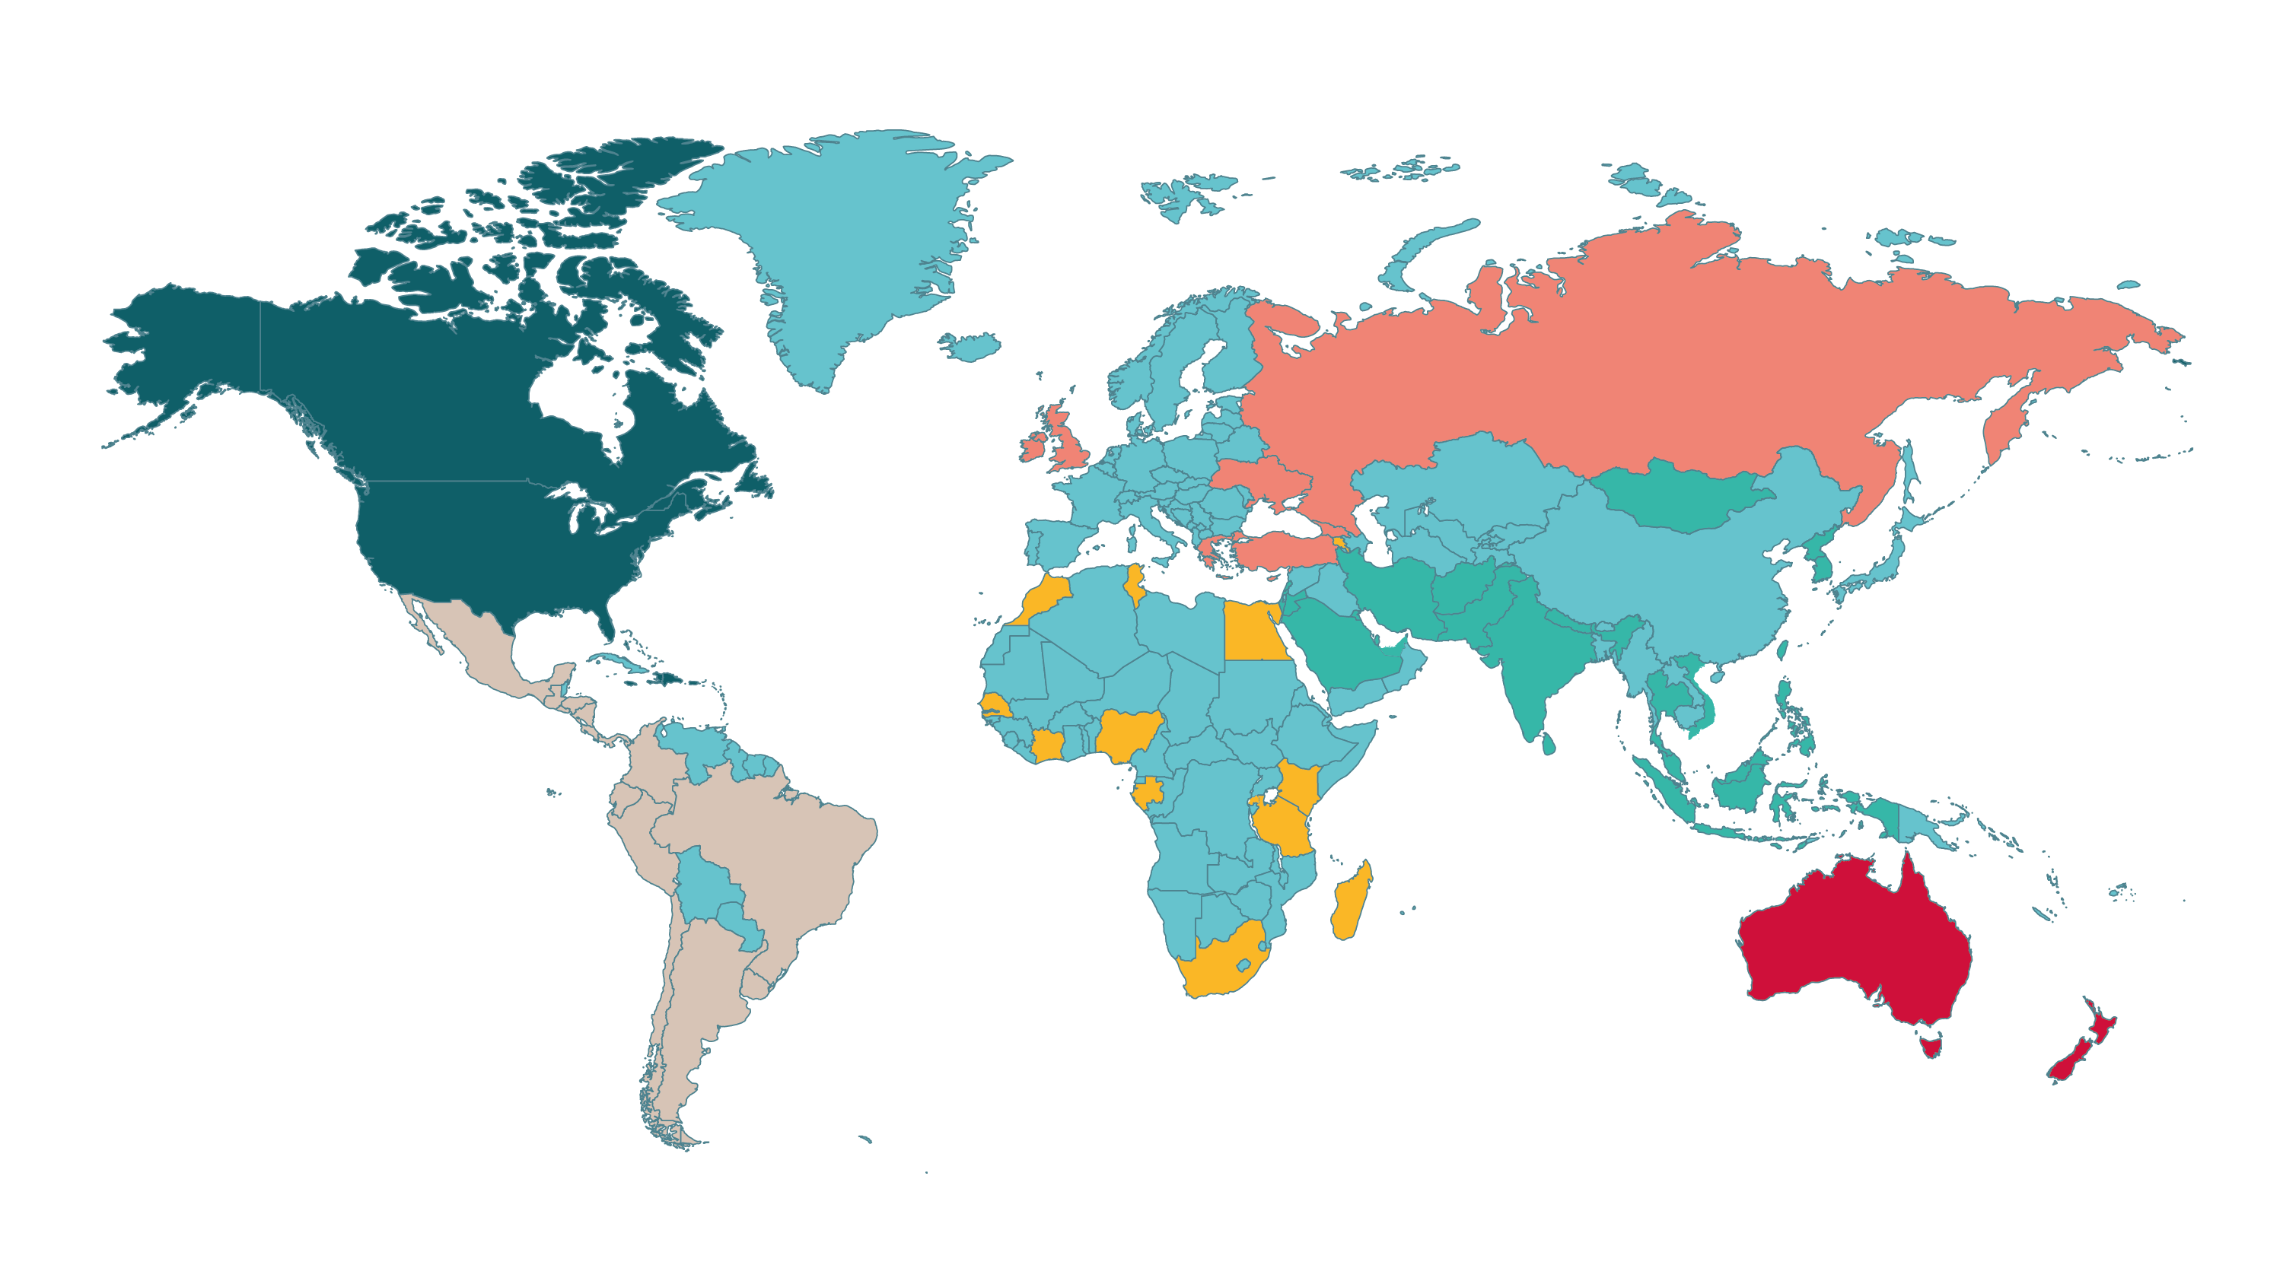
Commercial Map
Europe
Northern America
Asia
Latin America
Oceania
Africa

Slide 3
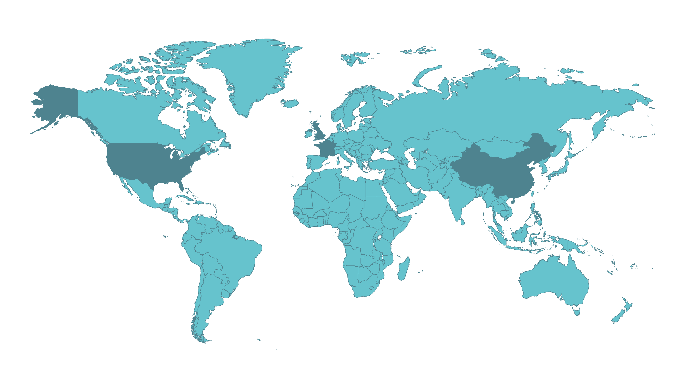
Our Operations
Minehead, Lowestoft + Kidderminster, UK
Piscataway, USA
Le Mans, France
Tianjin, China

Slide 4
Maps

Slide 5
Maps

Slide 6
Maps
-

Slide 7
Maps

Slide 8
Maps

Slide 9
Maps

