Slide 1
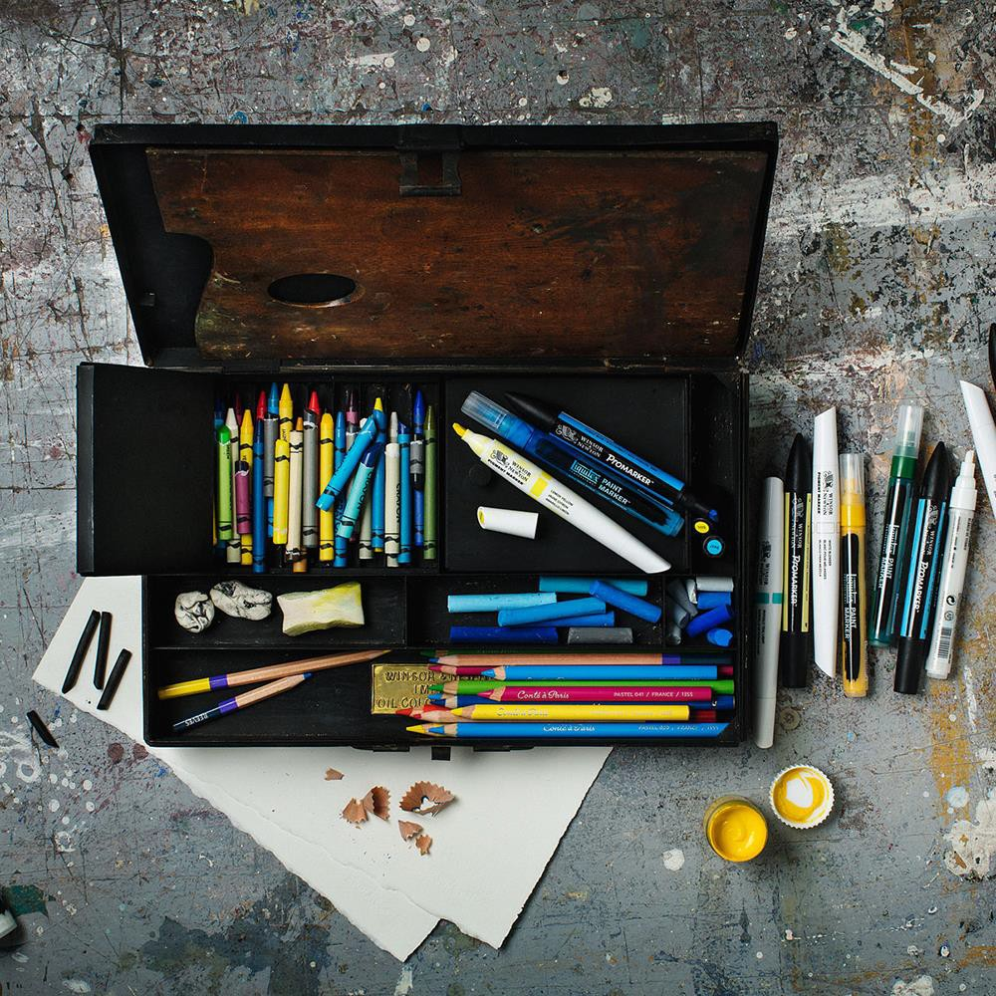
Colart Briefing Pack
London
January 2021
Colart International Holdings Ltd. The Studio Building, 21 Evesham Street, London, W11 4AJ
+44 (0) 208 424 3200 | info@colart.com | colart.com

Slide 2
About Colart
Some of the most famous artists in the world have used our brands to create spectacular work. We have some of the oldest and most respected brands on the planet. The only thing deeper than our roots is our belief that art makes a difference and what we do gives people the opportunity to express themselves and to explore their creativity. No matter what his or her ambitions, everyone can be an artist.
From the paintbrush to the printing press – creative revolutions begin with the tools. Today, the tools are more powerful than ever and more readily available. Digital and traditional tools exist side-by- side, blurring boundaries. We live in an age where anyone with something to say can express it in hundreds of ways. Whether it be through drawing, photography, painting, singing, dancing, Instagram, Snapchat – everyone can inspire and be inspired. It’s a truly creative revolution about to begin. In a world of robots, Virtual Reality and Artificial Intelligence, creativity and relationships are more at the core of being human than ever. And at Colart, we provide the tools to express this uniquely human experience.
However, it’s not enough to just have the best brands on the market, we also need the most dedicated, motivated and professional employees. Every employee is an ambassador of Colart, and how we are perceived. Every contact with Colart is a moment of truth that can either weaken or
strengthen our company’s brand.
We provide sustainable, creative tools and services to release pure expression whilst inspiring every artist in the world.
An International Company
Colart operates in a truly international marketplace. Whether they are professionals or amateurs, people paint in every country in the world. In fact, the ability of painting to transcend geographic and linguistic barriers has on several occasions been the inspiration for collaborative projects between our organisation and the United Nations.
The Colart Group is the leading supplier of colour and associated art material products across the world, including products such as brushes and surfaces which are designed for use by artists of all abilities. We enjoy over a one-third share of the world market for artists’ colours, as well as being a leading supplier of colour products to the education and craft markets.
Distribution channels vary widely by market and by product category, ranging from traditional fine art retailers to mass market retailers. We also sell to many other outlets such as stationary and toy stores, which are important in certain markets. One aspect that is consistent in all markets is the recognition and need to educate and support our end consumer - the artist.
Colart subsidiaries operate in 11 countries and are supported by a cohesive international network of independent distributors. Altogether, Colart brands are sold in over 120 countries, through thousands of distributors and retailers to millions of consumers. We carry a broad product range to satisfy the varying demands of artists, crafters and children. Up to 12,000 items may be stocked in any one Colart company. We recognise that every single Colart customer demands that orders are serviced at speed and with total reliability, with the maximum possible fulfilment rate. For these reasons, our top financial priority is to invest in those aspects of the business which can positively influence customer service.
Colart International Holdings Ltd. The Studio Building, 21 Evesham Street, London, W11 4AJ
+44 (0) 208 424 3200 | info@colart.com | colart.com

Slide 3
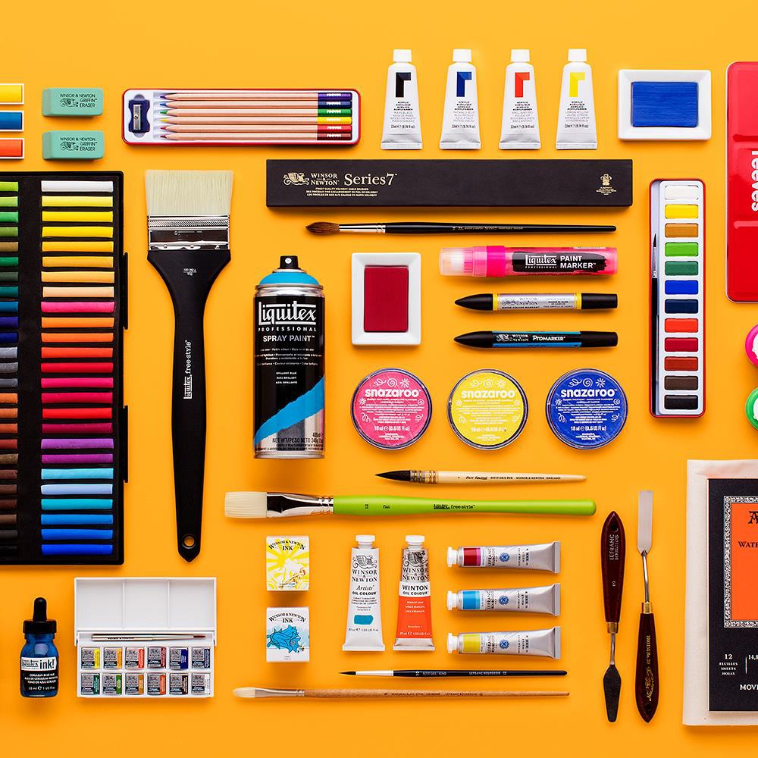
Categories
& Our Brands
London
October 2017
Colart International Holdings Ltd. The Studio Building, 21 Evesham Street, London, W11 4AJ
+44 (0) 208 424 3200 | info@colart.com | colart.com

Slide 4
Creative Tool Categories
Oil Colour
A large range of oil colours offering supreme quality and excellence suiting all levels of expertise from professional artists to students to amateurs.
Watercolour
As the inventors of the moist water colour we never underestimate the importance of using the purest pigments and gums to provide colours of unsurpassed brilliance and transparency suiting all levels of expertise from professional artists to students to amateurs.
Acrylic Colour
Brilliance of colour and extreme versatility are the hallmarks of our acrylics. Not only do we cover quality for artists, students and amateurs but we also cater for craft users with their different needs.
Gouache
The brightest, strongest gouache colours for artists and designers also widely used in fine art as an opaque water colour. The range includes a poster colour range for education.
Pastels
High quality pastels with brilliance of colour and smooth, supple texture.
Easels
A comprehensive range of high quality easels for sketching and studio work.
Inks
Drawing Inks and Calligraphy Inks with outstanding brilliance of colour.
Brushes
For over 150 years we have been producing the finest quality artists’ brushes combining expert craftsmanship with the highest grade materials.
Surfaces, Canvas, Paper
A wide range of high quality papers, canvas and surfaces for all media suiting the varying needs of expertise from professional artists to students to amateurs.
Mediums, Varnishes
A wide selection of oils and mediums to use with all types of colour and a variety of varnishes both modern and traditional.
Marker Pens
A comprehensive range of high quality marker pens for the graphic, craft and art market.
Accessories
Painting and Drawing accessories to suit every need of the artist whether professional, student or beginner including a wide range of instructional media for supporting the wider artist community allowing them to explore the full potential of our products
Colart International Holdings Ltd. The Studio Building, 21 Evesham Street, London, W11 4AJ
+44 (0) 208 424 3200 | info@colart.com | colart.com

Slide 5





Colart Brands
Our Brands
Our brands are at the heart of our business, and their unique heritage dates back to the 18th century.
We are commited to nurturing and developing these great brands. We do this by celebrating their diversity, fostering their individuality and preserving the unique elements of heritage.
At the same time, we constantly respond to the changing needs of artists by improving the performance of our product ranges through the application of the latest available technology.
Today, Colart is the world's leading artist's materials company, and through our brands we deliver true inspiration.
Founded 1832
Winsor & Newton is committed to the pursuit of perfection. Ever since it was founded by the partnership of chemist William Winsor and artist Henry Newton it has been a driving force in developing colour chemistry, pioneering art materials, and key developments within fine art practice
Founded 1766
Reeves, founded at a time when art was synonymous with tradition, is a brand that champions creativity. Offering a comprehensive portfolio of creative tools, Reeves seeks to guide and inspire every generations keen creative; simplifying and democratising the benefits of art.
Founded 1720
A pioneer in fine art colour, materials and tools. The two founders combined their botanical, biological and visionary skills to define the natural origins of iconic pigments. Today, their broad range of fine art, children’s and craft products are made to the same exacting standards.
Founded 1955
The world’s leading acrylic artist paint brand. Liquitex was the first water-based acrylic paint created in 1955 and since then they have partnered with artists to ensure that they continually evolve and innovate – resulting in a long history of acrylic innovation.
Founded 1795
Frenchman Nicolas Conté created the pencil as we know it. Used by masters like Delacroix, Degas and Picasso, Conté à Paris pencils, pastels, crayons and charcoals have changed the face of art – and are considered to be amongst the best drawing materials in the world.
Founded 1989
Snazaroo is the leading choice for quality and high standard face paint. Snazaroo celebrates childhood and provides the essentials for tapping into the joys of transformative play, with the best in face painting products and inspirational, simple and easy to follow step-by-step guides.
Colart International Holdings Ltd. The Studio Building, 21 Evesham Street, London, W11 4AJ
+44 (0) 208 424 3200 | info@colart.com | colart.com

Slide 6

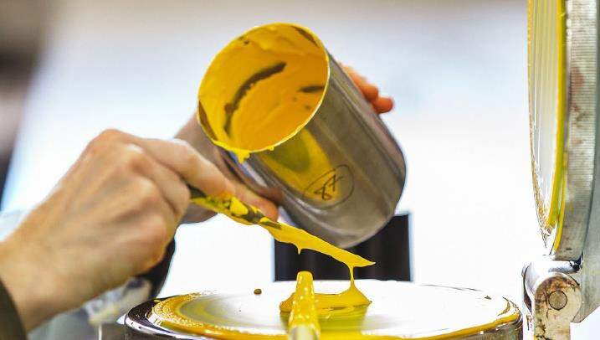
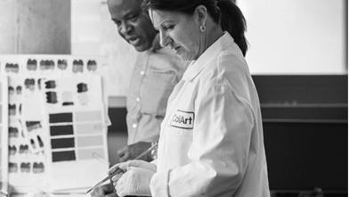
Founded 2009
With a goal to create a global community of creative hobbyists, students and professionals and provide them with their fix of culture, experience, product and personal development, Elephant offers a unique set of creative services including editorial, print and distribution.
With a renowned bi-annual art culture magazine with distribution in 19 countries, Elephant secures some of the most inspirational and creative premium content by partnering with some of the worlds most innovative companies.
Innovative Art Materials
Born from intensive research, development and dialogue with artists, our combination of technical expertise and consumer understanding delivers a unique and superior product offering to the market. For example, Artist Acrylic ensures no colour shift from wet to dry. Previously a limitation, common to all other competitive acrylic ranges. It literally means that with Artists Acrylic what you see when wet is what you get when the painting is dry. A benefit only possible thanks to our chemists who looked to other industries for inspiration.
Through testing the original product with selected artists, marketing quickly discovered that no colour shift also meant a new level of colour brilliance was achieved. In order to showcase this colour brilliance to artists marketing, operations and purchasing developed a new artwork with hand painted labels. A first for the whole Colart Group and not without its challenges. However close cross- functional collaboration overcame all hurdles and today the project team is proud to see the ongoing success of Artists Acrylic.
A second example is the new Liquitex Professional Spray Paint. Using innovative water-based technology, it has the unique benefit of being low odour and does not carry the skin or eye irritant warnings associated with other spray paints.
Liquitex Professional Spray Paint provides the same vibrancy, permanence and performance that Liquitex is known for, can be cleaned up with water when wet, and is permanent when dry, making it ideal for both indoor commissions and for use within an educational environment.
Colart International Holdings Ltd. The Studio Building, 21 Evesham Street, London, W11 4AJ
+44 (0) 208 424 3200 | info@colart.com | colart.com

Slide 7
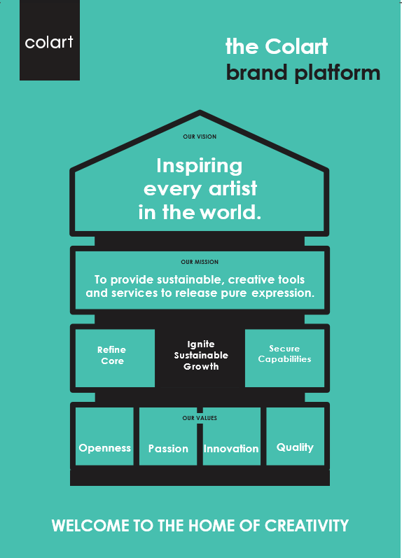
The Colart
Brand
Brand Platform
The universal language of art has the power of bringing people together.
At Colart, our role has always been to provide the tools needed to unleash freedom of expression in any shape or form. As we continue on our journey, there will be increased demand for our products at home, in the studio and even in the corporate workplace. The creative industry is growing and we will be there to meet that demand.
Colart International Holdings Ltd. The Studio Building, 21 Evesham Street, London, W11 4AJ
+44 (0) 208 424 3200 | info@colart.com | colart.com

Slide 8
Business and Culture
Welcome to the home of creativity
Culture can be defined as “the sum of all attitudes and behaviours within an organisation” – a platform to build on. To create a successful culture, it’s important for all of us to live and share the same vision, mission and values. By living according to these principles, the same cultural pattern will be woven over and over again. The results will not only be a more united business, it will attract and motivate the people who share our values. A strong culture is fundamental to building a sustainable business with an agile mind-set, and everything will be based on the principles found in our Brand Platform.
Our Vision
Inspiring every artist in the world
A journey doesn’t start with the first step, it starts with the last: the destination. The destination defines both the journey, those who take it, and every step along the way. Our vision is bold for a reason: we want to make a difference and spread the joy of being creative. There’s an artist in everyone and our vision is to inspire every one of them!
Our Mission
To provide sustainable, creative tools and services to release pure expression
Creativity is pure expression. It comes from nowhere and shapes our lives - from inventions to works of art to new ways of seeing ourselves. Our company is part of the creative process. Our materials and services are both traditional and modern, and our commitment to sustainability and creativity mean that Colart will remain innovative in an age of creative revolution. In short: what we do every day matters because we make the world more colourful and creative.
Our Values
Our values describe how we do things at Colart. They ensure that we’re all working together and pulling in the same direction. If we live these values, the same pattern will be woven again and again to create a strong culture and brand. And if we think sustainability in everything we do, that brand will be truly remarkable.
Openness
Being respectful and transparent
The key to growing as a company and as individuals is the same – being tuned in to the people around us. Colart has the talent to make a real difference in the art world if we nurture an open culture where we are free to learn from both successes and mistakes.
Passion
Enjoy to Perform
We want to empower our people to bring out their true potential. Having a genuine consumer focus and striving to excel builds the confidence and pride that is at the heart of all success.
Innovation
Challenging the status quo
You can’t lead from the middle of the crowd. You have to think ahead, be creative and just a little disruptive. We must make bold decisions that not only lead the industry but drive it.
Quality
Striving for excellence
Our heritage is an important stamp of quality for our customers and consumers, and we must remain true to this history. Quality must also be at the forefront of how we act as an employer and how we deliver on customer service.
Colart International Holdings Ltd. The Studio Building, 21 Evesham Street, London, W11 4AJ
+44 (0) 208 424 3200 | info@colart.com | colart.com

Slide 9
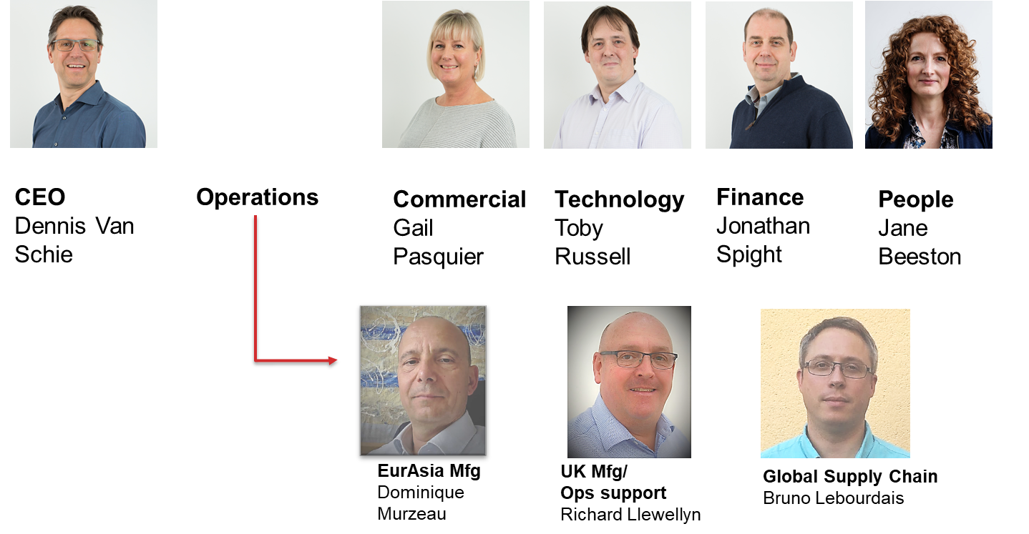

Our Strategy
Our Strategy comprises of three core focus areas, which are how we will deliver success:
Refine Core
Ignite Sustainable Growth
Secure Capabilities
We are committed to our Long Range plan of creating growth, which will involve necessary investments.
Why is it so important to grow the business? The answer is simple: to allow us continue to invest in innovation, a factor that has enabled us to buck the market trend for many years. It also makes it possible to continue investing in our employees through training and development and ensuring the safest possible working environment. Purpose creates Growth which creates Profitability which creates Opportunities. Everything is linked in an economic ecosystem.
Top Level Organisational Structure
Group Leadership Team
Colart Board Members
Dennis Van Schie and Jonathan Spight also sit on the Colart Board
Colart International Holdings Ltd. The Studio Building, 21 Evesham Street, London, W11 4AJ
+44 (0) 208 424 3200 | info@colart.com | colart.com

Slide 10
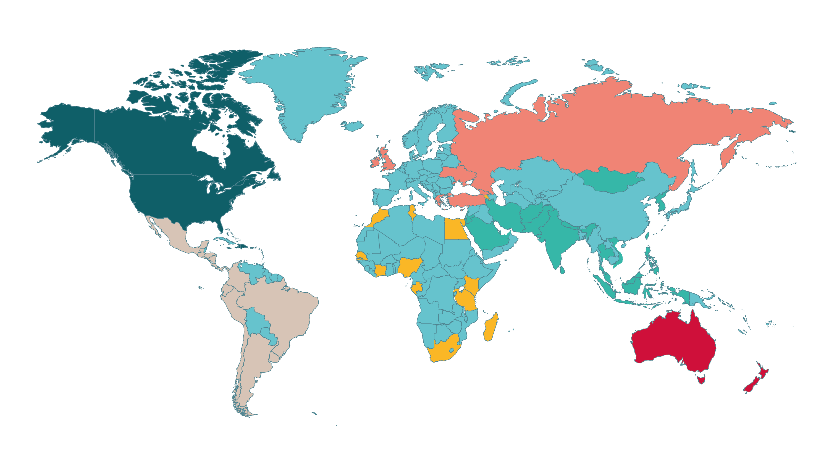
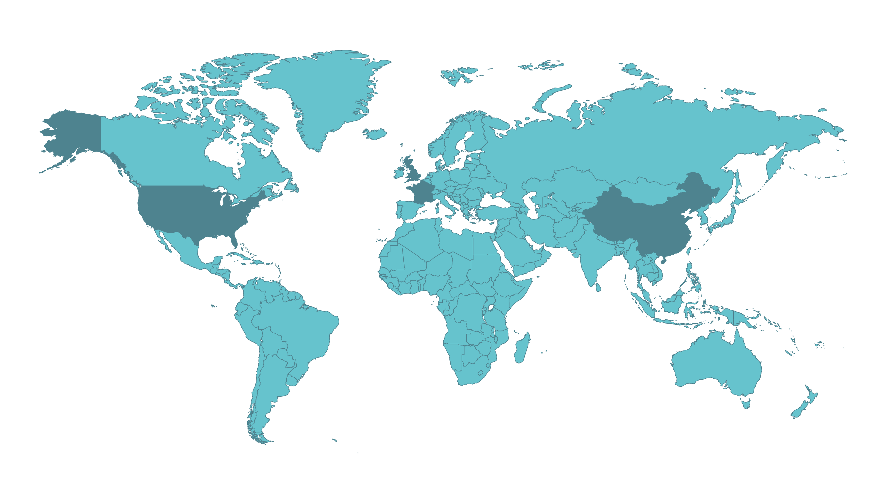
Business Footprint
Commercial
Northern Europe
UK
North America
Southern Europe
China
International
Operations
Minehead, Lowestoft + Kidderminster, UK
Piscataway, USA
Le Mans, France
Tianjin, China
Colart International Holdings Ltd. The Studio Building, 21 Evesham Street, London, W11 4AJ
+44 (0) 208 424 3200 | info@colart.com | colart.com

