Slide 1

Introduction to Legal at Colart

Slide 2
Overview of Slides
Overview of legal team
Scope of support
Legal
Compliance
UK Company Secretary
IP

Slide 3
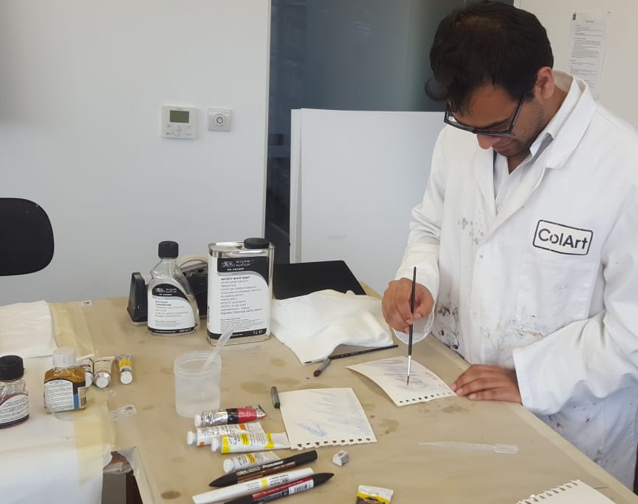
Legal Team
Just me, Group General Counsel
Solicitor, English law qualified
Joined the business in 2019
Based in London Hub
Report into Jonathan
Love the job – great place to work; empowering; ability to have a direct impact on the business; receptive organisation

Slide 4
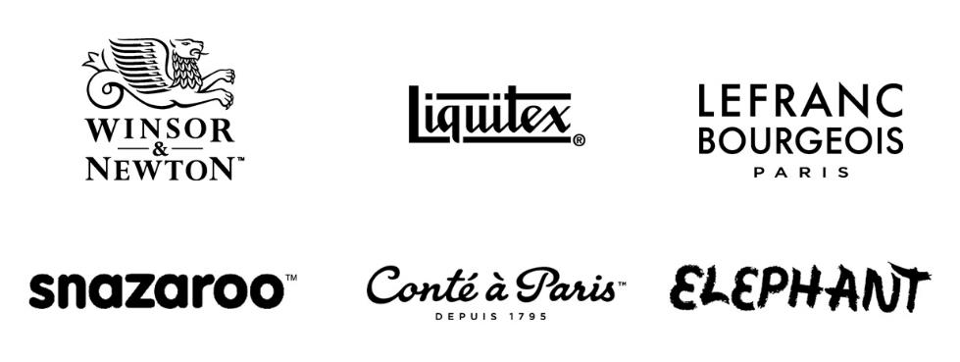
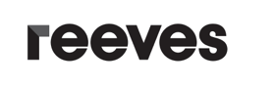
Global
All Leadership Levels
5
4
3
2
1

Slide 5

Legal – what do I do?
General Counsel
Real Estate
Litigation
B2B Commercial – B2B – our suppliers, customers, distributors, artists
B2C Consumer – artists
Ad Hoc matters

Slide 6
Compliance
Employee Code of Conduct
Business Partner Code of Conduct
Data Protection
Gifts & Hospitality
EthicsPoint
Competition Law
Sanctions

Slide 7
UK Company Secretary
Global Entities Tracker
Group Re-organisations
Re-creating all the records of all UK entities
Supporting globally where UK element comes into play

Slide 8
Intellectual Property – ensuring our brands are protected
Trademarks – oppositions, renewals, applications, monitoring (Watching Service), assignments
Copyright – external third parties seeking our permission to use our IP.
Patents
Domains (IT)
Trade secrets / formulations
Counterfeit / ‘passing off’

Slide 9
The End
Thank you.

