Slide 1

2021
First semester
Wellbeing program

Slide 2

SUMMARY
INTRODUCTION
SOCIAL WELLBEING
15
Our vision
New ambassadors
3
4
Community Gardening
Donation activities
Chocolate for Easter
16
17
18
MENTAL WELLBEING
5
Woman’s day & Children’s day
Choose to challenge
Color and painting workshop
Green life style lecture &
Leather product day
Museum WN oil workshop
6
7
8-9
10
11
WELLBEING AMBASSADORS
19
CONCLUSION
20
PHYSICAL WELLBEING
12
Afro Djembel session
Healthy Eating
13
14

Slide 3

OUR VISION
Inspiring Colart’s People Through Living Up To Our Promises By Focusing On Their Wellbeing
OUR WISH
Making each person ENGAGED and PROUD both in their personal and professional lives
Building TEAM SPIRIT and collective social and environmental commitment
Supporting END-TO-END WELLBEING (mental, physical, spiritual and emotional) in and out of Colart
Sharing common values : the values of Colart and the values of art
Sustainably develop our relationship with each other and our environment
Succeed together in the long term to re-energise & share in the beauty/creativity of art
Value our work and leverage our skills & energy to maximise the wellbeing of the greatest number

Slide 4
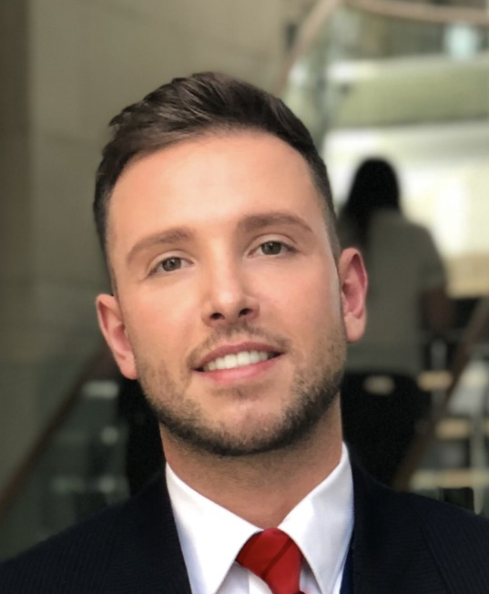
Our wellbeing ambassadors are the ones that make the difference with respect to our ongoing wellbeing activity so first and foremost we are pleased to welcome three new ambassadors:
Italy : Alice Villani
London Hub: Charlotte Caton and Kris Gebis
OUR NEW AMBASSADORS
An interview of Kris Gebis :
Kris, What does Wellbeing mean to you ?
To me, Wellbeing is understood as experiencing life satisfaction across different factors, such as economic, social or personal. In a work context it is about having a good day, being empowered and fit to achieve my potential.
What sort of Wellbeing initiatives and activities has the Wellbeing team launched in Head Office?
There are all sorts of different initiatives and activities that contribute to the Wellbeing of our employees such as quiet/meditation zone in the head office. The London Hub project initiatives are to organize Welcome Drinks in September, Elephant Space is purchasing a BBQ which will allow us to gather all together and engage as a team - this is a great way to meet colleagues and provide some work/life balance to our routine. Furthermore, there is a Wellbeing even calendar which is a great way of planning ahead some events, for example for Halloween, Christmas etc.
What has been the most exciting, interesting or important initiative that you have seen the Wellbeing team perform?
The very interesting/exciting and, undoubtedly, important initiative was recently shared by Jan Lennon. It is to inspire and 'wake up' the inner artist by designing a Christmas Card Challenge 2021. This was a fantastic idea to introduce people to the world of art and engage in collaborative activity. In a way, this initiative will contribute to the wellbeing due to the fact that any artistic activity is proven to help in stress reduction and relaxation.

Slide 5
MENTAL WELLBEING

Slide 6
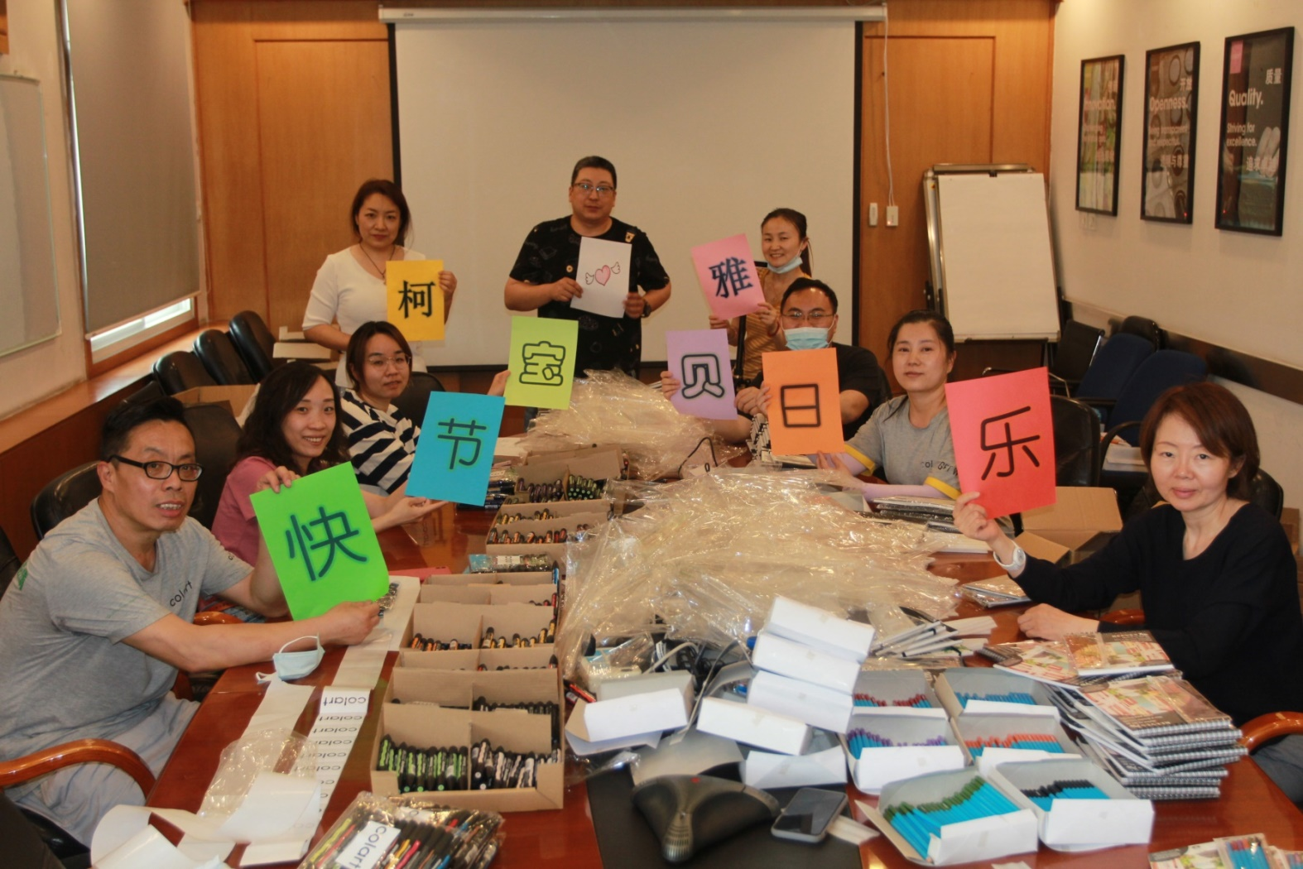
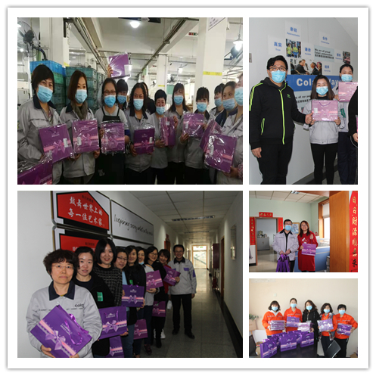

MENTAL WELLBEING
Woman’s day and Children’s day in Colart Tianjin:
Like every 1st June, children in China celebrate International Children’s Day. It is almost a holiday in the schools; so the children take advantage of this moment to carry out playful activities, performances, shows…

Slide 7
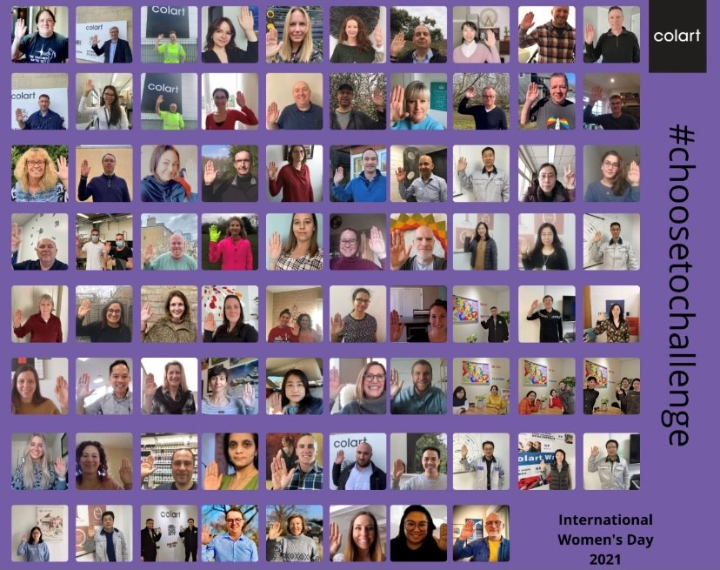
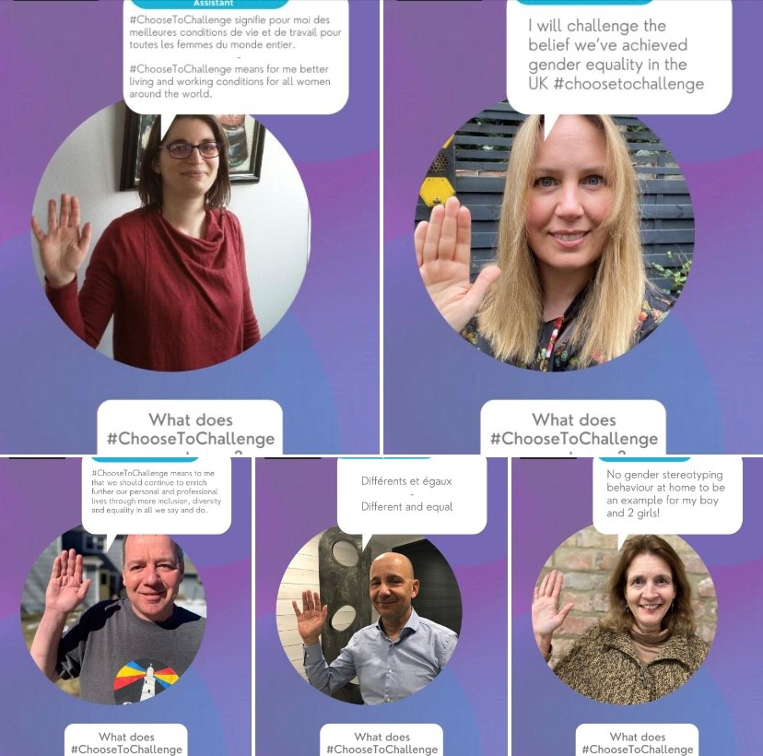
MENTAL WELLBEING
Choose to challenge for woman’s day :
March 8 is International Women’s Rights Day. Worldwide, it resonates as an invitation, an appeal, an incentive to act for gender equality, and more broadly for diversity and inclusion. This year, the ambition holds in three words: choose to challenge.

Slide 8
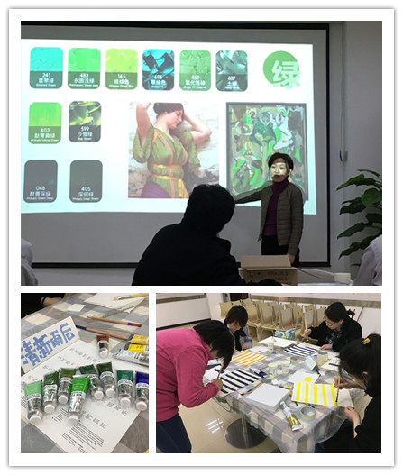
MENTAL WELLBEING
Color and painting workshop in Colart Tianjin

Slide 9
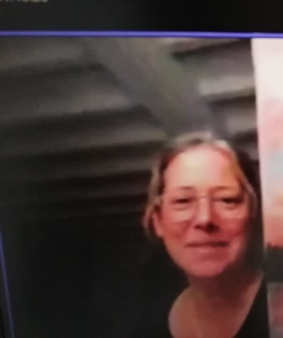
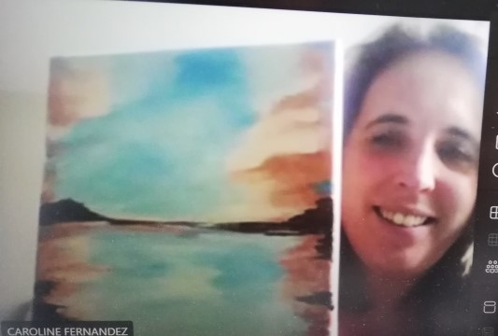

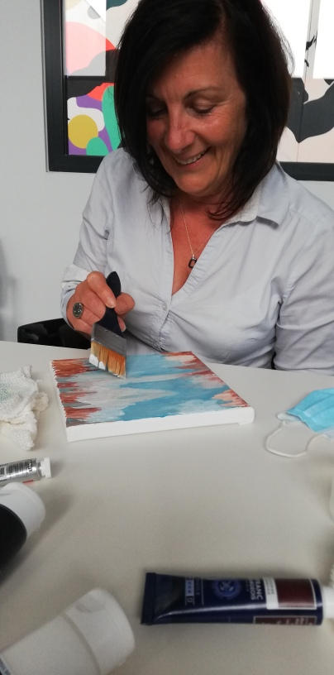
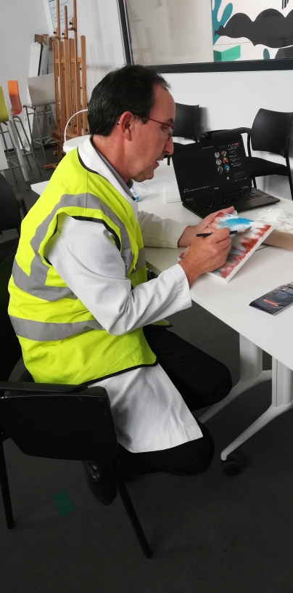
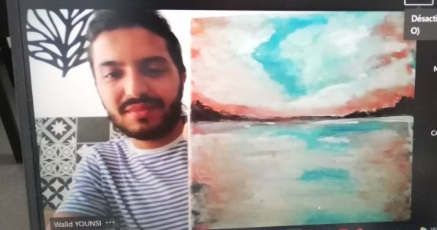
MENTAL WELLBEING
Painting a landscape with Laurent Blandin (artist)
“The wellbeing painting workshop allows to discover the use of products manufactured within the company while discovering a pictorial technique and awakens employees to art”
- By Laurent Blandin, Colart France

Slide 10
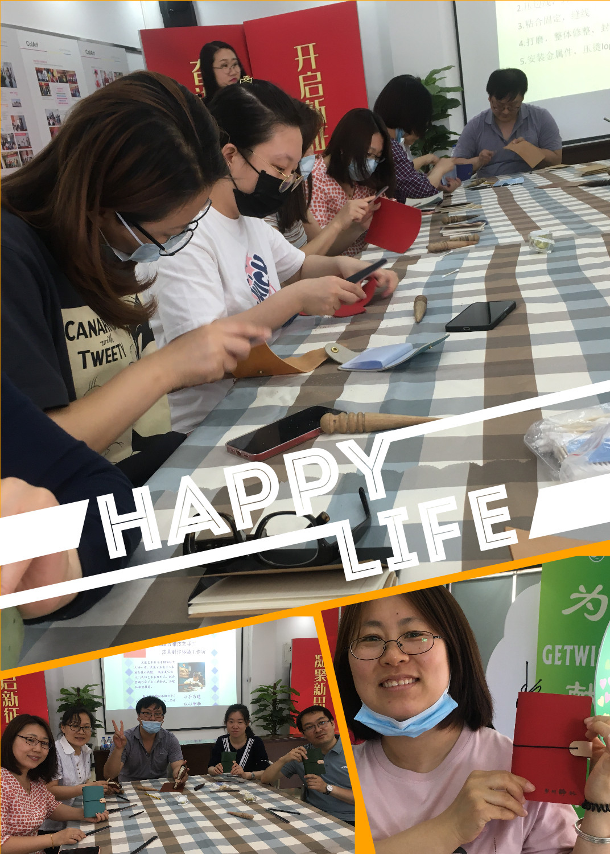
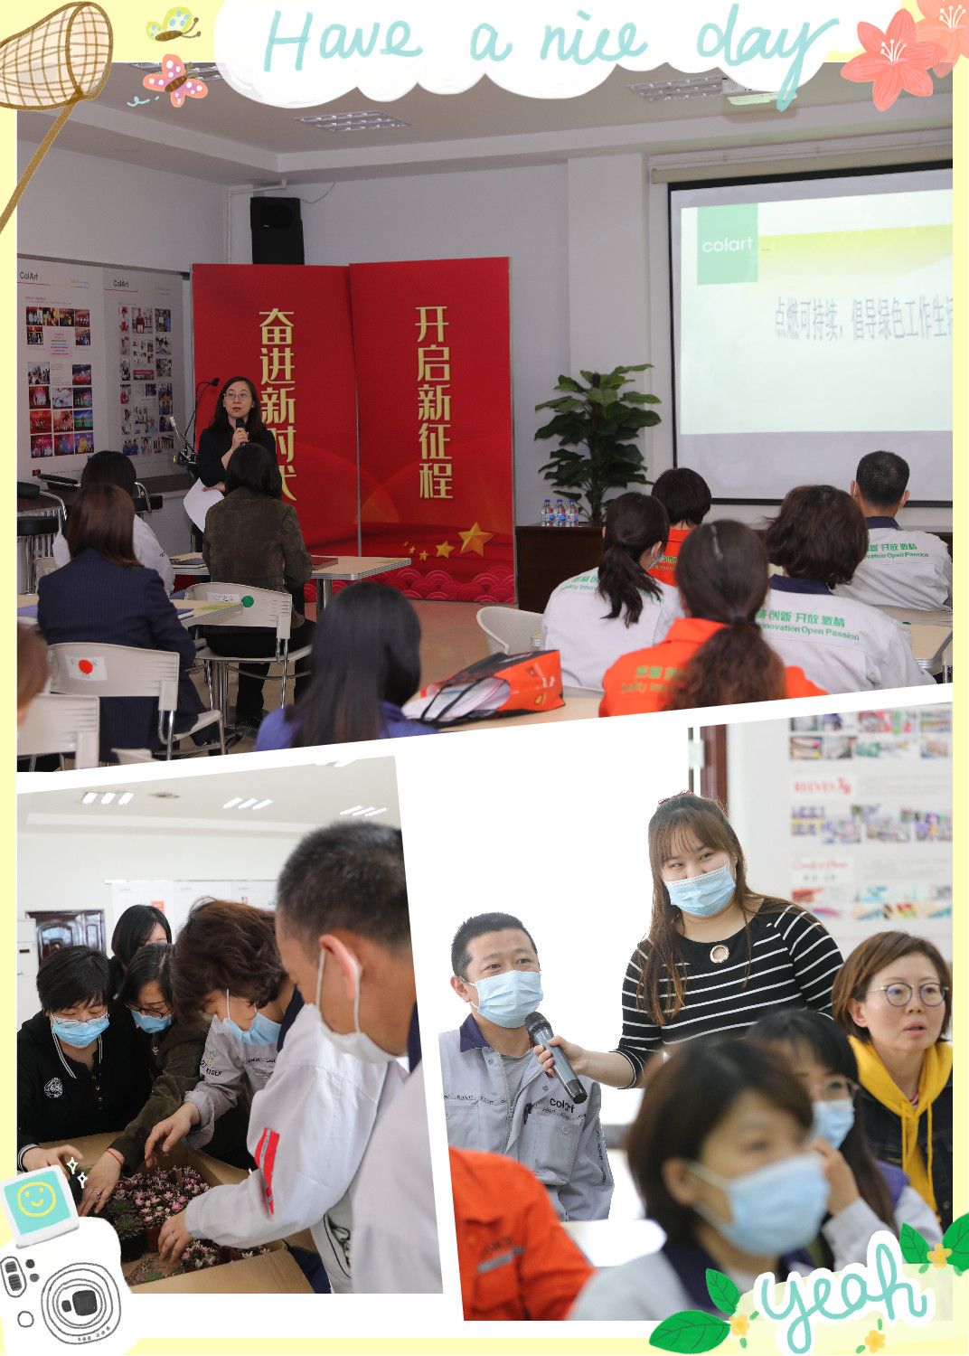


MENTAL WELLBEING
Green life style lecture and Leather product workshop in Colart Tianjin

Slide 11
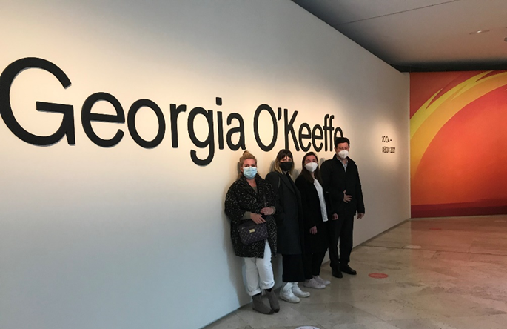
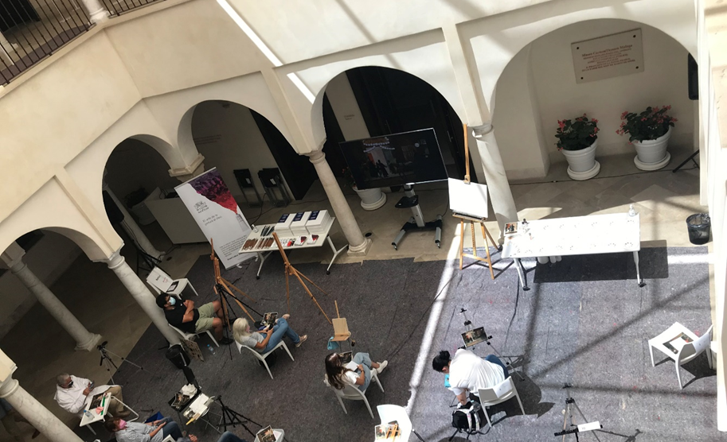
MENTAL WELLBEING
Museum Thyssen Madrid – Exhibition Georgia O’Keeffe from Colart Spain
Museum CAC Thyssen Malaga – WN Oil workshop from Colart Spain

Slide 12
PHYSICAL WELLBEING

Slide 13
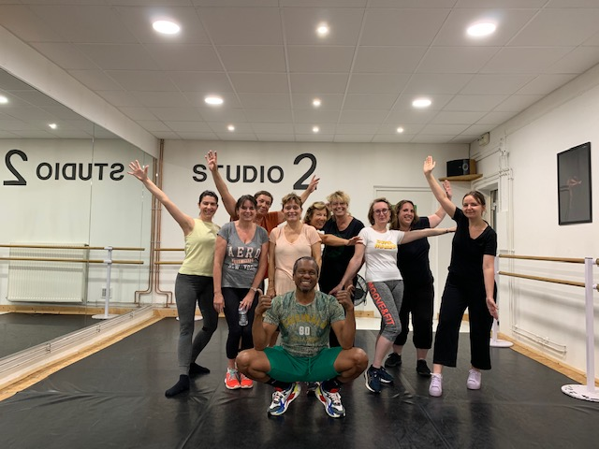

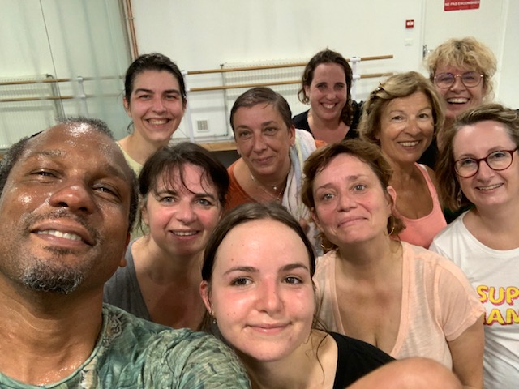
PHYSICAL WELLBEING
Afro Djembel session at le Mans
It feels good a little exercise!
See you on the track. — By Carole Briquet
Thank you for this moment of sharing—By Dominique Touchard

Slide 14
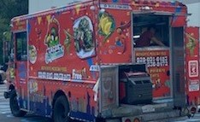
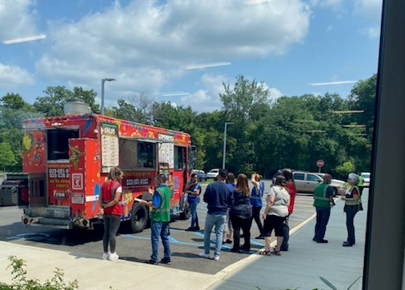
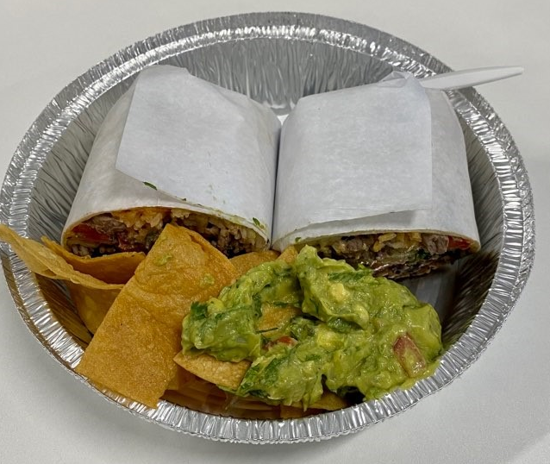
PHYSICAL WELLBEING
Supporting our health eating in Colart North America with a food truck for people in the Distribution Centre

Slide 15
SOCIAL WELLBEING

Slide 16
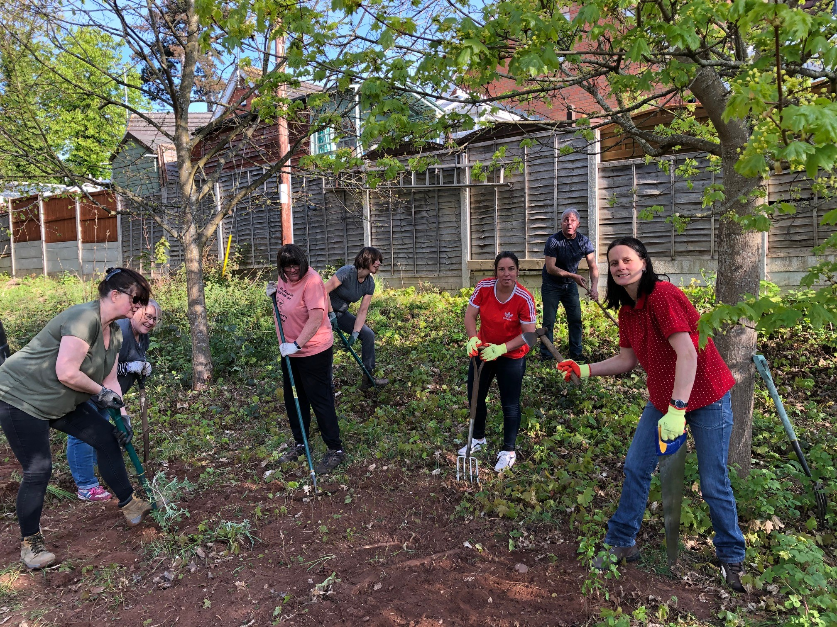
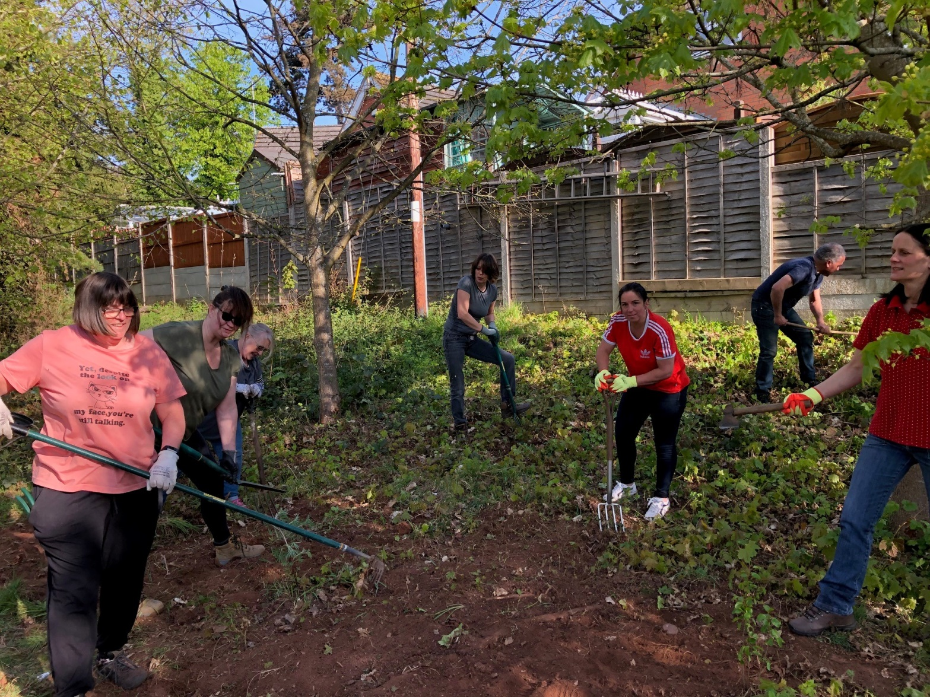
SOCIAL WELLBEING
Gardening session
Fran, Liza, Marcia, Sue, Julie, Ahmed and Jo from Colart Kidderminster busy at work with their spades clearing the weeds

Slide 17
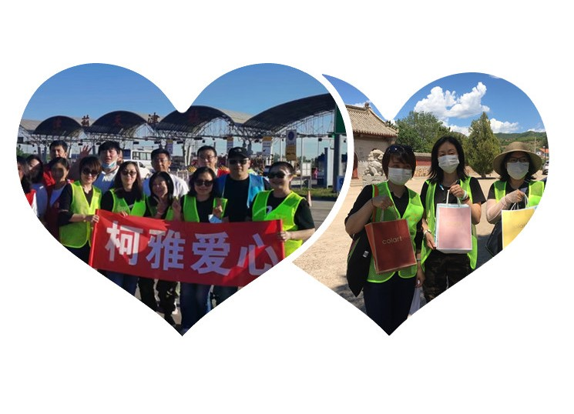
SOCIAL WELLBEING
Colart China activate donations in the community

Slide 18
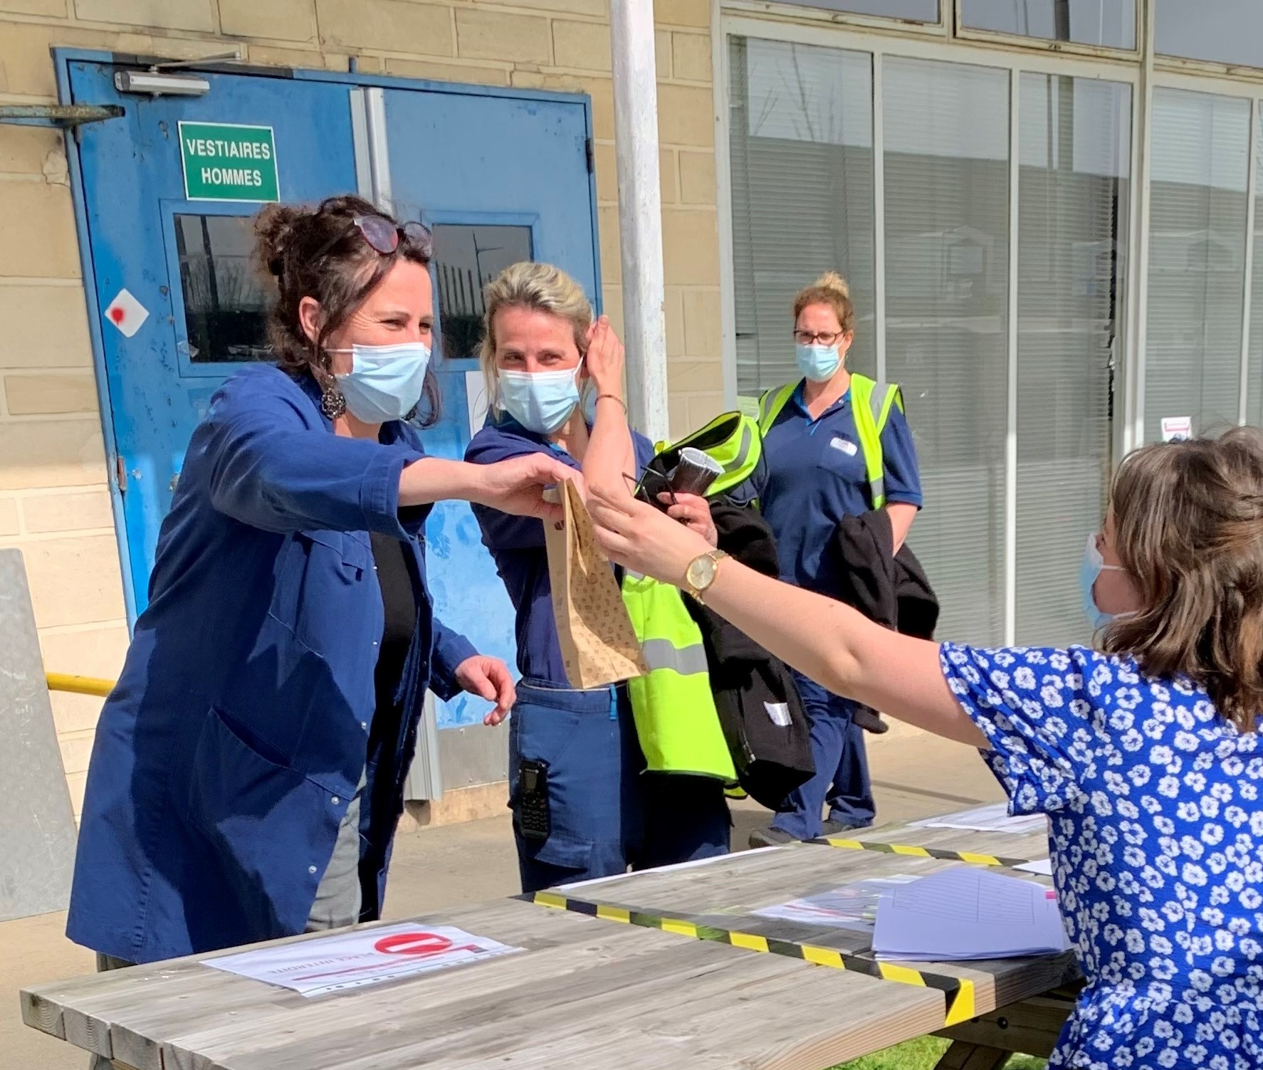
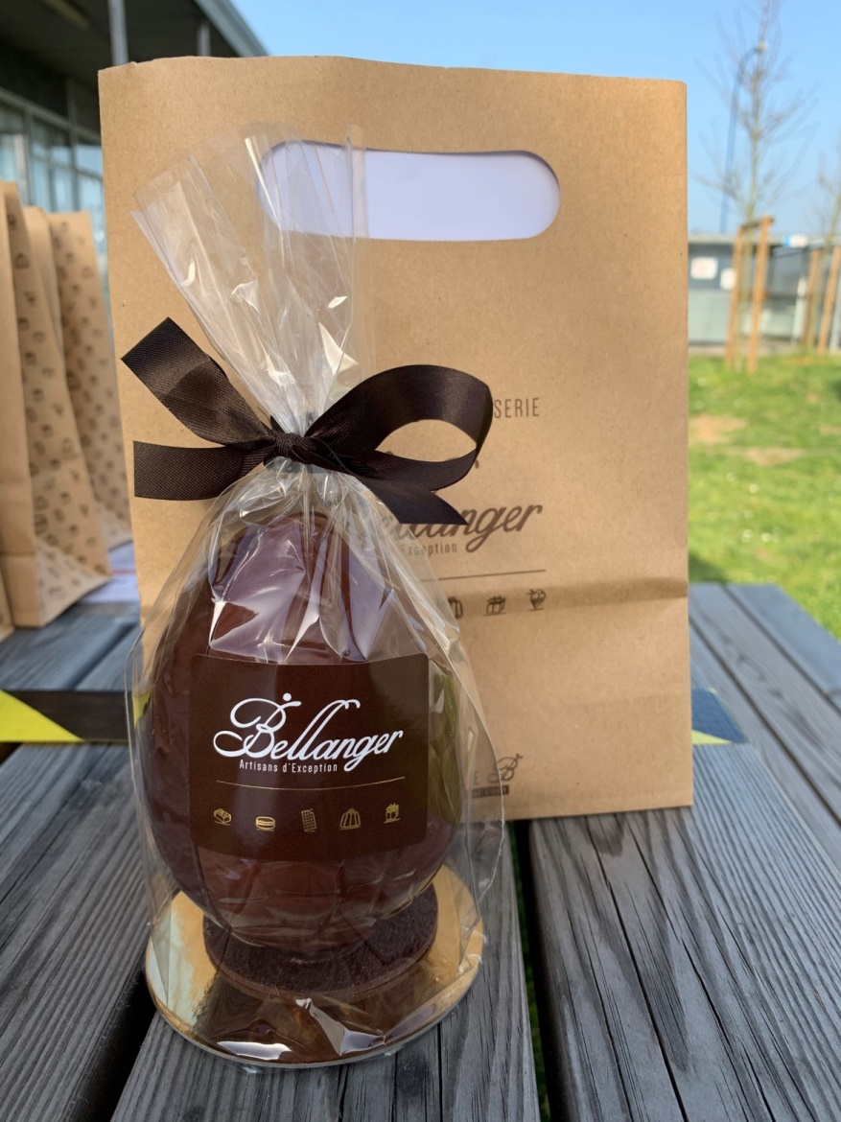
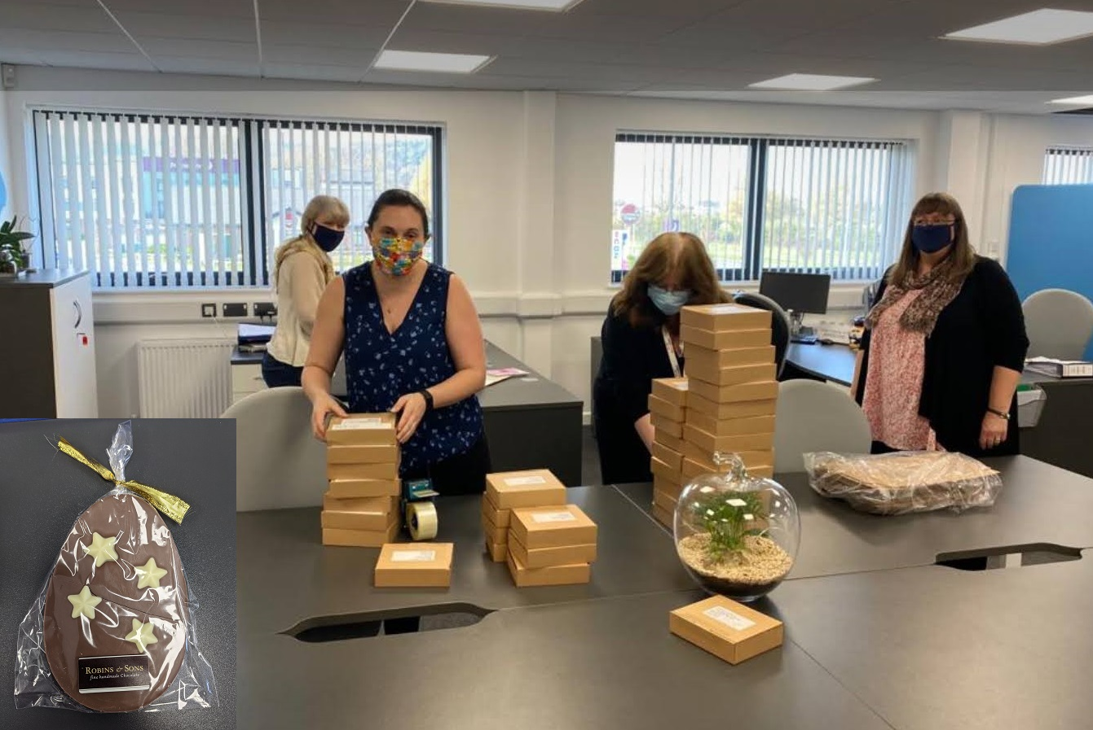
SOCIAL WELLBEING
Distribution of chocolate for Easter in Colart Le Mans
Posting Easter Eggs to people on Furlough in Colart Minehead

Slide 19
QUESTIONS OR COMMENTS ?
Feel free to contact your wellbeing ambassador if you have any questions, comments or ideas:
WELLBEING COORDINATOR - FRANCE
Carole Briquet
LE MANS Sonia Bergeot Geoffroy Cormier Anita David Marc Dumesnil Marie Loones Line Meziere Delphine Moquereau Kevin Viaud NORTH AMERICA April Edwards HEAD OFFICE – UK Kris Gebis Charlotte Caton KIDDERMINSTER – UK Hayley Griffiths Jan Lennon | FRANCE Elise Gerault INTERNATIONAL Manon Roucan CTAM/CHINA Lucy Zhang IBERICA Marta Tinocco ITALY Alice VILLANI MINEHEAD – UK Amanda Giess Mandy Rich Lucy Franklin Dave Gibbs

Slide 20
During the first semester of 2021 ,
We have added colour to our lives, and this is not the end ...

Slide 21


