Slide 1


Project Wisdom
The Launch of WN Shopify
September 2024

Slide 2
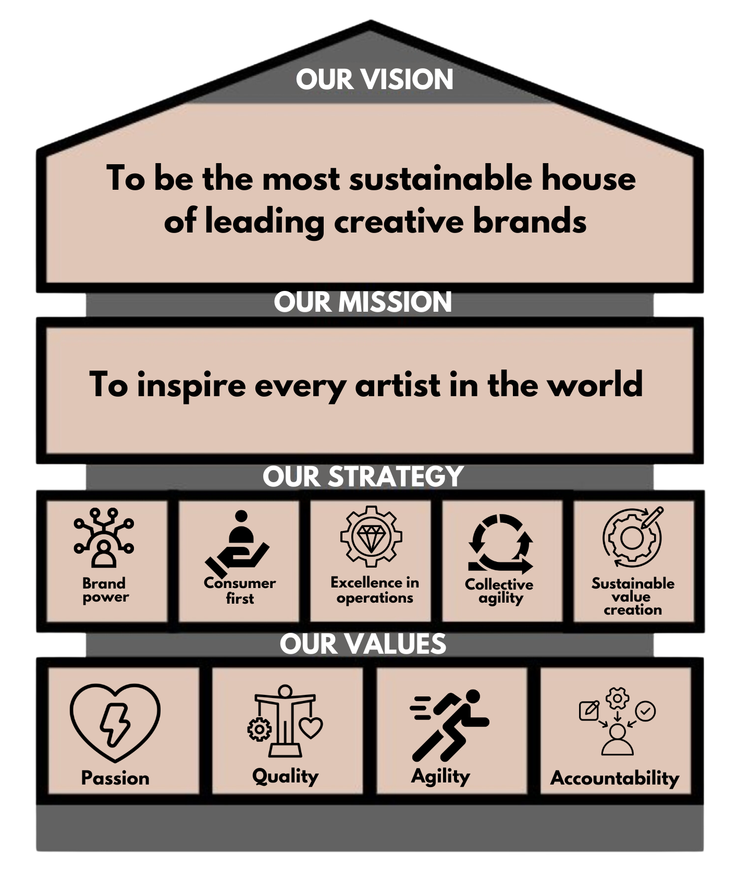






Project Wisdom Overview
Perform 2030
Under our Consumer First strategic pillar, a key priority is to increase the contribution of our brand websites (brand.com) to 10% of net sales by 2030.
Our brand websites enable us to meticulously manage the consumer journey and establish a direct, one-to-one relationship with each consumer.
The initial step in strengthening our brand websites involved migrating to a scalable, best-in-class ecommerce platform, aligning with our future business objectives and ambitions.
Project Wisdom built upon the successes and insights gained from Project Vision, to deliver our second Shopify ecommerce website – Winsor & Newton – earlier than originally planned!
Project Vision
Migrate Liquitex from WordPress to Shopify
2023 Oct
2023 Nov
2024 Feb
2024 April
2024 Sept
2025
Project Wisdom
Migrate Winsor & Newton from WordPress to Shopify
Perform 2030
Consumer First:
Increase the share of our brands websites from 1% to 10% of net sales
Notes:
{Kevin]
Good [morning/afternoon/evening] everyone, I’m excited to share the successful launch of our new Winsor & Newton website on Shopify. This is a significant milestone in our ongoing efforts to enhance our digital presence and drive growth through our brand websites.
Under our Consumer First strategic pillar, one of our key priorities was to increase the contribution of our brand websites to 10% of net sales by 2030. Our brand websites are not just online stores; they’re a direct channel through which we can meticulously manage the consumer journey and build a personal, one-to-one relationship with each consumer.
The first step in enhancing our brand websites was to migrate to a scalable, best-in-class e-commerce platform. This move aligns perfectly with our future business objectives and ambitions. Project Wisdom represents our commitment to our Perform 2030 goal.
Today, we celebrate the successful migration of our largest brand, Winsor & Newton, to Shopify.
This accomplishment not only showcases our capability to adapt and innovate but also sets the stage for migrating our other brands to Shopify in 2025.

Slide 3


Project Wisdom Team
Kevin Lee
Business Sponsor / Product Manager
Ellie Deakin
Global Ecomm
Daniel de la Fuente
Project Manager
Tom Ball
Brand Web Specialist
Tom French
Brand Digital
Danny Morgan
Senior Developer
Natalia Flindall
Web Developer
Tania Sernivka
Web Developer
Giuliano Riosa & Sam Webster
Solutions Architect
Rebecca Smith
SEO
Charlotte Blanc
CLM
Crystal Noble & Rachel Kozak:
Local Ecomm (UK & NA)
Agile teams are dedicated groups of people who don’t move between products or teams just because there’s a demand in a different area of the business this week. Therefore, they become a close-knit and trusted group of colleagues, finding a working rhythm for deliveries.
Key Stakeholders
Gail Pasquier Toby Russell Helly Summerly Anthony Taylor Josh Hart
Daily Stand-ups and monthly Stakeholder meetings
Notes:
{Kevin]
I want to extend a heartfelt thank you to the entire project team for their dedication and hard work in delivering this project on time. Your effort and expertise have been instrumental in making this launch a reality. Additionally, I’d like to express our gratitude to the key stakeholders for their unwavering support throughout this journey.
I will now turn it over to a few members of the Project team to share some additional insights and learnings of Project Wisdom

Slide 4
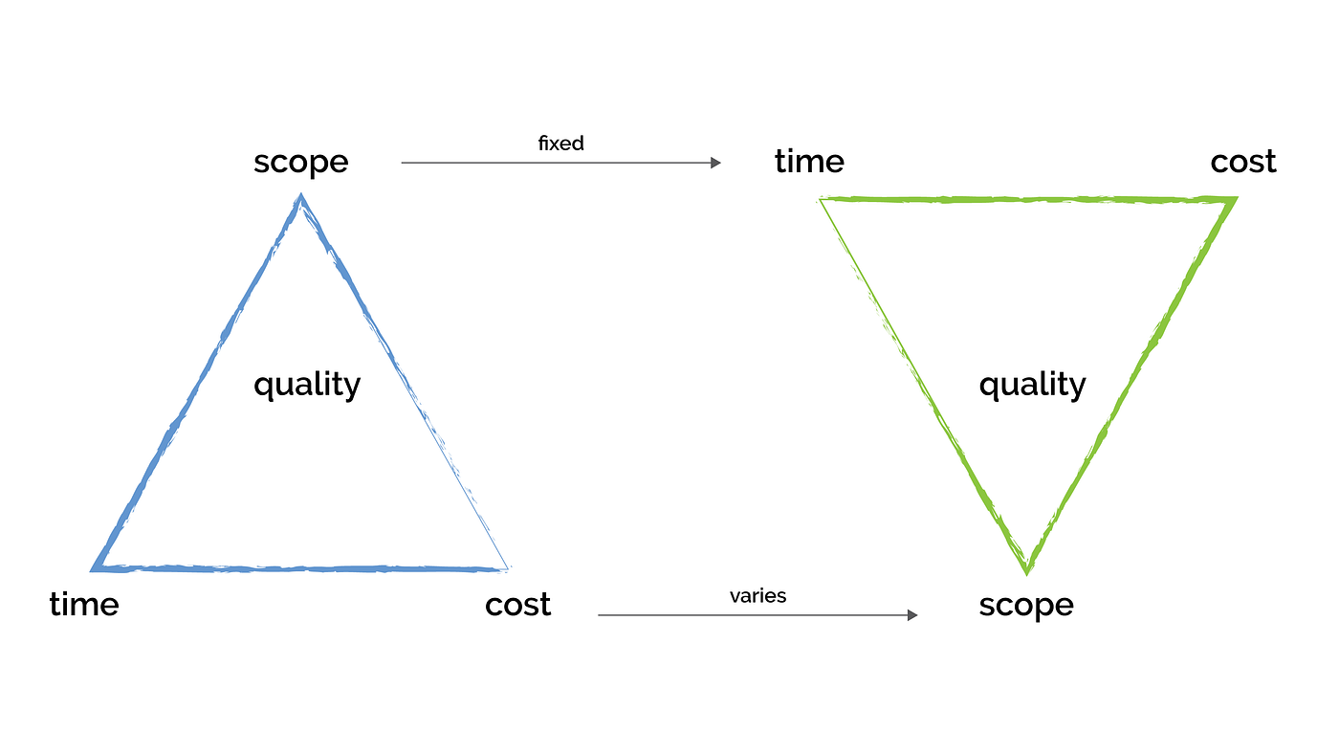
Inspiring Success Through Agile Project Management
Agility in Action
Our team’s agility enabled us to swiftly adapt to changes, making quick, impactful decisions that kept the project moving forward.
Passion for Collaboration
Passion drove our teamwork—through open communication and daily stand-ups, we relied on each other’s strengths to continuously improve and deliver.
Commitment to Quality
By breaking work into sprints, we focused on delivering high-quality results in every iteration, ensuring we met and exceeded expectations.
Shared Accountability
Every team member took accountability not just for their individual roles but for the project’s overall success, creating a culture of trust and ownership.

Slide 5


Bringing ‘Through the eyes of the artist’ to Shopify
X
Notes:
It’s been a big year for Winsor & Newton the brand. We kicked off 2024 with our new brand positioning ‘Through the eyes of the artist’ . This involved updating the previous website, and all the assets that go with it, to reflect and represent the new brand positioning. This was a key first stage and put us in really good stead for the launch of our new website later on.
We also announced a wonderful new partnership with Paul Smith’s Foundation for which there is a dedicated section on the website for.
We have exciting new products hitting the markets this quarter.
And… in the last 5 months, we’ve been working hard behind-the-scenes to build a brand new shopify website … which will support the business DTC ambitions and also continue to improve on the overall brand experience.
So, we’re extremely delighted to have launched the new website, featuring NPDs, brand-led campaigns and enhancements to the navigation, search functionality and product listings, as well as optimisation of our brand content. Such as the community work which we’re really proud of and all the important educational content we offer to artists, all of which Tom Ball will now take you through in more detail.

Slide 6
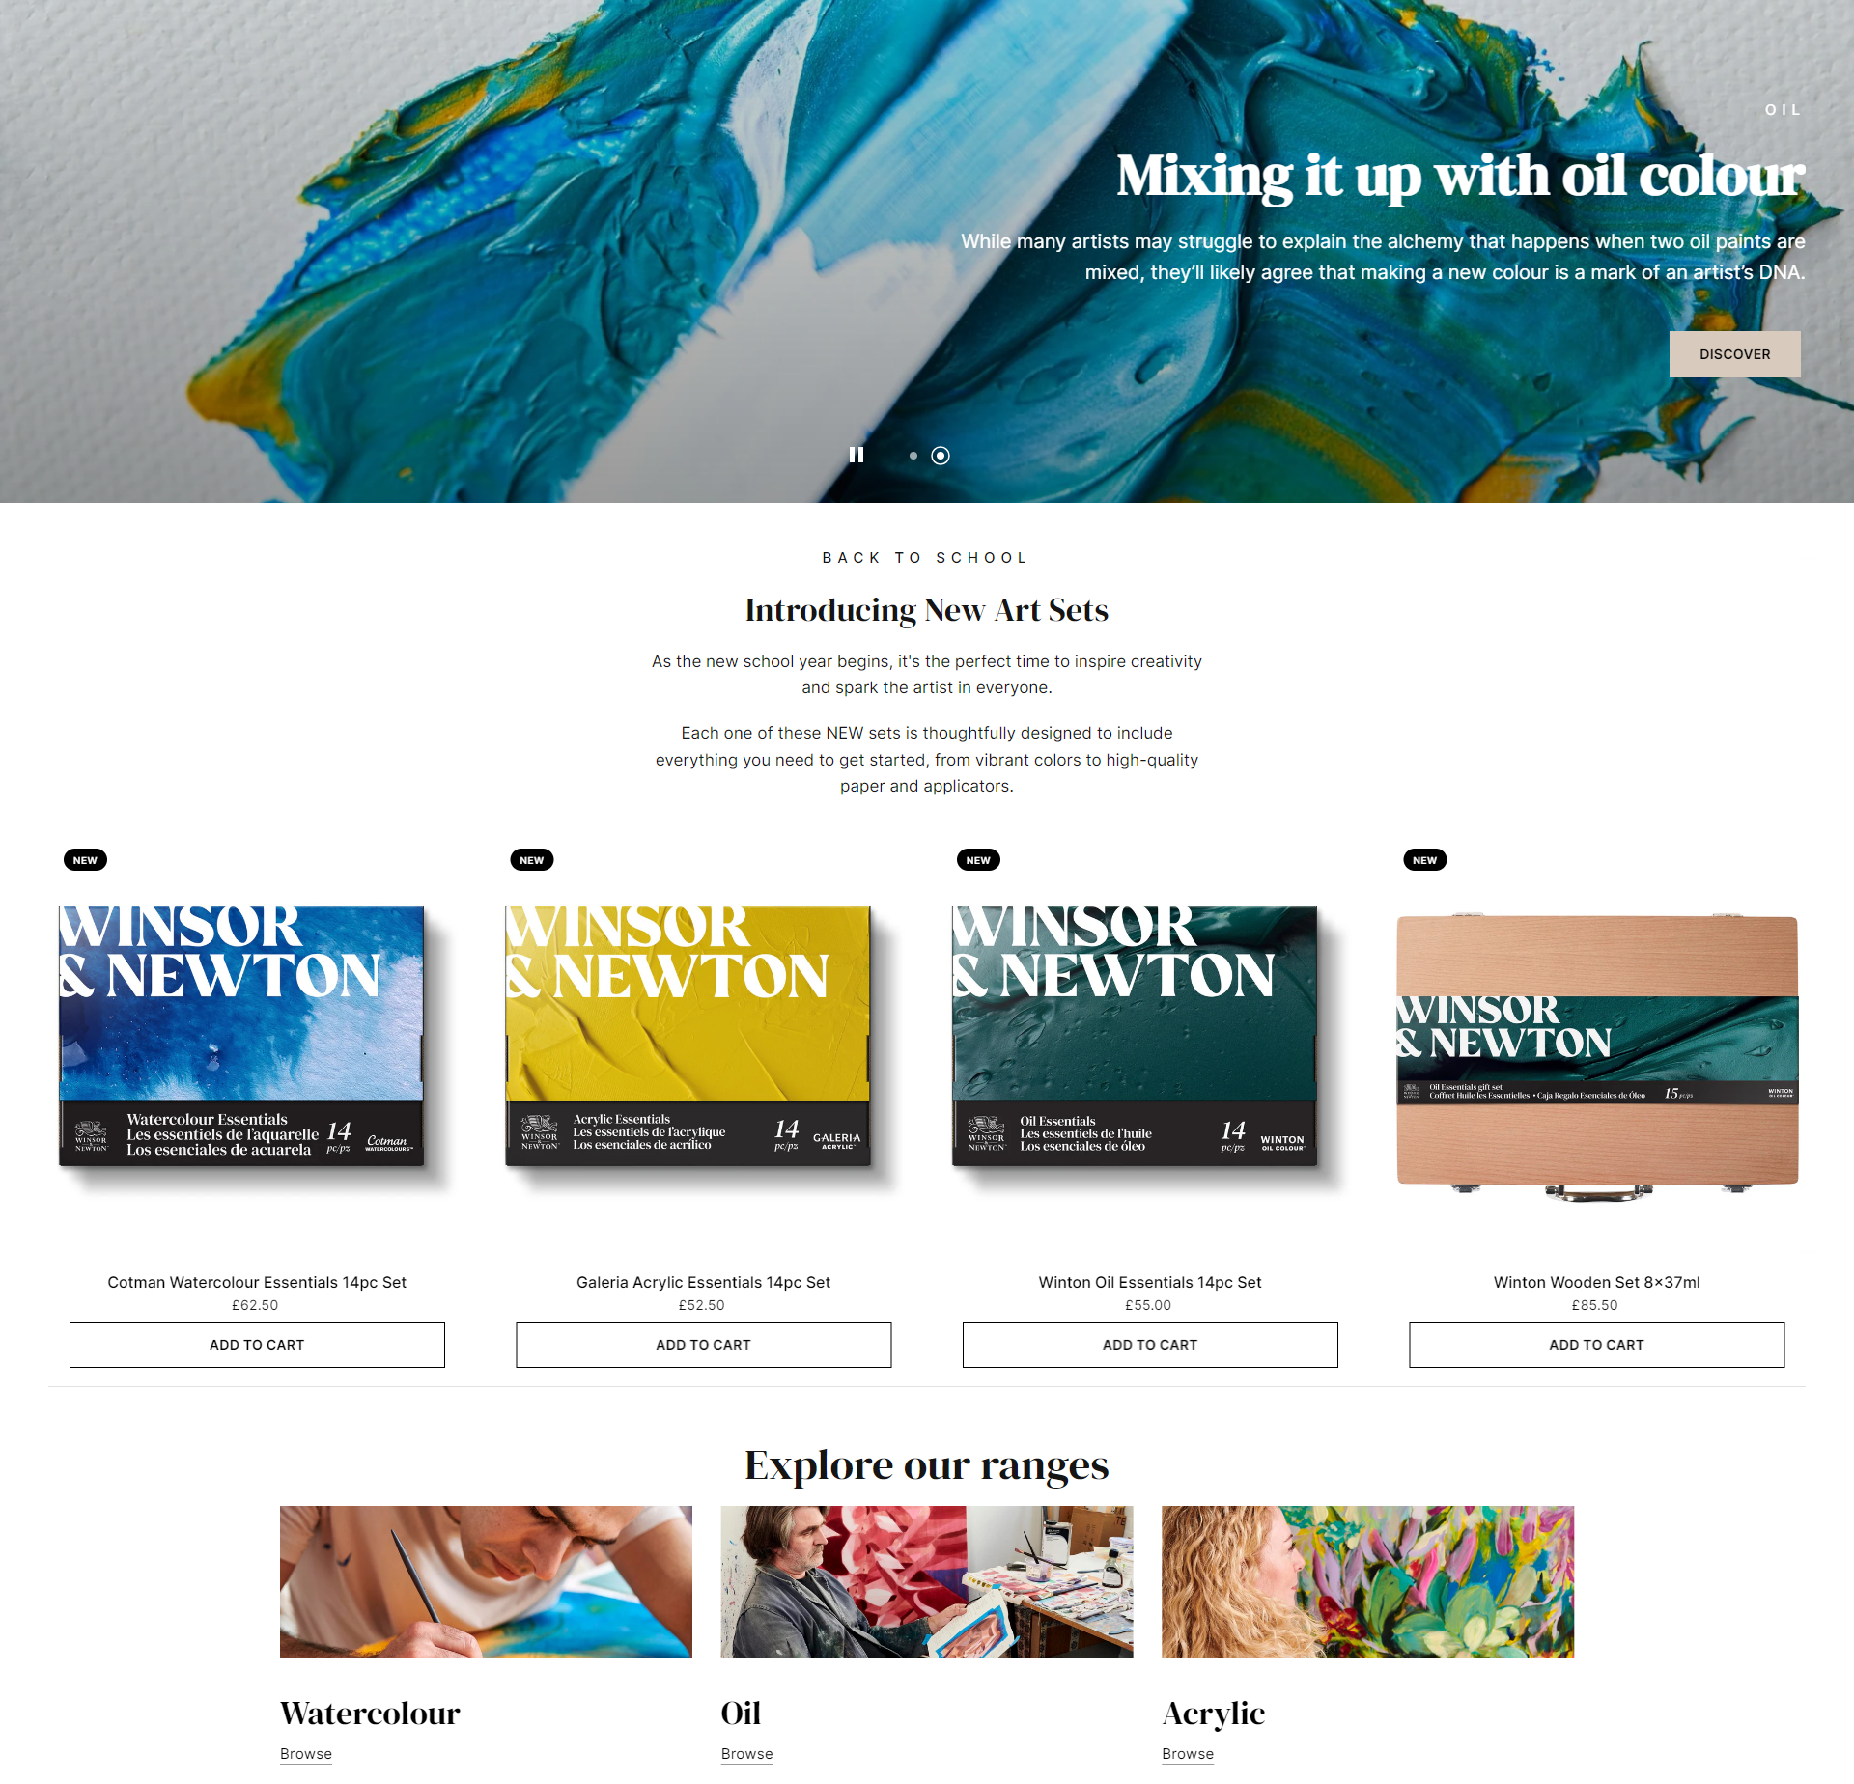
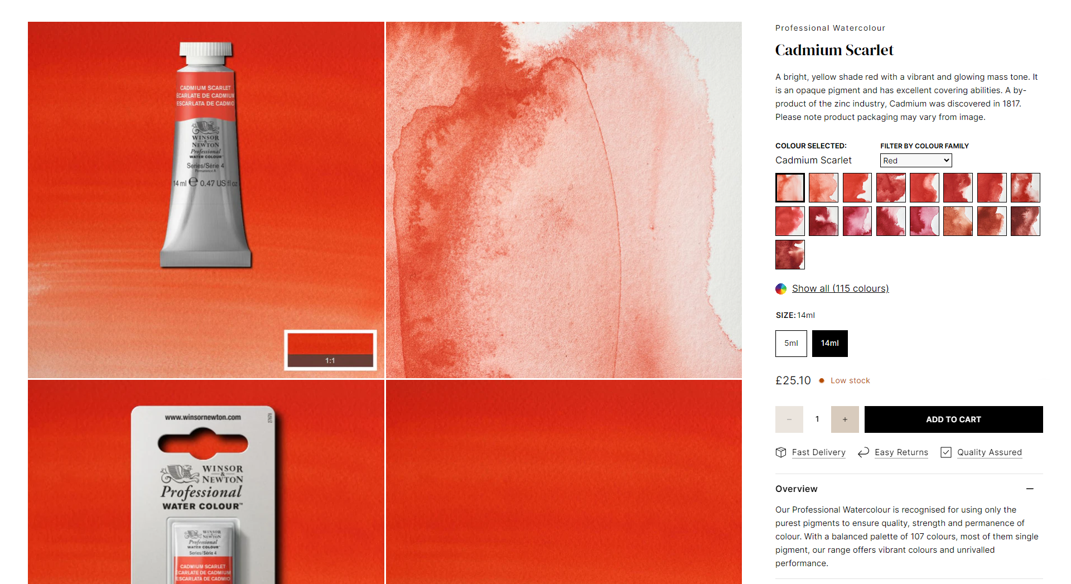
Enhancing the brand experience
Product detail pages (PDP)
Product Shots
NEW Lifestyle Images (range-wide)
USPs
Recommended products
Homepage
Working closely with our ecommerce team to optimise the merchandising of this page
Healthy mix of merchandising and brand-led content
Notes:
As Kevin touched on, this migration will primarily look to feed into Colart’s DTC aims. Building this new site will undoubtedly improve the ecommerce experience for our customers, but it has also afforded us the opportunity to integrate a huge wealth of internal and external feedback to improve the brand experience too.
The migration to shopify has allowed us to finally implement product detail pages – which allow us to truly communicate our brilliant products by showcasing product shots, lifestyle photography, products USPs and video content as well as being able to recommend other products.
We’ve also worked on a new homepage which we now believe is a healthy mix of brand-led content as well as product merchandising.
We’ve also taken the time to improve the discoverability of our brushes section, giving a much improved customer experience - as well as optimising all our community and educational content which I’ll cover in more detail shortly
The Brand Team will continue to work closely alongside our ecommerce team on a day-to-day basis, ensuring that we’re delivering a fantastic brand experience as well as an efficient customer journey from brand content to checkout.

Slide 7
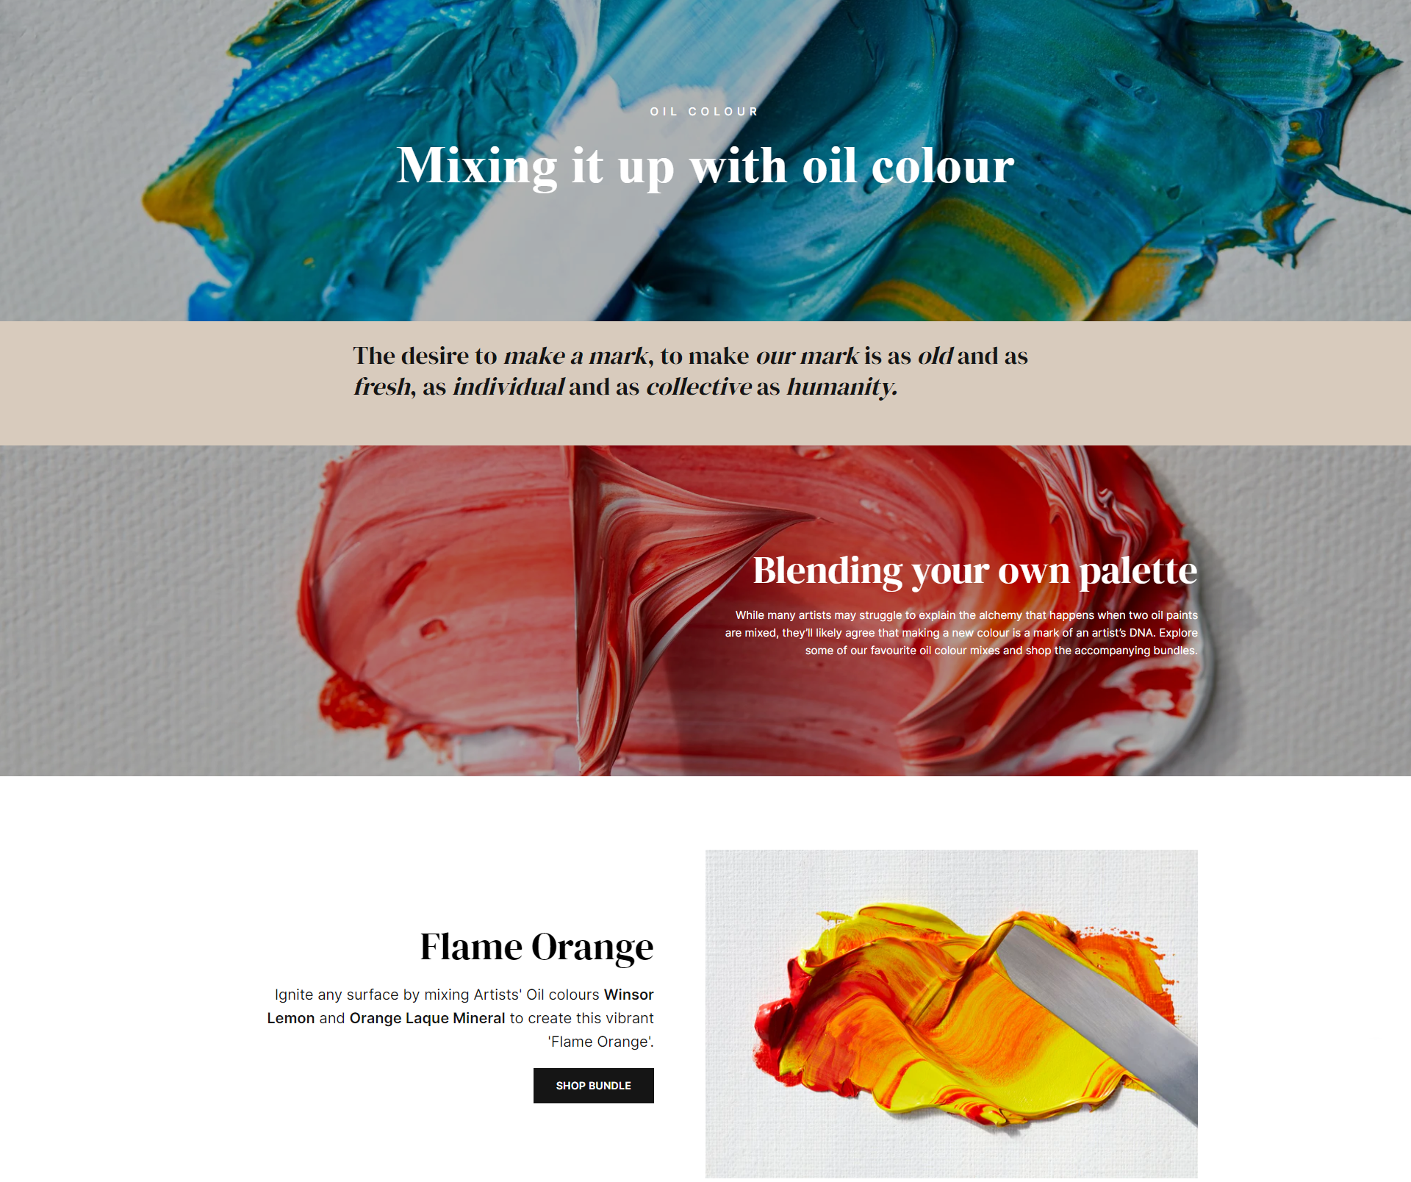
Delivering brand-led campaigns
Project Wisdom allowed us to build a website that served ‘Through the eyes of the artist’ as best as possible
First look at what Shopify has to offer us for brand-led campaigns will come in our oil campaign ‘Mixing it up with oil colour’
Our seasonal gifting campaign will be the first example of a more commercial campaign
Notes:
The launch of TTEOTA at the beginning of 2024 included an update to our previous wordpress site to fall in line with the new visual identity and tone of voice of the brand – so much of the new brand positioning had already been covered off in a separate project at the beginning of the year.
Whilst that was an important step for winsornewton.com, moving to shopify has allowed us to build a home that truly serves this positioning in the best possible way.
And you will get the first taste of how shopify supports this new brand positioning during our oil colour campaign, which starts in the next couple of weeks. Shopify has enabled us to offer bundles together for our consumers which will support the campaign ‘mixing it up with oil colour’ and allowing our consumers to blend their own palette – something which was not available to us on the old website.
Our seasonal gifting campaign towards the end of the year will be a great showcase of how Shopify can help us to deliver a more commercially focused brand campaign and a perfect blend of DTC and brand communications.

Slide 8
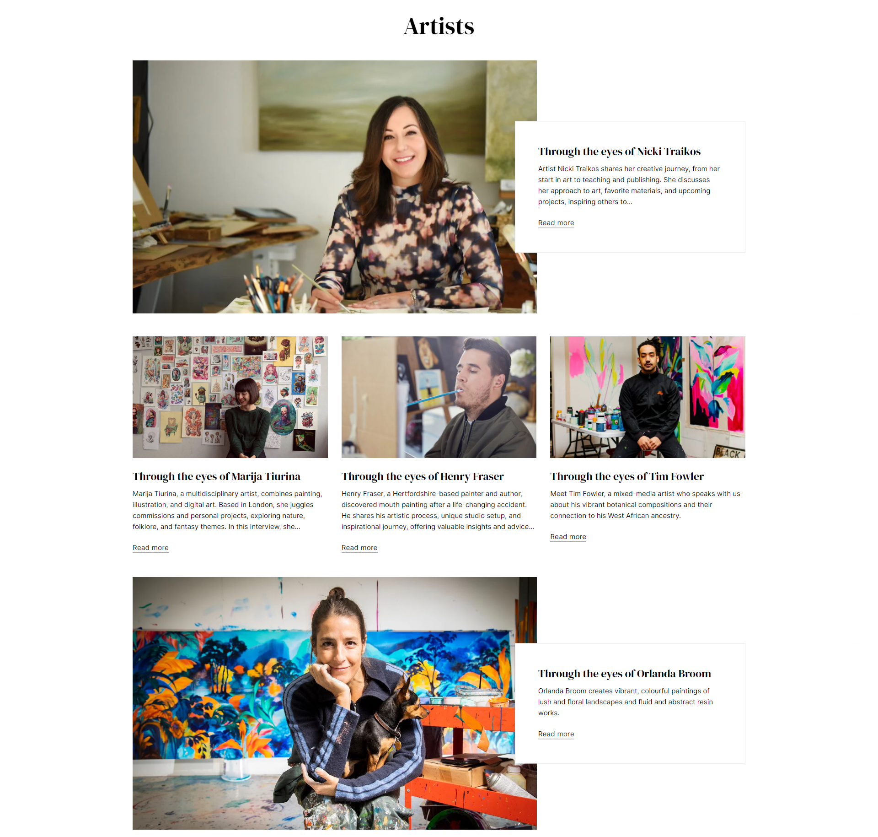
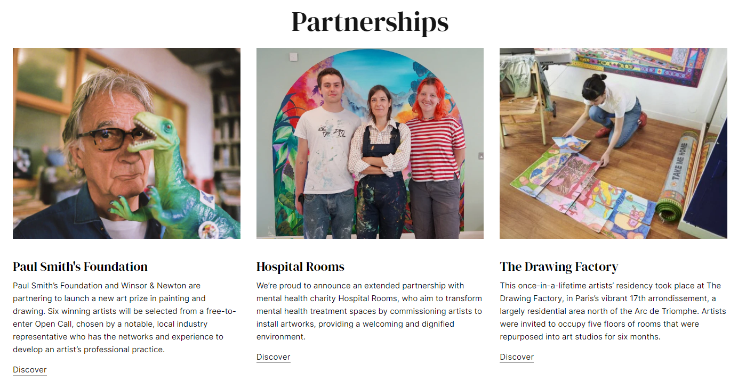
Community section
Will continue to showcase ongoing and previous partnerships
Will now be the home of our artist-led series ‘Through the eyes of’ (formerly ‘Featured Artist’)
Notes:
We’ve also taken this opportunity to update the Community section of the website.
Winsor & Newton has always maintained a strong connection with its community and it was very important to the Brand Team that this was reflected within the new website.
So to that end, our new and improved community section sits at the top of the website and contains information about ongoing and previous partnerships whilst also being the main hub for all of our artist-led content.
Our ‘Featured Artist’ series has been fully renamed to ‘Through the eyes of’ and has its own section on the site, giving it more prominence than before where it was previously buried within our articles section.

Slide 9
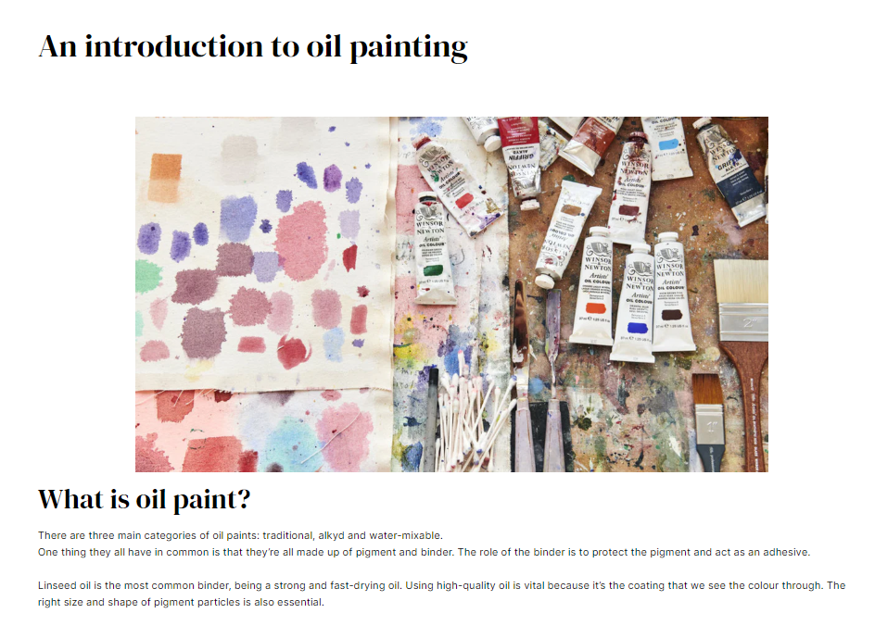
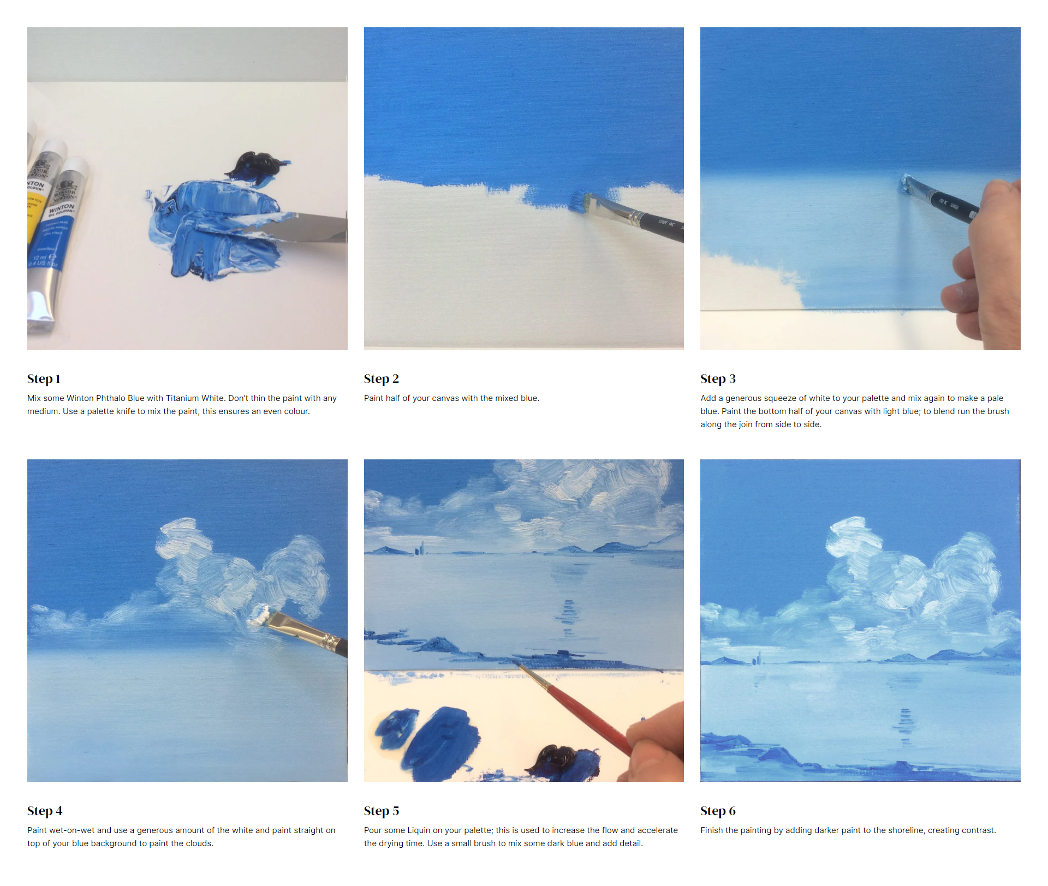
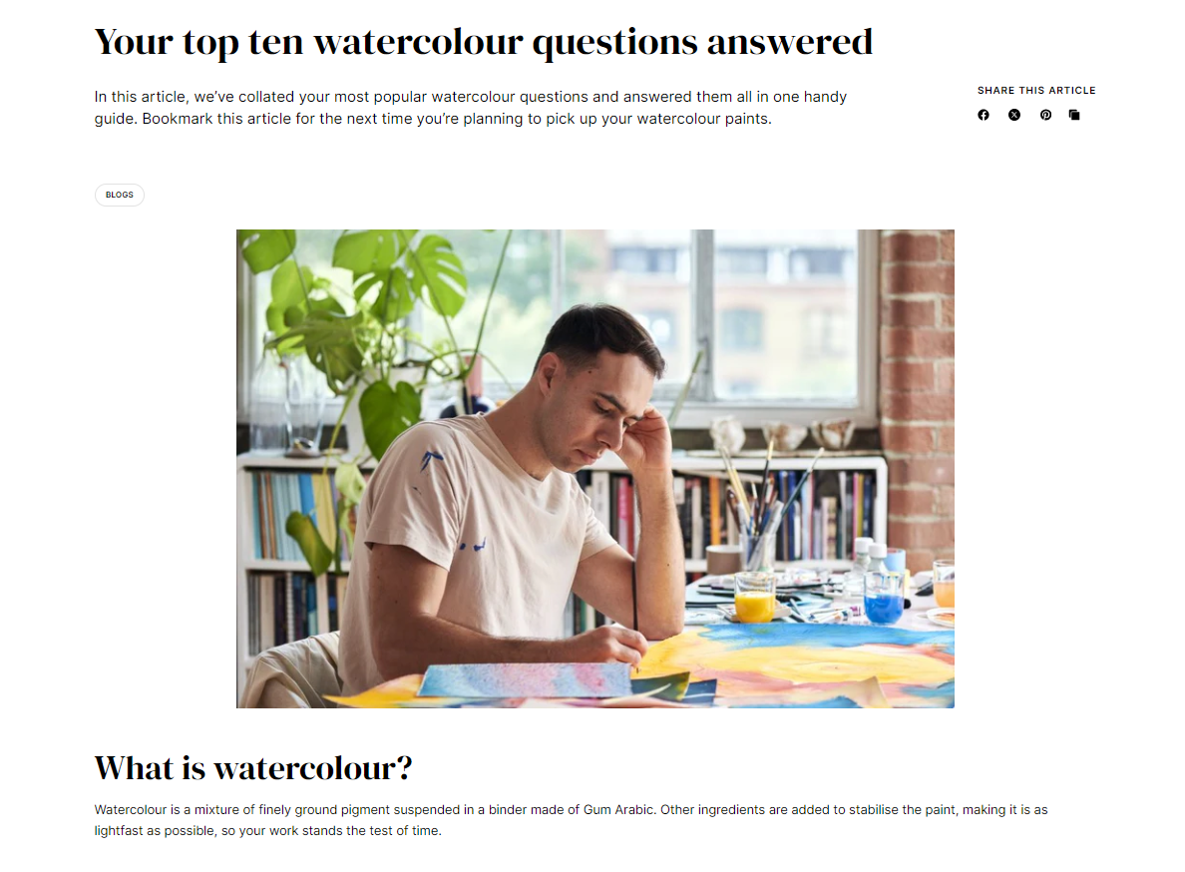

Enhancing our educational content
Articles
Guides
Masterclass & How-tos
Learn
Solve
Develop
Notes:
And WN also prides itself on supporting our community of artists - our vast library of educational content being the foundation for that.
And despite DTC being such a huge focus for this project, we have also been able to streamline and improve WN’s educational content offering.
This content section is now called ‘resources’ and sits at the top of the website, alongside the community section.
We’ve streamlined this section to enhance both the website performance, but also allows each individual piece of content to be richer and more useful to the reader.
We have now four main formats of educational content, or resources:. Articles, Guides, Masterclass and How-tos.
During the project, we really took time to consider the purpose of these resources and what they offer our consumers.
Articles, we’ve decided, are for our long-running colour stories format, our new winsor newton archive series, as well as blogs about a variety of topics ranging from sustainability, art history, and product innovations.
Our guides are now a more prominent part of the site and aim to support artists to solve any problems they may have and looks to address frequently asked questions that artists have about products.
And finally, our Masterclass series and our range of How-to’s are intended to help artists to develop new or existing skills and techniques.
We’ve also housed all the colour charts and composition and permanence tables in the resources section now too.
We’ve not only restructured and streamlined our resources section, but we’ve also looked to optimise each individual piece of content. You’ll hopefully now notice there is much more cross-selling, related content sections and bespoke filtering on the collection pages.
Whilst we go through this DTC drive within Colart, it’s still important that Winsor & Newton maintains its status as a brand pushing art forward and being an ally and a friend to artists. As our brand manifesto says:
To make our marks is to grow. Outwardly. Inwardly.
To better our art. Ourselves. Our society.
With that, I will hand over to Natalia who will take us through us some technical advantages of shopify compared to wordpress

Slide 10
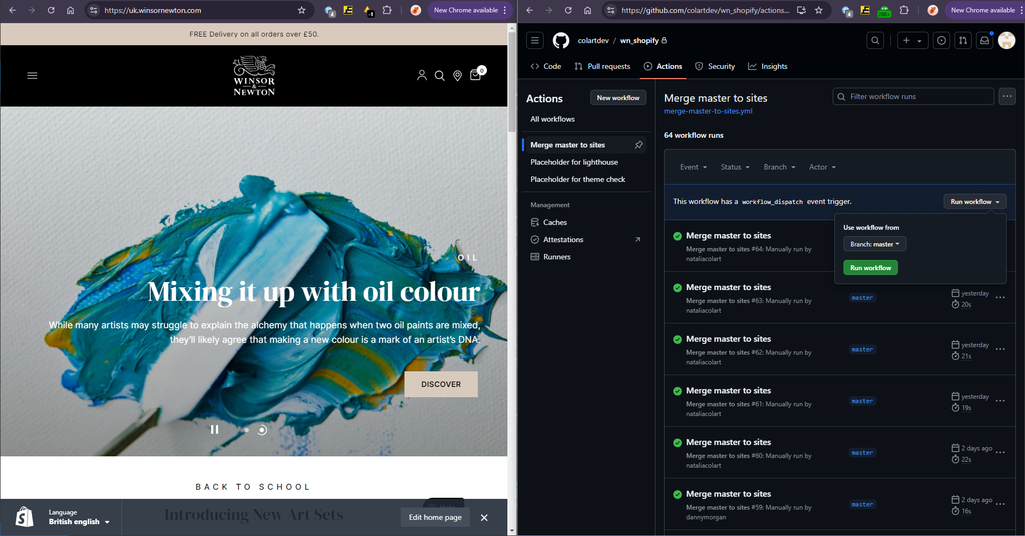
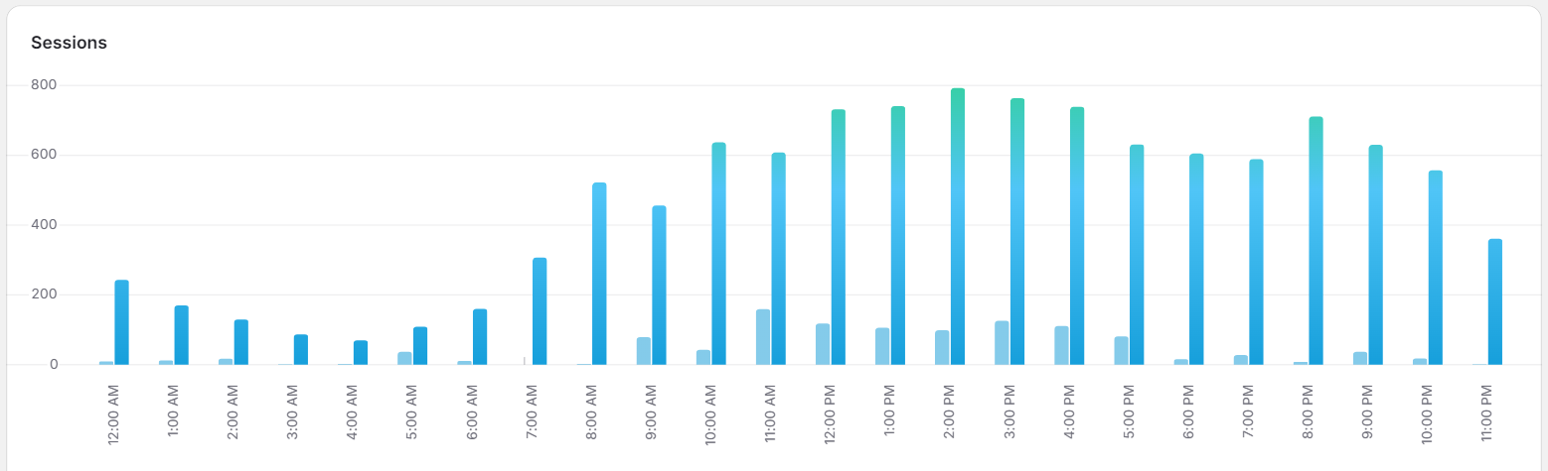
Shopify features vs Wordpress
Live Changes & Efficiency
Shopify: Enables instant live changes with no downtime, ensuring a smooth e-commerce experience.
WordPress: May require manual intervention especially with custom features.
​Performance & Scalability
Shopify: Utilizes native cloud infrastructure optimized for high traffic, ensuring reliable performance.
WordPress: Performance depends on hosting, often requiring additional caching and optimization plugins for speed and scalability.

Slide 11
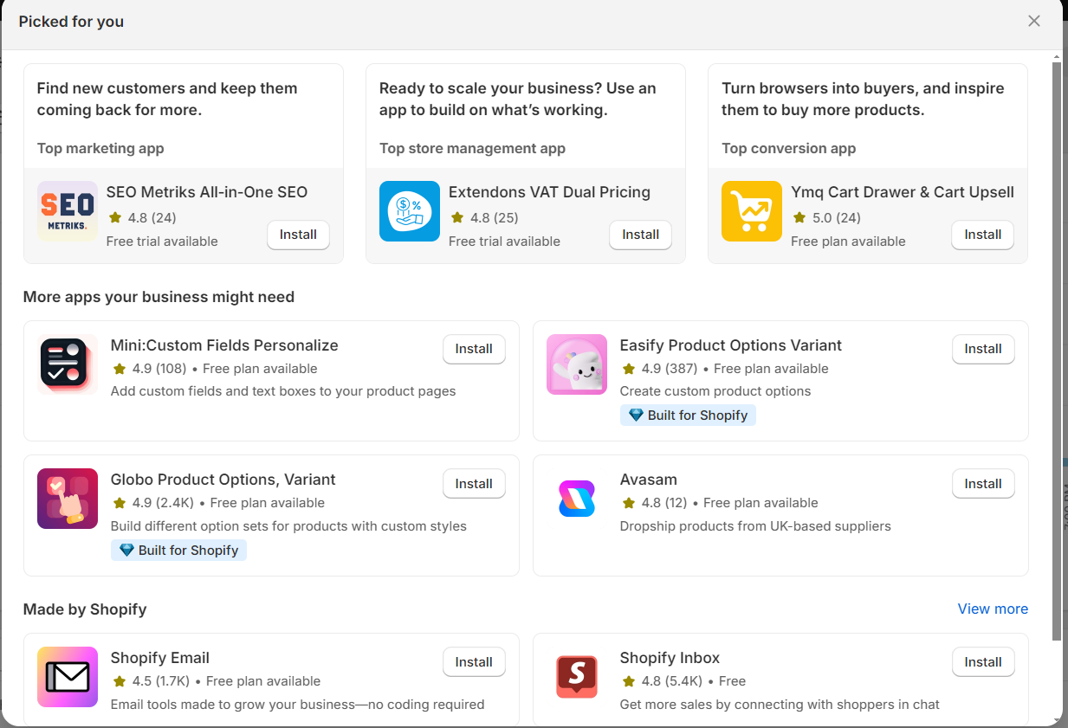

Shopify features vs Wordpress
Support & Ecosystem
Shopify: Offers extensive support and a curated app ecosystem tailored for e-commerce.
WordPress: Has a larger plugin ecosystem, but quality and reliability can vary.
Maintainability & Developer Experience
Shopify: Offers a robust, secure, and scalable backend with built-in tools like the Liquid engine for a streamlined development experience.
WordPress: Requires managing multiple plugins and third-party integrations, increasing complexity and maintenance challenges.

Slide 12
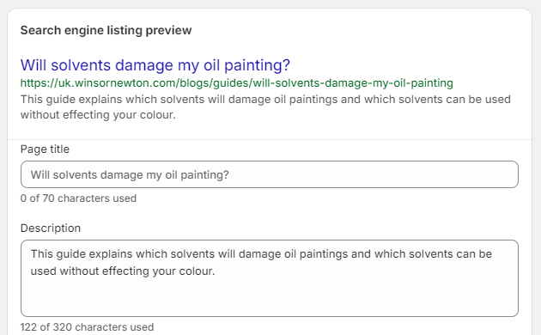

SEO used in decision making
SEO insights and data helped us make smarter decisions
Shopify makes it easier to optimise for search engines
Easily update important page elements within Shopify CMS.
Shopify pages load faster (an important search ranking factor).
Better handling of local language pages via automated hreflang.
Data-driven approach to content migration and optimisations.
Defined URL / domain structures that are easier for search engines to understand and scale to future stores.

Slide 13


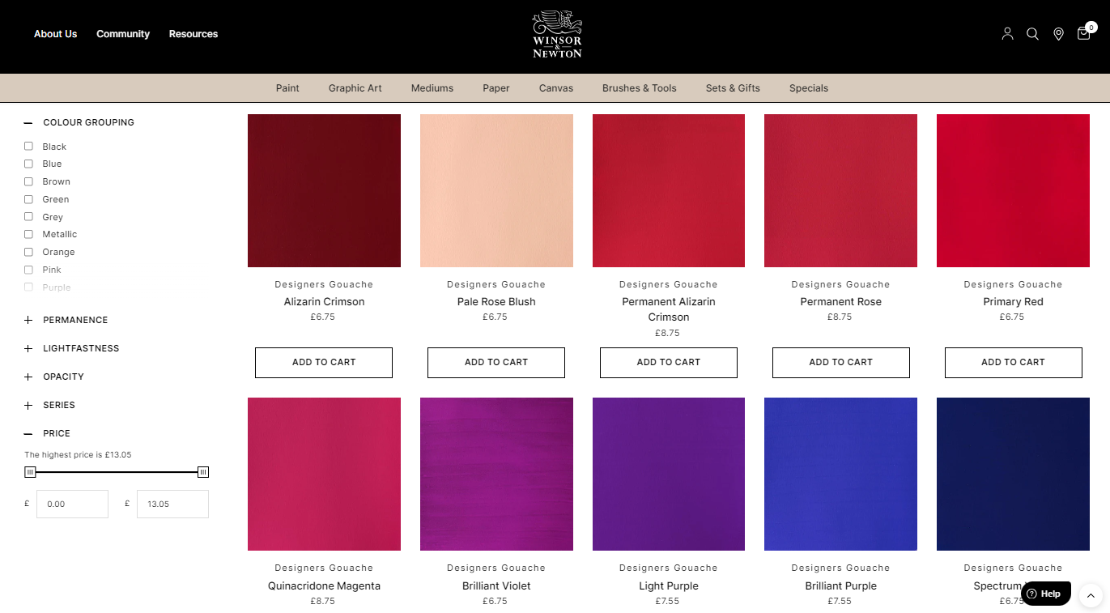
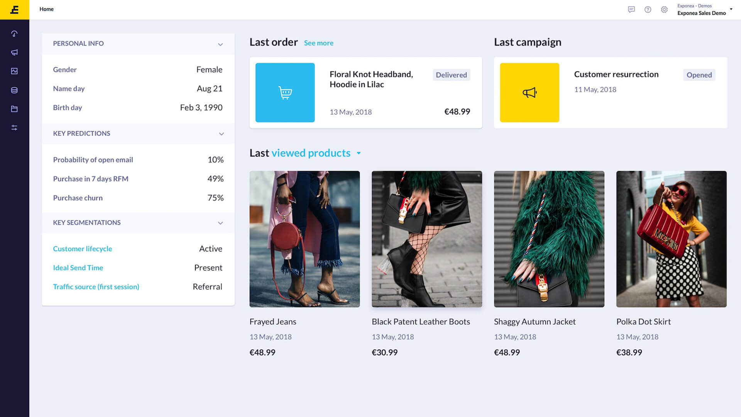
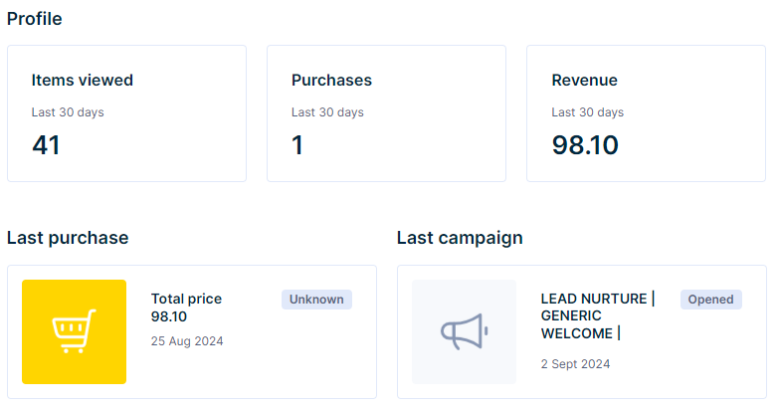
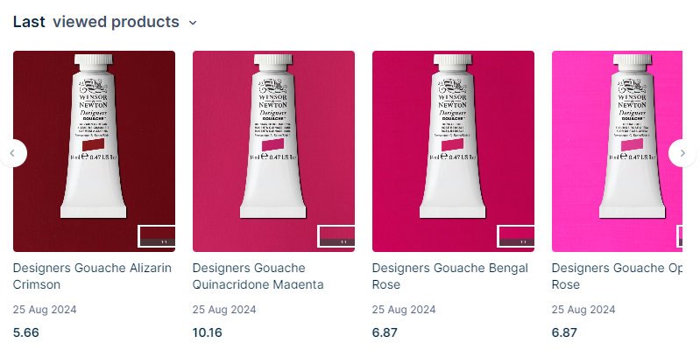
Shopify app enriches our CRM data
New custom Shopify app enriches our CRM data for a better understanding of how artists shop on winsornewton.com
Shopify app provides our CRM (Bloomreach) with more data points than before, which can be used in analyses, segments, and marketing campaigns.

Slide 14
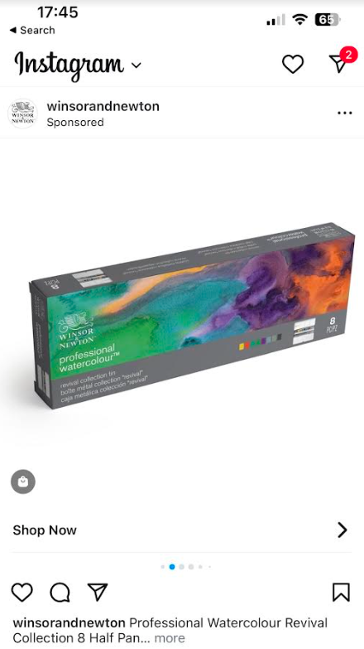
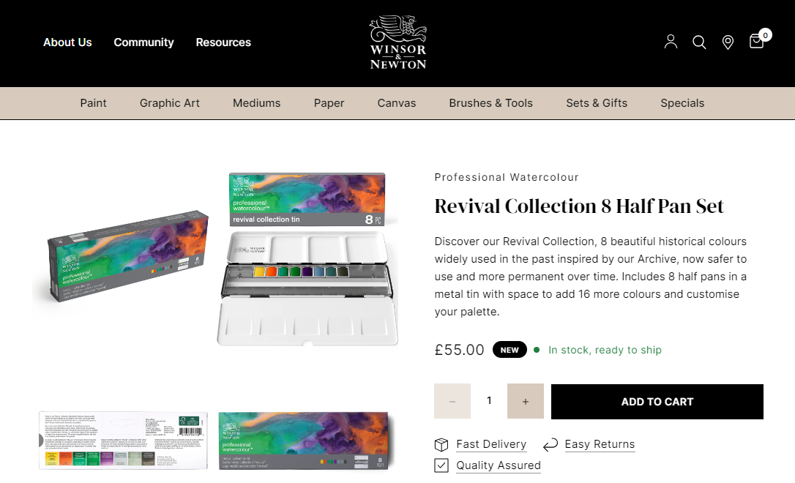
A richer post-click experience
New Winsor & Newton site provides a richer and more relevant post-click experience from our marketing campaigns.

Slide 15
Notes:
{Kevin]
Again, a big thank you to everyone that has been a part of this amazing Project Team.
As we move forward, the Winsor & Newton website on Shopify will not only enhance our customer experience but also play a crucial role in achieving our strategic mid-term goals.
I am excited about the opportunities this platform presents and look forward to continuing our journey with renewed energy and focus. Thank you.

