Slide 1


Celebrating 2024 - Technology
Projects, Year-on-year Comparison & bau

Slide 2
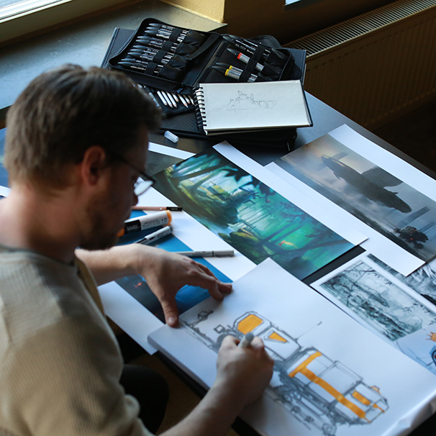
Contents
Development
Industry Solutions
Application & BI
Technical Operation
China IT

Slide 3
DEVELOPMENT

Slide 4
Projects
10%
Collective Agility
B2B UI redesign
Consumer First & Brand Power
Migrating brand.com to Shopify*
Project Speed (W&N)
Bloomreach Shopify app
Shopify Forms
AI Chatbot*
Operational Excellence
STAM Le Mans and CTAM
B2B China* (launch: Mar ‘25)
B2B My Account* (launch: Mar ‘25)
Workflows integration with PowerBI
Sustainable Value Creation
Accessibility fixes (W&N and LQX)
PIM In-house
30%
30%
Platform
30%
D2C
STAM
* Continues into 2025
B2B
Other

Slide 5
YoY Comparison
10%
10%
10%
20%
30%
30%
2023
30%
2024
2025
60%
40%
30%
30%
D2C: Shopify Migration: LQX, Reeves, W&N, & Conté à Paris launched
D2C: Shopify migration complete: LB, SNZ, Charbonnel, LQX and W&N FR launched
D2C: Project Speed (LQX and W&N); LB Ecom launched, Mediums Finder
B2B: UI/UX improvements, China rollout, My Account
B2B: Merchandising, TBC
B2B: Rollout to DE and NA, Customer Pricing, UI/UX improvements
STAM: Le Mans and CTAM rollout
STAM: WMS, Sensors, and DC7 rollout
OTHER: The Bank: Inhouse, Waste Packaging, PIM: Colart Data Portal
OTHER: Workflows BI integration and UI, PIM: In-house
OTHER: Product Data Platform, The Bank rebuild, Workflows M3 integration

Slide 6

BAU
19%
By platform/application
Managing website bugs and change requests is essential for keeping our websites running smoothly and ensuring a seamless user experience.
This work is crucial for maintaining site reliability and improving functionality and performance over time.
47%
34%
Change
modification outside of original design
Bug
Issues or not working as designed
B2B
OTHER (Bloomreach, Colart Info, Colart.com, Intranet, PIM, Store Locator, The Bank, Waste Packaging, Workflows)
D2C

Slide 7
INDUSTRY SOLUTIONS

Slide 8
Projects
Operational Excellence
WMS – Le Mans Implementation*
TMS Enhancements for Morpheus in Le Mans
STAM Implementation in Le Mans and CTAM
IoT Implementation for all Production Lines and integration with STAM.
KPI Implementation for Colart Americas
DC4 Process Optimization:
  Outbound Improvements:
    Pallet merging process for enhanced tracking and traceability.
    Automated UPS shipping service types integration.
    Pallet weighing log and display on placards to streamline outbound logistics.
  Inventory Optimisation:
    Enhanced Cycle Count procedures allowing for counting by item total quantity by location.
2024
DC4 Process Optimization
STAM
* Continues into 2025
WMS Implementation – Le Mans
Other

Slide 9
Resource Projections
YoY Comparison
2024
2025
DC4 Process Optimization
DC4 Process Optimization
WMS Implementation – Le Mans
WMS Implementation – Le Mans
STAM Implemenatation: Le Mans and CTAM
STAM : Snazaroo Implementation, Weight Scale enhancement
OTHER: KPI Implementation, IoT Implementation
OTHER: Process Enhancements and changes

Slide 10

BAU
By Site/Application
Managing bugs and change requests is essential for keeping supply chain applications running smoothly and ensuring production and distribution teams have a seamless experience.
This work is crucial for maintaining reliability and improving functionality, efficiency, and performance.
Change
Process optimisation or enhancement
Bug
Issues or not working as designed
WMS - US
STAM – Le Mans
WMS – Le Mans

Slide 11
APPLICATION & BI

Slide 12
Projects
M3 Improvements & New Implementations
Replaced non-standard M3 processes for managing L01/DC9 goods transfer with a standard, more reliable solution.
Activated Colart permanent establishment as part of the final steps in the Tango project (improving the Northern Europe structure).
Introduced a new costing method for Merchandising to better reflect item costs.
Improved CTAM and Crown M3 processes following their Go-Lives.
Activated and tested an ad hoc reporting tool embedded in the Infor suite, replacing MRC for live M3 reporting.
Enhanced communication efficiency between B2B and B2C websites and M3 by improving Microservices processes.
Developed integration/interfaces for VENA and Money Box with M3.
M3 maintenance
Tested and installed Maintenance Corrective Pack 27 in Production for M3.
Customers moved to EDI
Amazon, Cultura, Dunelm, Artist & Craftsman, McPherson.
BI Improvements & New Implementations
Enhanced global report computing performance.
Conducted EPOS proof of concept using MS Fabric.
New Reports
Bill of Material extraction tool for Method.
Waste packaging report for declarations.
HR leavers report.
Global stock analysis report.
Quality scorecard report.
First pass rate report for paste manufacturing.
WMS reports for the USA.
Accounting tracker.

Slide 13

Bugs & Changes
Application
Most tickets managed by the Application team involve implementing changes and supporting end users. Only a small number (less than 10%) relate to system bugs. Fixing setup issues is not considered a bug.
The limited number of bugs is due to Colart running the latest M3 release for over four years, with new processes rigorously tested by both the Application and Business teams before activation.
BI
The BI team monitors pipeline processes and data cube refreshes daily to ensure data remains up to date.
In 2024, the team focused on streamlining and improving reports, enhancing back-end structures and data retrieval, and optimising the use of cloud computing resources to manage costs.
Additionally, the BI team laid the groundwork for MS Fabrics, preparing the new BI architecture for 2025.

Slide 14
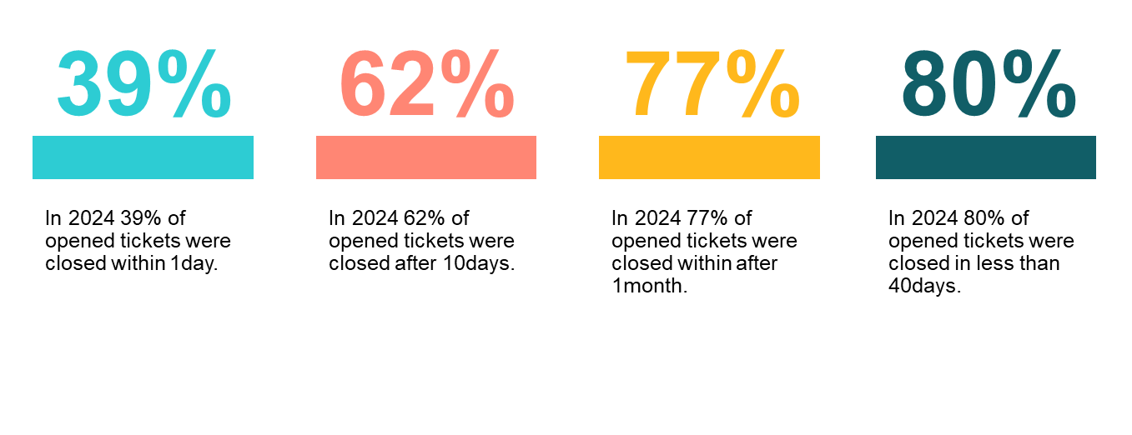
Application Team Highlights
Supporting Performance
454 tickets created in 2024
393 tickets closed in 2024 (including backlog from 2023)

Slide 15
TECHNICAL OPERATION

Slide 16
Projects
Infrastructure
M3 Hardware upgrade in Le Mans and Paris data centre
DR setup for M3
1 Gig line for Le Mans and Hub
Starlink Piscataway
Reduced cost in cloud services and moved/build all test environments to Le Mans server room
UPS (Uninterruptible Power Supply)
Hardware replacement to use fiber
Security
MFA (Multi Factor Authentication)
Data encryption of all devices used in Colart
24/7 Monitoring the entire tech estate for Colart
First Line Support
Screen cloud to showcase content information regionally or globally
Horoquartz upgrade
Total across Colart 4403 tickets raised; 4294 tickets closed
25%
45%
Platform
30%
First Line
Other (Security, Patching, Server setup, monitoring)
Infrastructure

Slide 17
BAU
Management of Tech Estate
BAU focuses on maintaining the stability and efficiency of IT systems to support daily business activities. This includes tasks such as monitoring, servers, networks, and applications, applying updates, and performing regular backups to ensure smooth operations.
It also involves incident management, where issues are resolved quickly to minimise downtime, and handling service desk requests to support end users.
Addressing threats and safeguarding business assets is another key focus.
Email Threats
16,958,136 Blocked
Browsing Threats
712,320 Sites Blocked
First Line Support
Security
Infrastructure

Slide 18
CHINA IT

Slide 19
Projects
25%
Infrastructure
Server room relocated smoothly during CTAM downsizing.
  New server room built with updated cabling for the office and lab areas.
  CCTV, Wi-Fi, and phone systems reinstalled after the server room move.
  Gas-based fire suppression system installed.
STAM system implemented in CTAM.
Backup line bandwidth increased to ensure continuity in case of primary line failure.
Software
Windows 11 upgrade completed for CTAM.
Print sharing project successfully implemented.
Applications
Developed an auto-submission tool for M3 query reports, automating 8 regular reports.
Created a BI tool for the marketing team to track future inventories and slow-moving items.
83% of application tickets resolved by the China team.
45%
Platform
30%

Slide 20
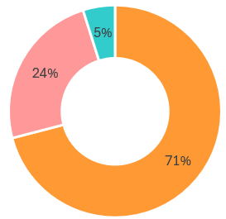
BAU
Management of Tech Estate
BAU focuses on maintaining stable IT services and providing timely support for application systems. This includes ensuring a stable network environment, supporting new projects, delivering ongoing IT solutions, conducting Wi-Fi surveys, and more.
Timely M3 and OA support is crucial to keeping CTAM operations running smoothly.
We use the Jira platform to record daily tasks and allow end users to submit support requests.
Jira Tickets
CTAM Jira Ticket Status
554 Jira ticket in total
393 infrastructure tickets
161 application tickets
134 app cases fixed by China team
App tickets resolved by Group IT Team
Infrastructure Tickets
App tickets by China IT Team

